Slide 1



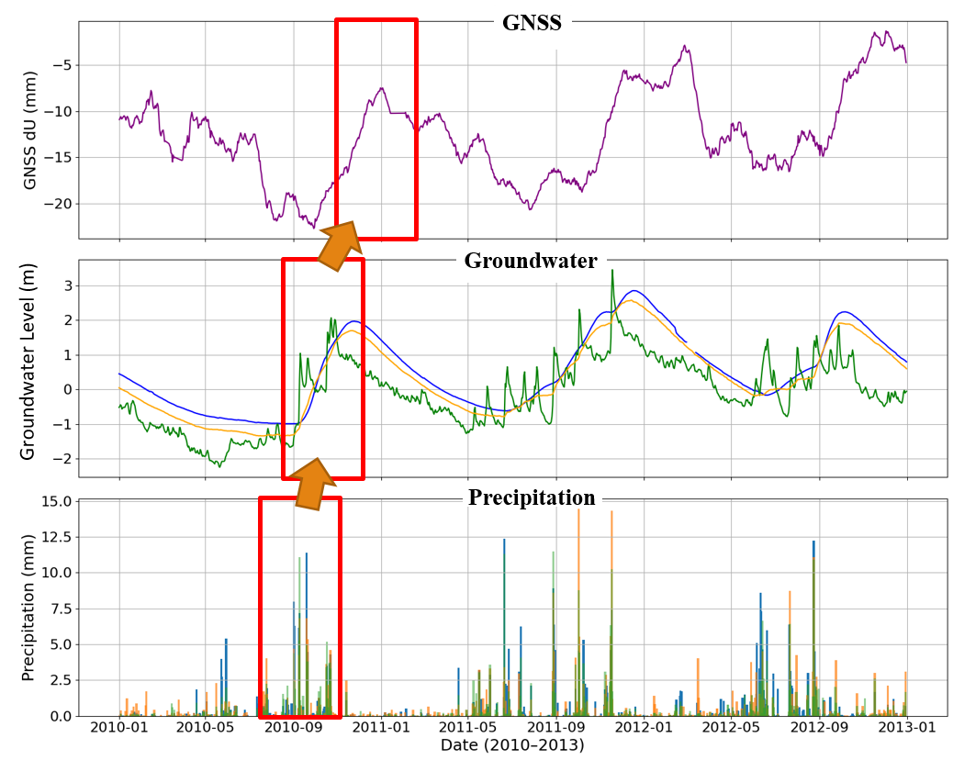
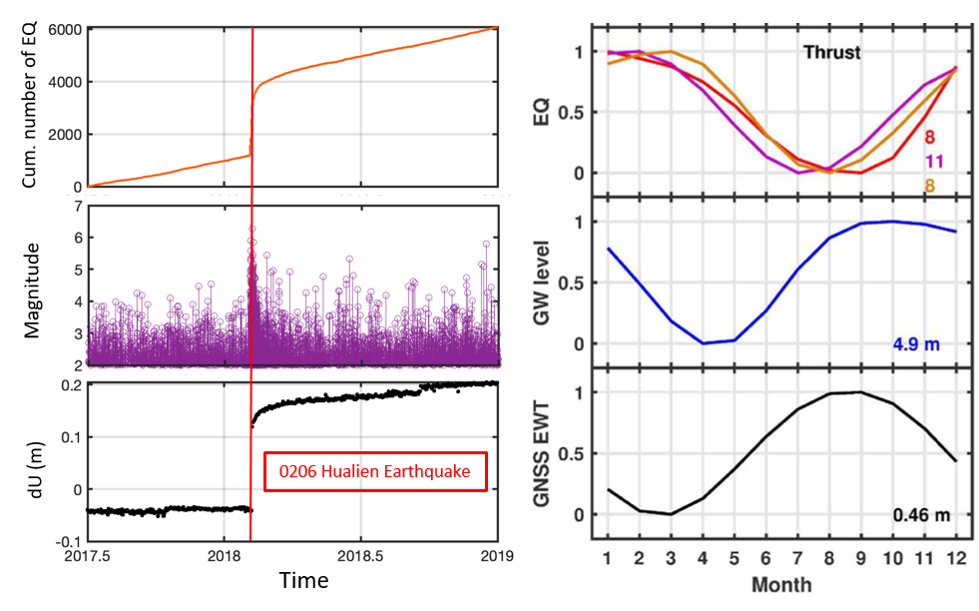
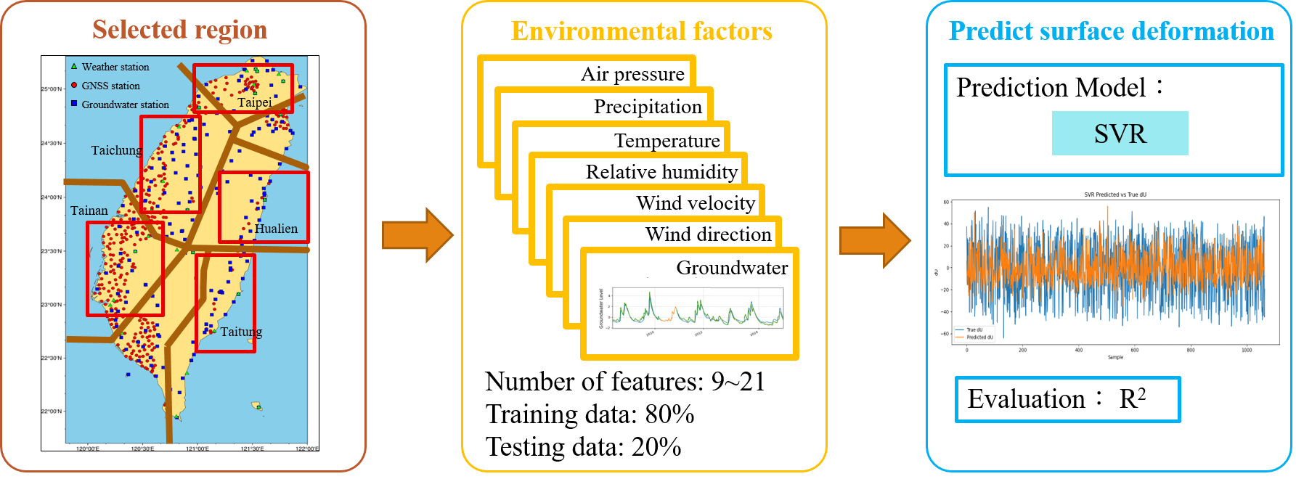
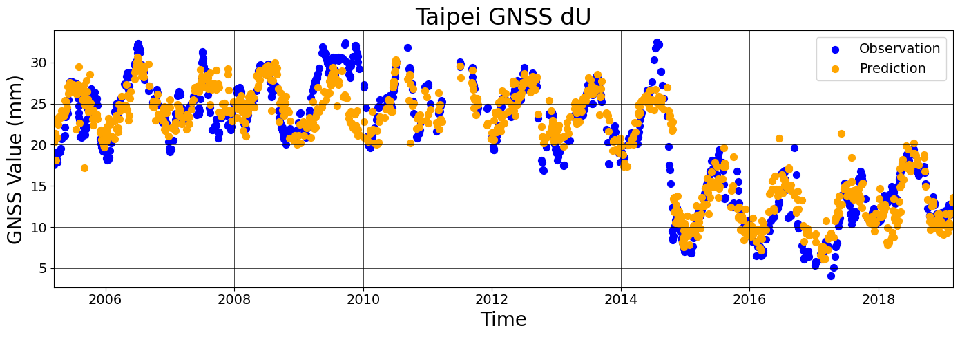
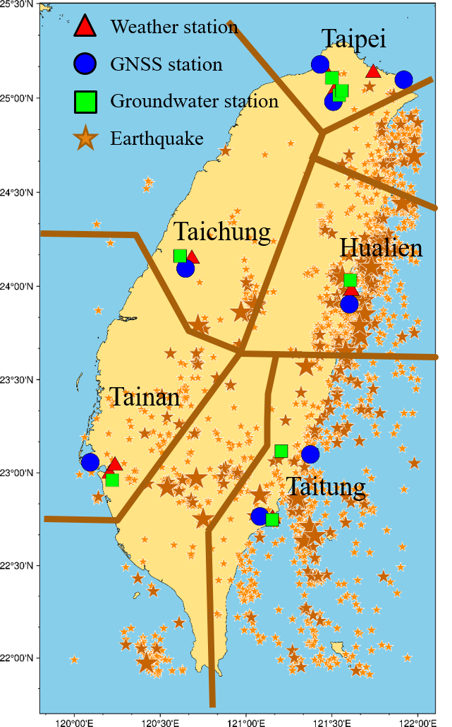
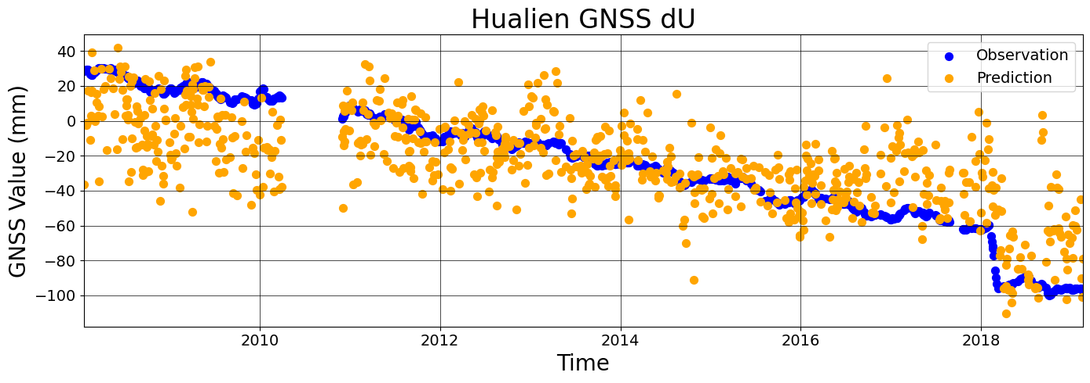
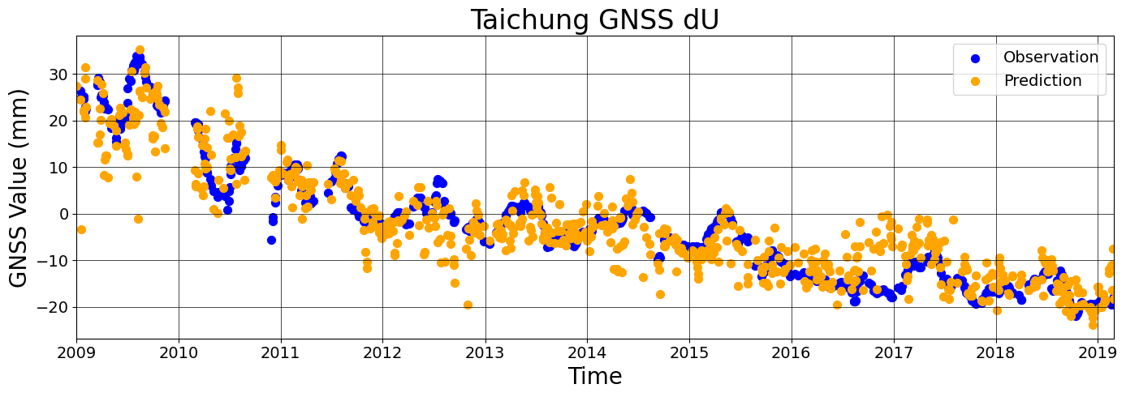
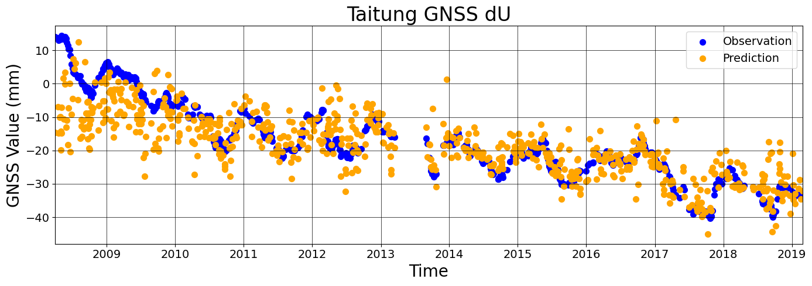
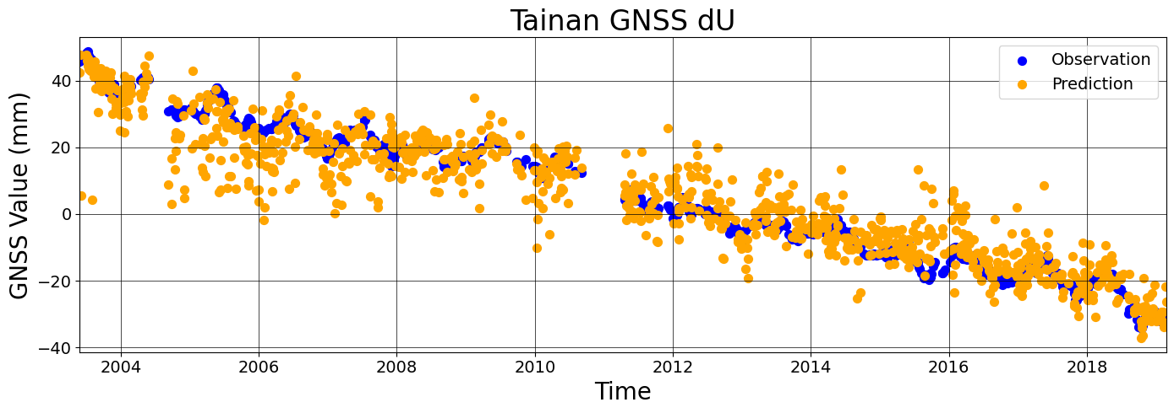
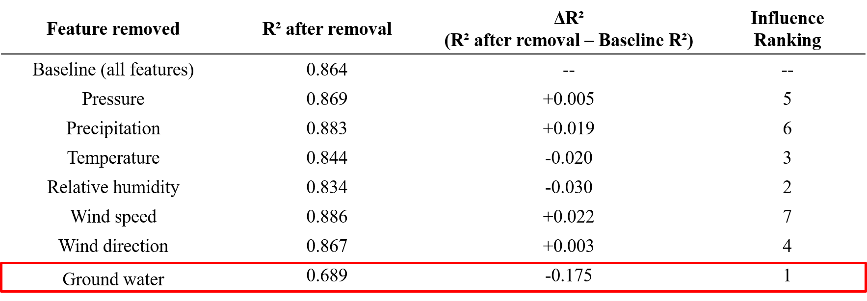
Investigation of climate sensitive natural hazards
using machine learning approach
Student：Yu-Lun Mai¹⁾
Supervisor：Kate Hui-Hsuan Chen²⁾、Wan-Ru Huang²⁾、Hsiang-Han Chen²⁾
Acknowledgement：Chun-Hsiang Chan²⁾、Wei Peng²⁾、Yao-Chieh Chen²⁾
¹⁾ National Taichung University of Education
²⁾ National Taiwan Normal University
Key Questions
Factors affecting surface deformation
Is there a regional difference in the climate sensitivity of surface deformation?
(Fig. 2)This figure shows time series of GNSS vertical displacement, groundwater level, and precipitation in the Taipei area. All three display annual periodicity with a time lag, where rainfall increases groundwater level, which in turn uplifts the ground surface.
This demonstrates that GNSS is highly
sensitive to environmental and
hydrological changes.
Can we develop a climate sensitivity model of surface deformation?
Surface Deformation and natural hazard
The Global Navigation Satellite System (GNSS) can detect subtle surface deformations, helping us better understand earthquakes and natural hazards.
(Fig. 1A) shows the time series at station HUAL in Hualien, where the sudden subsidence on February 6, 2018 corresponds to the Mw 6.4 earthquake, and its decay resembles the temporal pattern of seismicity.
Fig. 2 Correlation between surface deformation and
environmental characteristics
Research Process
(Fig. 3A) Study areas follow Taiwan’s seismic zoning.
(Fig. 3B) For each GNSS station, 9–21 nearby environmental features are selected.
(Fig. 3C) SVR is applied with 80% training and 20% testing data, and performance is evaluated by R².
(Fig. 1B) shows gradual deformation that closely follows groundwater level variations rather than seismicity, indicating hydrological control on the seasonal signal.
A
Hsu et al., (2021)
B
Hsu et al., (2021)
A
B
C
Fig. 1 The relationship between surface deformation and natural hazard
Fig. 3 Research framework diagram
Prediction results for different areas
Taipei R²: 0.841
Hualien R²: 0.534
Taichung R²: 0.806
Taitung R²: 0.618
(Fig. 4) Comparison between observed and predicted GNSS vertical displacements (dU) at five stations across Taiwan, along with their spatial distribution relative to weather stations, groundwater stations, and earthquakes. The coefficient of determination (R²) varies from 0.53 (Hualien) to 0.86 (Tainan), suggesting that surface deformation in Taiwan is strongly influenced by weather and groundwater conditions. Among all sites, Tainan shows the highest predictive performance, while overall, predictions in western Taiwan outperform those in eastern Taiwan.
Tainan R²: 0.864
Fig. 4 Number of earthquakes in different regions and prediction results
Conclusion
Feature ablation test Results
Surface deformation is influenced by both geological hazards and environmental factors.
SVR can stably predict GNSS time series using environmental data
Groundwater level is the most significant environmental factor affecting deformation.
Prediction works better in western Taiwan than in eastern Taiwan
Tectonic activity reduces prediction accuracy, while stable regions show stronger correlations.
(Tbl. 1) Feature removal analysis indicates that groundwater level is a key factor, exerting a notable influence on GNSS surface deformation predictions.
Tbl. 1 Feature ablation test Results
Number of earthquakes in each region
Area | Magnitude ≧ 4 | Magnitude ≧ 5 | Magnitude ≧ 6
Taipei | 57 | 7 | 0
Taichung | 83 | 12 | 3
Tainan | 101 | 10 | 1
Hualien | 716 | 85 | 7
Taitung | 417 | 50 | 5
(Tbl. 2) Hualien and Taitung experience more earthquakes than other regions, which may explain the lower predictive performance when using only environmental features. This suggests that tectonic activity is an important factor in GNSS surface deformation.
Reference
Hsu et al.,(2020). Assessing seasonal and interannual water storage variations in Taiwan using geodetic and hydrological data
Hsu et al.,(2021). Synchronized and asynchronous modulation of seismicity by hydrological loading: A case study in Taiwan
Tbl. 2 Number of earthquakes with a magnitude of 4 or above in different regions

