Slide 1
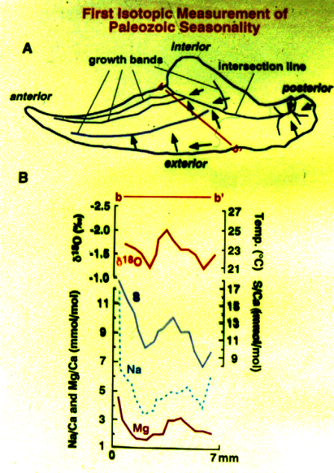
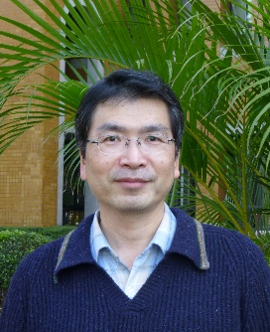
The first to publish critical data on Late Carboniferous seasonality
Department of Earth Sciences
Study of Paleoenvironment
My main research focus has been on the stable carbon and oxygen isotope compositions and elemental contents of Palaeozoic and Cenozoic fossil shells (mainly brachiopods, molluscs and foraminifers) and carbonate rocks as a geochemical tool to reconstruct global palaeoenvironments, as well as to tool to achieve/constrain stratigraphical correlations.
Techniques used in study
Sample collection, petrographic thin sections preparation, observation of diagenesis using cathodoluminescence microscope, Isotope Ratio Mass Spectrometer, and Inductively Coupled Plasma Optical Emission Spectrometer (ICP-OES).
Late Paleozoic middle-latitude Gondwana environment
Horng-sheng Mii, Professor
Department of Earth Sciences,
t44006@ntnu.edu.tw
Background:
PhD in Geology,
Texas A&M University,
College Station, TX, USA
Publications
Mii, H.-S. and Grossman, E.L., 1994. Late Pennsylvanian seasonality reflected in the 18O and elemental composition of a brachiopod shell. Geology 22, 661-664.
Mii, H.-S., Shi, G. R., and Wang, C.-A., 2013, Late Paleozoic middle-latitude Gondwana environment -stable isotope records from Western Australia: Gondwana Research, v. 24, p. 125-138.
Ren, H., Chen, Y.-C., Wang, X. T., Wong, G. T. F., Cohen, A. L., DeCarlo, T. M., Weigand, M. A., Mii, H.-S., and Sigman, D. M., 2017, 21st-century rise in anthropogenic nitrogen deposition on a remote coral reef: Science, V. 356, p. 749-752 (19 May 2017:Vol. 356, Issue 6339, pp. 749-752.

Slide 2
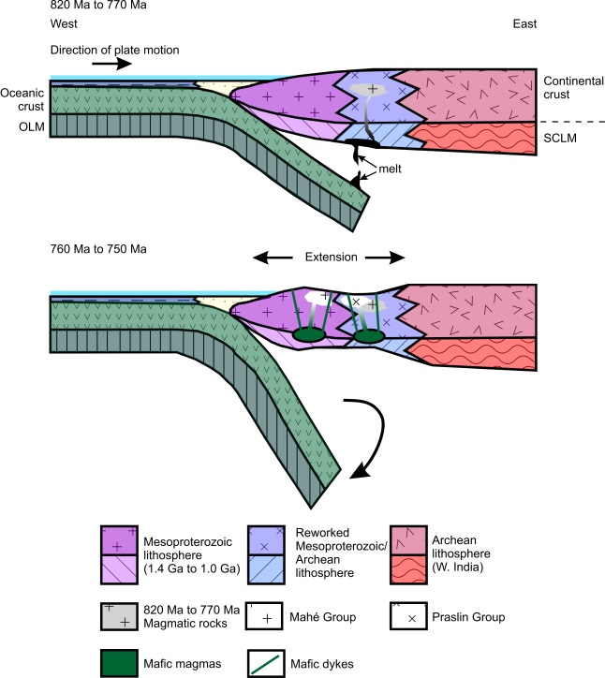
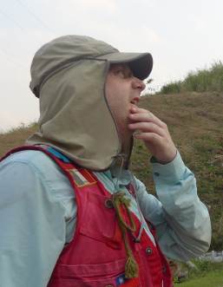
Formation of the Neoproterozoic granites of the Seychelles microcontinent:
Department of Earth Sciences
Evolution of continental crust
I work on a diverse set of igneous rocks from the continental crust that range from ultramafic to felsic. Using whole rock geochemistry, mineral chemistry, radiogenic isotopes and U-Pb age dating, my group and I investigate the origin and development of the large igneous provinces, petrogenesis of Venusian basalt, Pan-African Orogeny, and break-up of Gondwana.
Techniques used in study
Wave length dispersive X-ray fluorescence;
Laser ablation inductively coupled plasma mass spectrometry; Thermal ionization mass spectrometry;
Electron probe micro analyzer.
J. Gregory Shellnutt, Professor
Department of Earth Sciences, College of Science
jgshelln@ntnu.edu.tw
Background:
PhD in Earth Science, The University of Hong
Kong, Hong Kong SAR
Publications
Shellnutt, J.G., Nguyen, T.D., Lee, H.-Y., 2020. Resolving the origin of the Seychelles microcontinent: insight from zircon geochronology and Hf isotopes. Precambrian Research. Precambrian Research 343, 105725.
Shellnutt, J.G., Pham, T.T., Denyszyn, S.W., Yeh, M.-W., Tran, T.A., 2020. Magmatic duration of the Emeishan large igneous province: insight from northern Vietnam. Geology 48, 457-461.
Shellnutt, J.G., 2019. The curious case of the rock at Venera 8. Icarus 321, 50-61,

Slide 3
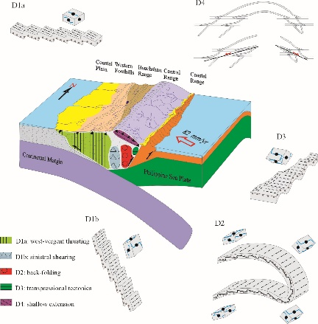
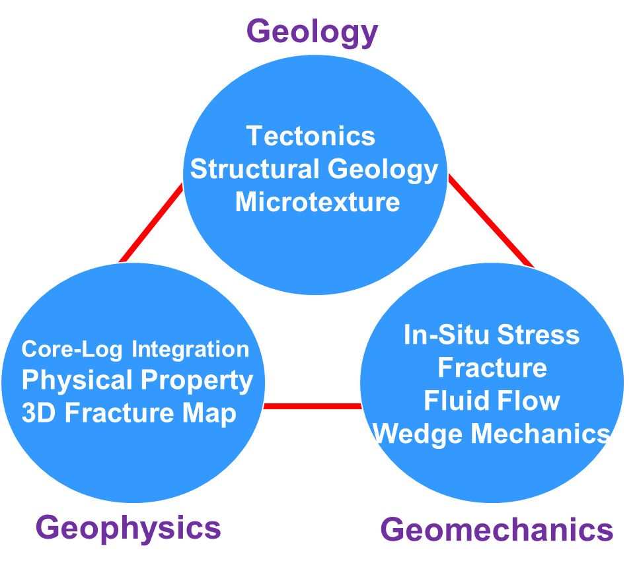
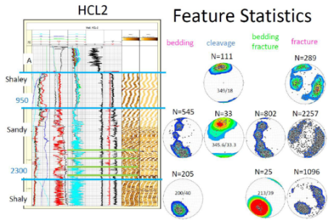
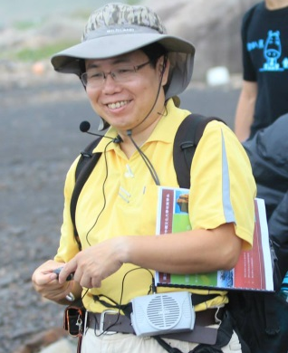
Department of Earth Sciences
Structural Geology & Geomechanics
Lab research mainly aims to analyze aspects of geological structures and to explore their construction relationship between stress and strain. Based on observations of geological structures from different structural levels on multiple scales, we examine and evaluate their characteristics of geometric features, kinematics and dynamics to understand the origin and the role in the context of orogenic evolution, and apply concepts and results to the stress assessment, strain analysis, fracture reactivation examination, and relevant technique development of underground resources and deep-seated waste disposals.
Our research achievements in characterization of Taiwan mountain building processes and geothermal exploration
Techniques used in study
Strain Evaluation, Microfabric Examination, In-Situ Stress Assessment, Fracture Characterization, Fault Reactivation Analysis,
En-Chao Yeh, Associate Professor
Department of Earth Sciences,
Structural Geomechanics Laboratory
ecyeh@ntnu,edu.tw
Background:
Ph.D. in Department of Geosciences, Pennsylvania State University, U.S.A.
Publications
Chou, Y.-M., C. Aubourg, E.-C. Yeh, S.-R. Song, Y.-K. Lin, F. Humbert, X. Jiang, and T.-Q. Lee, (2020) The Magnetic Fabric of Gouge Mimics the Co‐seismic Focal Mechanism of the Chi‐Chi Earthquake (1999, Mw 7.6). Geophysical Research Letters, Accepted manuscript online by 22 October 2020, DOI: 10.1029/2020GL090111.
Lu, Y.-C., S.-R. Song, S. Taguchi, P.-L. Wang, E.-C. Yeh, Y.-J. Lin, J. MacDonald, and C.M. John, (2018) Evolution of hot fluids in the Chingshui geothermal field inferred from crystal morphology and geochemical vein data. Geothermics, 74, 305-318.
Mondro, C.A., D. Fisher, and E.-C. Yeh, (2017) Strain histories from the eastern Central Range of Taiwan: A record of advection through a collisional orogen. Tectonophysics, 705, 1-11.

Slide 4
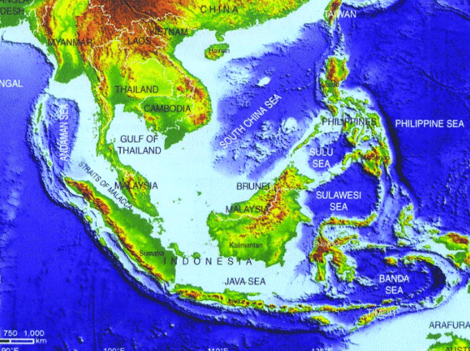
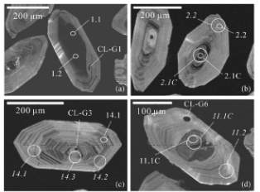
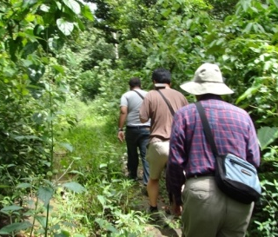
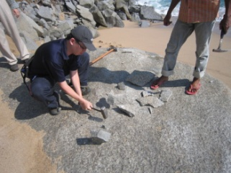
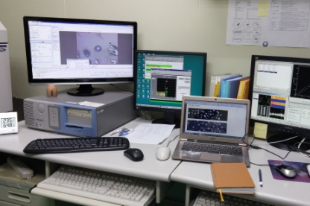

Department of Earth Sciences
Understanding magmatic processes: Geochemical and geochronological studies
We study the island arc magmatism and volcanism processes in the Northern Luzon Arc (Taiwan and Philippine) and the Western Sunda-Banda Arc (Sumatra and Java Island, Indonesia). Our researches are focusing on igneous geochemistry, zircon uranium-lead geochronology, volcanology and experimental petrology of the Cenozoic volcanic island rocks. We welcome students who want to visit our lab for learning geochemical analyses and using geochemical data.
Techniques used in study
Operations on X-ray Fluorescence (XRF),
Scanning Electron Microscope (SEM),
Energy Dispersive Spectrometer (EDS),
Electron Probe Micro-Analyses (EPMA),
Laser Ablation Microprobe (LAM)-ICPMS
Study area:
Northern Luzon Arc
Western Sunda-Banda Arc
Focus on:
Magma evolution
Petrogenesis
Cenozoic volcanism
↓ Field survey and sample collection
Yu-Ming Lai, Assistant Professor
Department of Earth Sciences
Lab of Magmatic and Volcanic Processes
ymlai@ntnu.edu.tw
Background:
PhD in Department of Geosciences,
National Taiwan University, Taiwan
Laboratory analysis →
Publications
Zircon U-Pb and Hf isotopic constraints on the magmatic evolution of the Northern Luzon Arc. Terrestrial Atmospheric and Oceanic Science, 2018, 29 (2), 153-190.
Age, geochemical and isotopic variations in volcanic rocks from the Coastal Range of Taiwan: Implications for magma generation in the Northern Luzon Arc. Lithos, 2017, 272-273, 92-115.

Slide 5
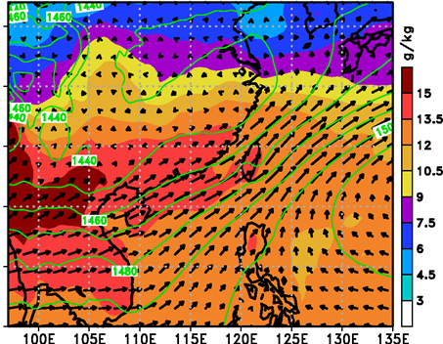
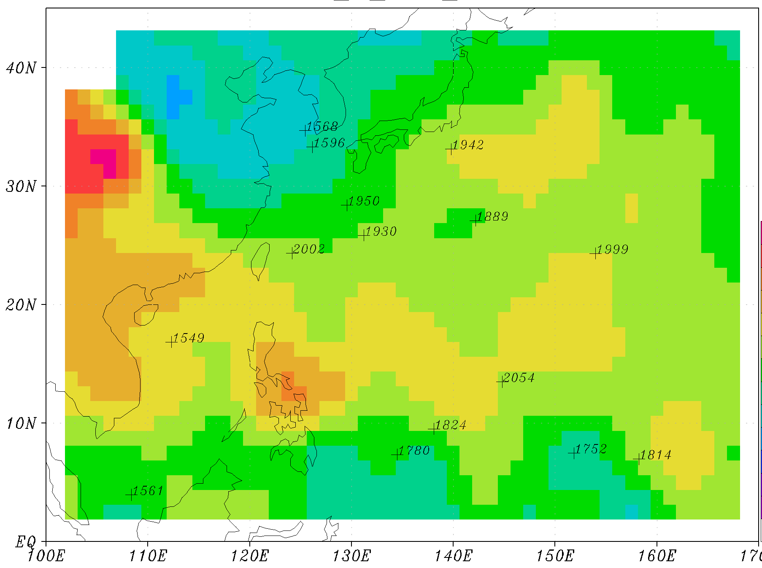
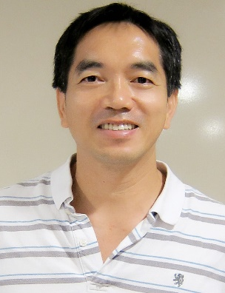
Department of Earth Sciences
Study typhoon and Mei-yu rainfall
My researches mainly focus on the studies of southwesterly flows, typhoons, Mei-yu rainfall, and marine boundary layer. Using 40-y of climatological data, we have identified formation stages of southwesterly flows in Mei-yu seasons. In a study of Typhoon Marakot, we have found the roles of typhoon interaction with southwesterly flows in heavy rainfall. We have also documented the marine boundary layer height in western North Pacific using the COSMIC/FORMOSAT 3 GPS radio occultation data.
Strong southwesterly flows transport moisture-laden air to Taiwan, resulting in heavy rainfall.
In winter high marine boundary layer heights are approximately located within the paths of the North Equatorial Current and the Kuroshio Current.
Techniques used in study
Weather Research and Forecast model simulation,
Data assimilation,
Ensemble forecast,
Terrain effect
Fang-Ching Chien, Professor
Department of Earth Sciences
jfj@ntnu.edu.tw
Background:
Ph.D. in Atmospheric Sciences, Department of Atmospheric Sciences, University of Washington, USA
Picture
Publications
Chien, F.-C.*, J.-S. Hong, and Y.-H. Kuo, 2019: The marine boundary layer height over the western North Pacific based on GPS radio occultation, island soundings, and numerical models. Sensors, 19, 155. https://doi.org/10.3390/s19010155.
Chien, F.-C.*, and Y.-C. Chiu, 2019: A composite study of southwesterly flows and rainfall in Taiwan. J. Meteor. Soc. Japan, 97, 1023−1040, https://doi.org/10.2151/jmsj.2019-057.
Paul, S., C.-C. Wang*, F.-C. Chien, and D.-I. Lee, 2018: An evaluation of WRF Mei-yu rainfall forecasts in Taiwan during 2008-2010: Differences in elevation and sub-regions. Meteorol. Appl., 25, 269-282.

Slide 6
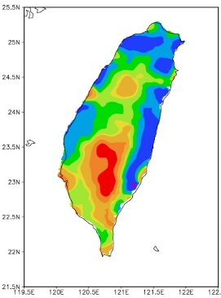
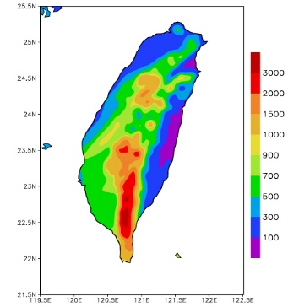
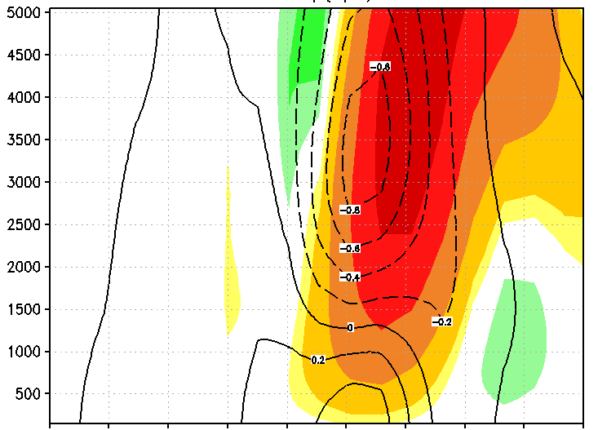
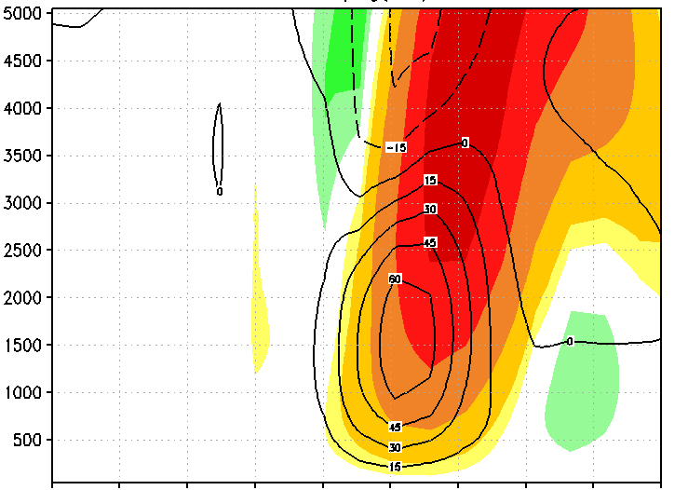

Model simulations of Typhoon Morakot (2009) and its rainfall
Department of Earth Sciences
Numerical modeling of hazardous weather systems
My research interests are mainly in mesoscale and synoptic meteorology and focus on hazardous precipitation systems and severe weathers, such as: typhoons (tropical cyclones), various mesoscale convective systems (MCSs) in the Mei-yu season, and severe local storms. I am also interested in issues related to numerical weather prediction (NWP) and the application of artificial intelligence (AI) in its decision-making process.
Techniques used in study
Cloud-resolving model (CRM); mesoscale model; large-scale parallel supercomputers (e.g., Taiwania 1, NTNU HPC); model simulations and sensitivity tests; gridded datasets for analysis; potential vorticity (PV) inversion; diagnostic analysis.
4-day
total
(mm)
4-day
total
(mm)
Observation
Model (CReSS)
Back-building and merging of convective cells inside rainband
p_{d}’
_
vPGF_{d}’
_
Height (m)
Chung-Chieh Wang, Professor and Chair
Department of Earth Sciences and Institute of Marine Environmental Science and Technology
Lab of Weather and Convection
cwang@ntnu.edu.tw
Background:
PhD in Atmospheric Sciences, Department of
Geography, Ohio State University,
Columbus, OH, USA
+
+
Publications
Wang, C.-C.*, S.-K. Ma, and R. H. Johnson, 2020: A numerical study on the influences of Sumatra topography and synoptic features on tropical cyclone formation over the Indian Ocean. Mon. Wea. Rev., 148, 2777-2799.
Wang, C.-C., L.-S. Tseng*, C.-C. Huang, S.-H. Lo, C.-T. Chen, P.-Y. Chuang, and N.-C. Su, 2019: How much of Typhoon Morakot’s extreme rainfall is attributable to anthropogenic climate change? Int. J. Climatol., 39, 3454-3464.
Kuo, H.-C., S. Tsujino, C.-C. Huang, C.-C. Wang*, and K. Tsuboki, 2019: Diagnosis of the dynamic efficiency of latent heat release and the rapid intensification of Supertyphoon Haiyan (2013). Mon. Wea. Rev., 147, 1127-1147.

Slide 7
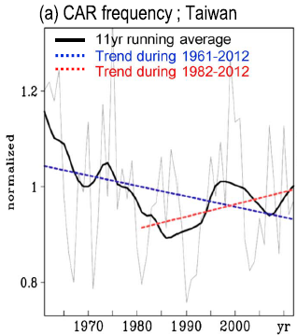
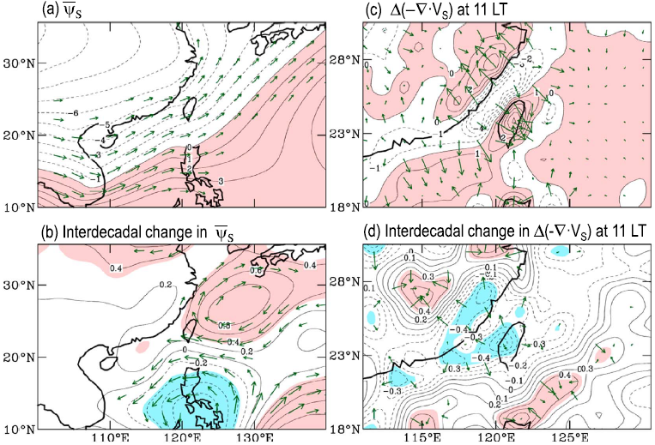

Department of Earth Sciences
Climate analysis and model simulation diagnosis
My research interests focus on the variations and related mechanisms of precipitation characteristics over the East Asian monsoon region. I have conducted a series of studies examining the influence of long-term changes in large-scale circulation on the local diurnal rainfall events over Taiwan and Southern China. Recently, I’m also interested on validating the performance of satellite precipitation over Taiwan.
Techniques used in study
Observational data; CMIP model simulation data; satellite precipitation data; reanalysis data; diagnostic analysis; monsoon climate; climate change; weather change; future projection.
Diurnal rainfall frequency in Taiwan
summer mean of surface stream function ($\overline{{\text{Ψ}}_{\text{s}}}$) and the diurnal anomalies of the surface wind convergence $\text{∆}\text{(−}\text{∇}\text{∙}{\text{V}}_{\text{s}}\text{)}$ at 11 LT.
Huang et al. (2015; JGR):
Both the southwesterly flow over the South China Sea and the convergence at 11 LT over Taiwan have become weaker in the later period. These circulation changes, which could lead to a reduction in dynamical lifting over the past five decades, may explain the long-term decline in diurnal rainfall frequency over most of Taiwan.
Wan-Ru Huang, Professor
Department of Earth Sciences wrhuang@ntnu.edu.tw
Background:
PhD in Atmospheric Sciences, Iowa State University, Ames, IA, USA
Publications
Huang, W.-R.*, P.-Y. Liu, Y.-H. Chang and C.-Y. Liu, 2020: Evaluation and Application of Satellite Precipitation Products in Studying the Summer Precipitation Variations over Taiwan. Remote Sens. 12, 347.
Huang, W.-R.*, Y.-H. Chang and P.-H. Huang, 2019: Relationship between the Interannual Variations of Summer Convective Afternoon Rainfall Activity in Taiwan and SSTA(Niño3.4) during 1961-2012: Characteristics and Mechanisms. Scientific Reports, 9, 9378.
More publications please refer: https://web.ntnu.edu.tw/~wrhuang/
ORCID: https://orcid.org/0000-0002-2171-4075

Slide 8
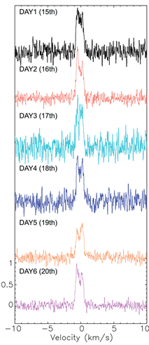

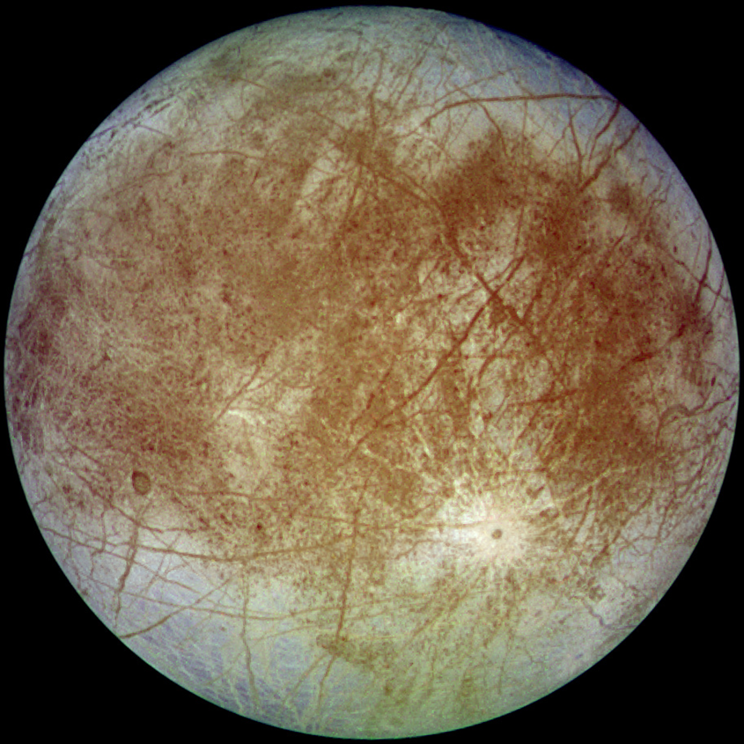
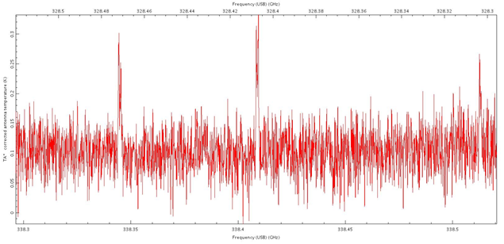
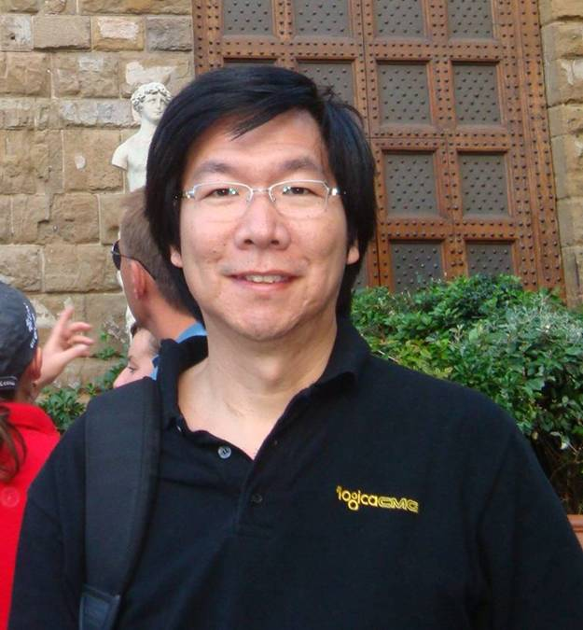
Department of Earth Sciences
Molecular Astrophysics and Astrobiology
Research Focus:
Search for prebiotically important complex organic molecules (COMs) in space –
  Is life unique on Earth or ubiquitous in the universe?
Study of Solar System and interstellar comets –
  Besides understanding of the origin and evolution of Solar System, comet study may shed light on the origin of life on Earth.
Study of Solar System icy worlds –
  Some icy worlds may possess subsurface oceans. Are these icy worlds habitable? Do they harbor life?
Telescopes used in study:
The Atacama Large Millimeter/submillimeter Array (ALMA; world’s largest ground-based observing facility), Submillimeter Array (SMA), James Clerk Maxwell Telescope (JCMT), Submillimeter Telescope (SMT), and the Kitt Peak 12m (12M).
(Left) Daily intensity variation of HCN emission of comet 46P/Wirtanen during perihelion. (Center top) Interstellar pyrimidine is one of the COMs searched for. (Top right) Water plume was detected with ALMA on Europa, an icy moon of Jupiter. (Bottom) Methanol lines observed in a short-period comet.
Yi-Jehng Kuan, Professor
Department of Earth Sciences;
Center of Astronomy and Gravitation;
ASIAA (Institute of Astronomy and Astrophysics, Academia Sinica)
kuan@ntnu.edu.tw
Background:
PhD in Astronomy, University of Illinois
at Urbana-Champaign, USA
Picture
Publications
Coulson, I.M.; Liu, F.-C.; Cordiner, M.A.; Kuan*, Y.-J.; Chuang, Y.-L.; Charnley, S.B.; Tseng, W.-L.; Milam, S. N.; Ip, W.-H.; Lin, Z.-Y. 2020, “JCMT Spectral and Continuum Imaging of Hyperactive Comet 46P/Wirtanen”, Astronomical Journal, 160, 182
Cordiner, M.A.; Milam, S.N.; Biver, N.; Bockel´ee-Morvan, D.; Roth, N.X.; Bergin, E.; Jehin, E.; Remijan, A.J.; Charnley, S.B.; Mumma, M.J.; Boissier, J.; Crovisier, J.; Paganini, L.; Kuan, Y.-J.; Lis, D.C., 2020, “Unusually High CO Abundance of the First Active Interstellar Comet”, Nature Astronomy, 4, 861
Cordiner, M.A., Charnley, S.B., Kisiel, Z., McGuire, B.A., Kuan, Y.-J. 2017, "Deep K-band Observations of TMC-1 with the Green Bank Telescope: Detection of HC₇O, Nondetection of HC₁₁N, and a Search for New Organic Molecules", Astrophysical Journal, 850, 187

Slide 9
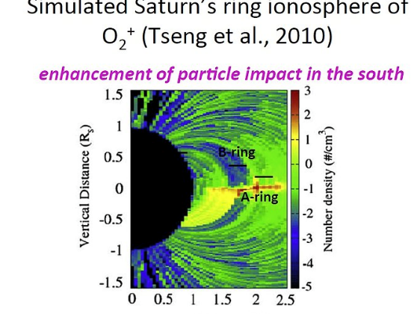
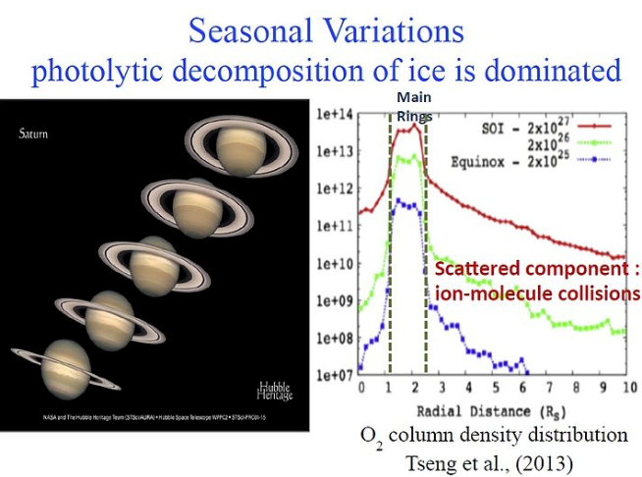

Department of Earth Sciences
Exploring the Solar System
Research Interest
My work is focused on the simulations of the structures and compositions of the neutral clouds of different origins with a plasma chemistry model based on the latest space mission data such as Cassini and Rosetta. In addition, I am particularly interested using the ground-based radio telescopes to study the small bodies in the solar system (i.e. Europa, Enceladus, Titan and comets), which can improve understanding of the sources, dynamics and evolution of their neutral exospheres and interactions with the ambient plasma environments.
Wei-Ling, Wendy, Tseng, Assistant Professor
Department of Earth Sciences
wltseng@ntnu.edu.tw
Background:
2009 Ph.D., Astronomy, National Central
University, Taiwan
Post-Degree Appointments
Jan. 2012 – July 2014 Research Scientist
Division of Space Science and Engineering, Southwest Research Institute, San Antonio, TX, USA
Dec. 2009 – Nov. 2011 Research Associate (Postdoc)
Department of Materials Science and Engineering, University of Virginia, Charlottesville, VA, USA
Publications
Waite, J. H. et al., (including Tseng, W.-L.), 2018, “Chemical interactions between Saturn's atmosphere and its rings”, Science, 362, 2382
Johnson, R. E., Tseng, W.-L., Elrod, M. K., Persoon, A. M., 2017, "Nanograin Density Outside Saturn's A ring", Astrophysical Journal Letters, Vol. 834, No. 4
Gu, H., Cui, J., Liu, D. -D., Welbrock, A., Tseng, W. -L. & Xu, X. -J., 2019, “Monte Carlo calculations of the atmospheric sputtering yields on Titan”, Astronomy & Astrophysics, 263, A18
Coulson, I. M., Cordiner, M. A., Kuan, Y.-J., Tseng, W.-L. et al., 2017, “JCMT Spectral and Continuum Imaging of Comet 252P/LINEAR”, The Astronomical Journal, Vol 153, No. 4

Slide 10
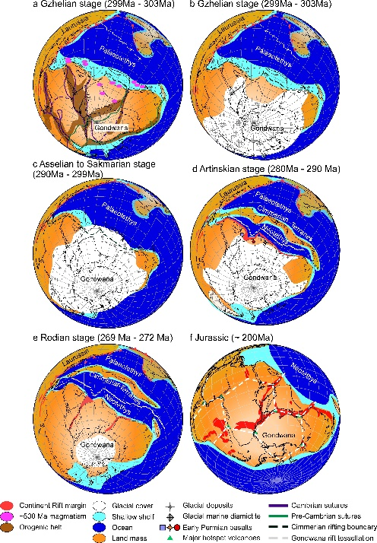
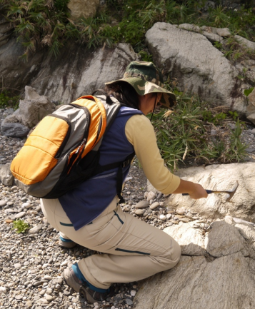
Department of Earth Sciences……
Geochronology Tectonic Structural Evolution
⁴⁰Ar/³⁹Ar geochronology method is a powerful tool to decipher the timing of structural event of metamorphic rocks. It has been used to assign reliable ages to the Earth and numerous meteorites along with highly deformed rocks within plate scale shear zones. However, the geological meaning of Ar ages obtained from mineral separates were hotly debated as multiple factors as: internal deformation, recrystallization, fluid circulation or preservation of inherited argon pre-metamorphic signature by shielding effect can affect the outcome of Ar ages within one mineral grain. For one to successfully decipher heterogeneities of ⁴⁰Ar/³⁹Ar data that experienced complex metamorphic/deformation histories, detailed knowledge of microstructural/ micropetrological relationships of examined minerals, and numerical diffusion modeling of argon retention or loss are required.
Techniques used in study
Structural & Microstructural geology
Petrography
Mineralogy
Radioactive Isotope Geochemistry
Yeh & Shellnutt, 2018
Chiu et al., 2018
Meng Wan (Mary) Yeh, Professor
Ar-Ar Geochronology Lab/ Earth Sciences department
Email: marywyeh@gmail.com
Background:
PhD. In Structural Geology
School of Earth Sciences, James Cook University, Townsville, Australia
Publications (representative)
TH Huang, MW Yeh* (2020) Structural Evolution of Extended Continental Crust Deciphered from the Cretaceous Batholith in SE China, a Kinmen Island Perspective. Frontiers in Earth Science 8, p.330
K Suga, MW Yeh (2020) Secular variation of Early Cretaceous granitoids in Kyushu, SW Japan: the role of mélange rocks as a possible magma source. Frontiers in Earth Science 8, p.95
JG Shellnutt, MW Yeh, NHT Pham, TY Lee (2019) Cryptic regional magmatism in the southern Saharan Metacraton at 580 Ma. Precambrian Research 332, 105398
Hue Anh Mai; Yu Lu Chan; Meng Wan Yeh*; Tung Yi Lee (2018, Apr). Tectonic implications of Mesozoic magmatism to initiation of Cenozoic Basin Development within the passive South China Sea margin. International Journal of Earth Sciences, DOI 10.1007/s00531-017-1537-y P.35-56.
Yu-Ping Chiu, Meng-Wan Yeh*, Kuang-Hsuan Wu, Tung-Yi Lee, Ching-Hua Lo, Sun-Lin Chung, and Yoshiyuki Iizuka (2018). Transition from extrusion to flow tectonism around the Eastern Himalaya Syntaxis. Geological Society of America Bulletin.

Slide 11
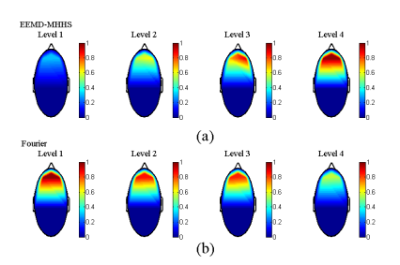
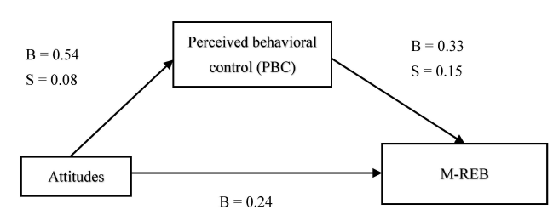
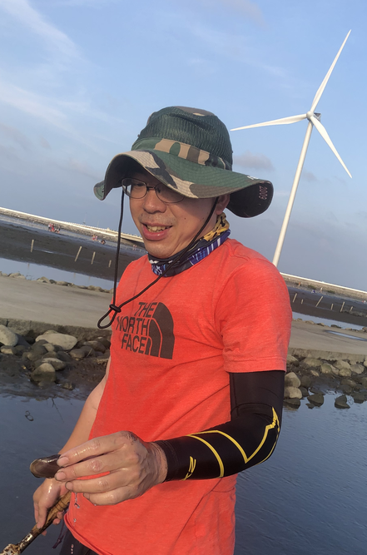
Department of Earth Sciences
Earth Science Education
Research interest
My research primarily focuses on two main areas: the mechanisms of students' learning and earth science education. In the investigation of human learning, we predominantly employ neuroimaging techniques to scrutinize the brain's functioning during the learning process. Within the realm of earth science education research, our principal objective is to explore strategies that enhance citizens' understanding of global changes and the implications of environmental issues, particularly those pertaining to marine environments. In addition to these efforts, we have also developed various tabletop games, digital media resources, and scaffolding materials to support students' learning of earth science.
Topographic Theta energy maps of subject x for a quick comparison of two stated methods. (a) Results derived from the proposed EEMD-MHHS method. (b) Results derived from the Fourier based technique.
The mediation effect of perceived behavioral control in marine environmental attitude-behavior correspondence
Ting-Kuang Yeh,
Associate Professor,
Department of Earth Sciences and Institute of Marine Environmental Science and Technology
tkyeh@ntnu.edu.tw
Background:
PhD in Earth Sciences,
National Taiwan Normal Univ.,
Taiwan
Publications (updated)
Hung, L. Y., Wang, S. M., & Yeh, T. K.* (2023). Kolb's experiential learning theory and marine debris education: Effects of different stages on learning. Marine Pollution Bulletin, 191, 114933.
Hung, L. Y., Wang, S. M., & Yeh, T. K.* (2022). Collaboration between the government and environmental non-governmental organisations for marine debris policy development: The Taiwan experience. Marine Policy, 135, 104849.
Chen, C. S., Chien, T. S., Lee, P. L., Jeng, Y., & Yeh, T. K.* (2020). Prefrontal brain electrical activity and cognitive load analysis using a non-linear and non-stationary approach. IEEE Access, 8, 211115-211124.
Funding:
Ministry of Science and Technology

Slide 12
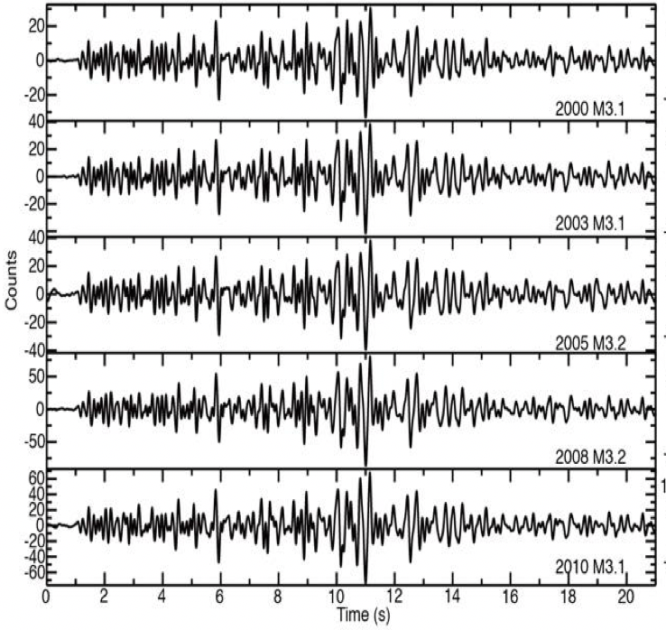
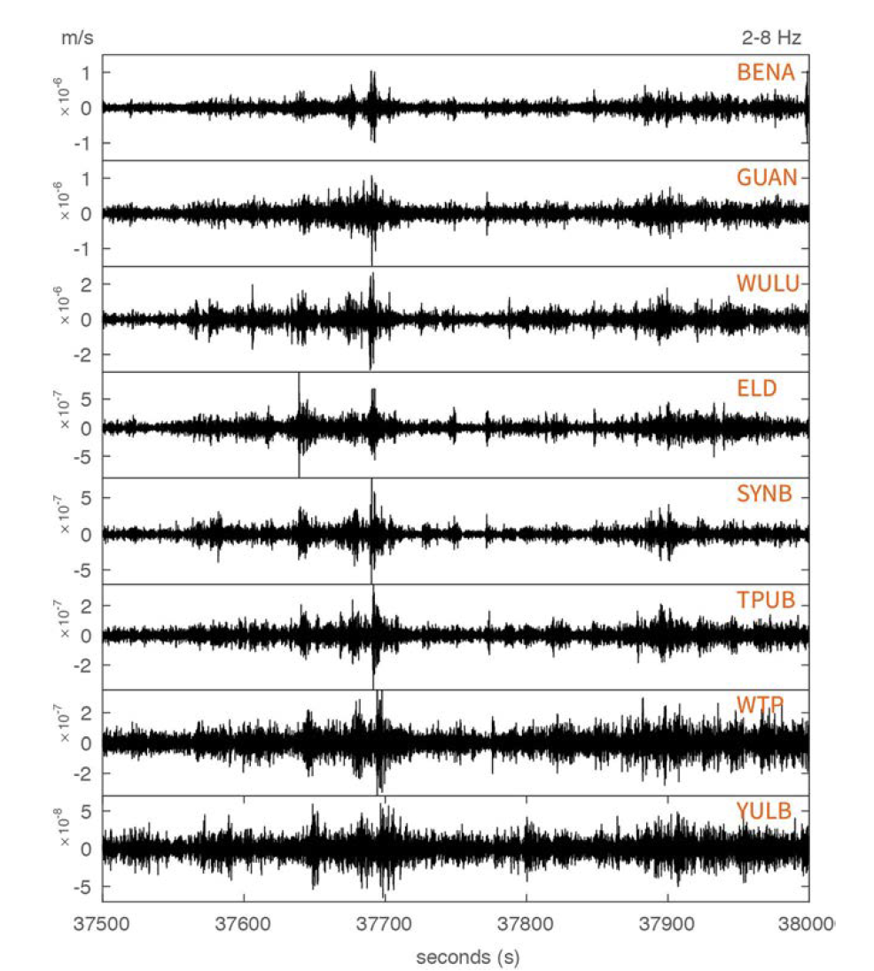

Department of Earth Sciences
Observational Seismology
Research interest
Repeating earthquakes
Slow earthquakes
My research is primarily focused on earthquake seismology, mainly the physics of seismological phenomena associated with different styles and mechanisms of slip in natural fault systems. The general goal is to better understand where, when, and how fault creeps. We have detected repeating earthquake, tectonic tremor, earthquake swarms in Taiwan and build catalogs as complete as possible, to understand their spatiotemporal characteristics and physics behind. I am also interested in urban seismology - what are the characteristics and origin of seismic noise in cities? In such project, we aim at exploring (1) how many types of recurring, strong Noise are produced by human activities in Taipei city, (2) what are their spatiotemporal characteristics and the possible origins.
Classification of seismic signals using machine learning
Urban seismology
Techniques used in study
Signal Processing
Seismic signatures of aseismic slip
Publications (updated)
Chen, K. H. et al. (2022), Characteristics and impact of environmental shaking in Taipei metropolitan area, Scientific Reports, 12, 743, https://doi.org/10.1038/s41598-021-04528-6. ​
Chen, Y. et al. (2022), Dynamic characteristics of TAIPEI 101 skyscraper from rotational and translation seismometers, BSSA, https://doi.org/10.1785/0120220147.
Chen, K. H. et al. (2023), Segmentation characteristics of deep, low-frequency tremors in Shikoku, Japan using machine learning approaches, Earth, Planets and Space, 75:32, https://doi.org/10.1186/s40623-023-01776-w.
Kate Huihsuan Chen,
Professor, Dept. of Earth Sciences
katepili@ntnu.edu.tw
Background:
PhD in Earth Sciences,
National Cheng Kung Univ.,
Taiwan
https://katepili.wixsite.com/kate-chen/research

Slide 13
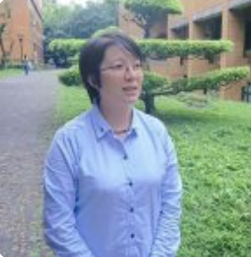
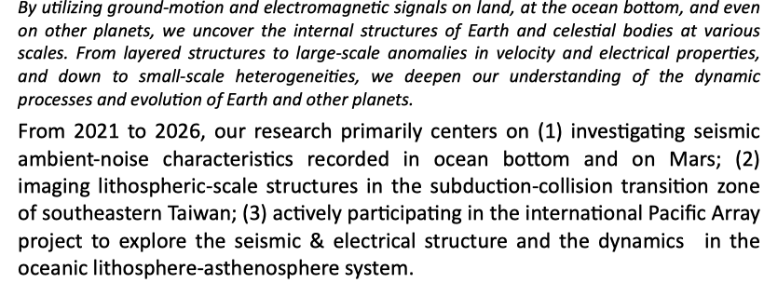
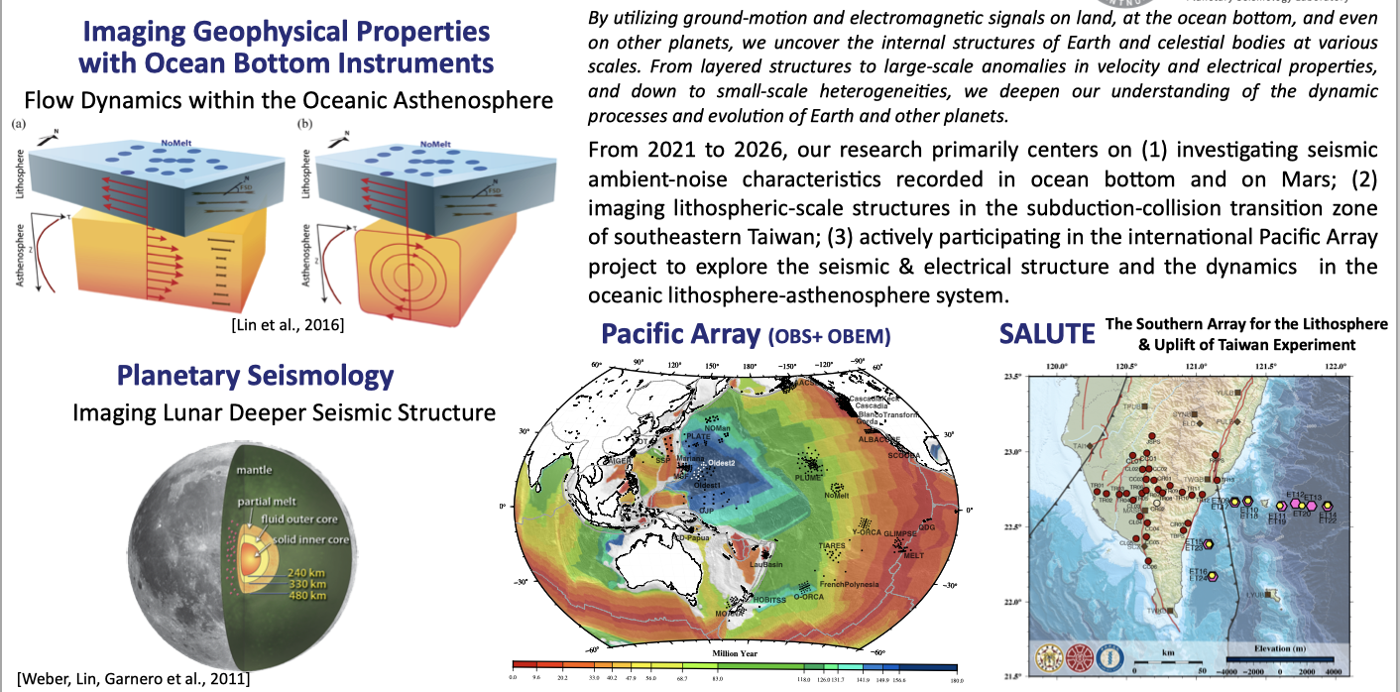
Department of Earth Sciences
Planetary Seismology Lab
Patty Pei-Ying Lin, Assistant Professor, Dept. of Earth Sciences
pylin.patty@ntnu.edu.tw Background: PhD in Geophysics, The University of Arizona
Funding: Ministry of Science and Technology

