Slide 1
Automatic classification of local, regional and teleseismic earthquakes using machine learning techniques – k-nearest neighbors (kNN)
報告者：聶家駿
指導老師：陳卉瑄老師
指導助教：葉庭禎 陳耀傑

Slide 2
Outline
Motivation and Our Goals
Methods - Machine Learning in Geoscience - kNN classification - True Positive rate (TP)
Data and Analysis
Result
Conclusion

Slide 3
Motivation
The traditional classification of seismic events requires the integration of physical and statistical techniques, which demands as many stations as possible.
Can we develop a system of robust seismic event discrimination using only one SINGLE STATION for real time earthquake monitoring?
Notes:
The classification of seismic events requires the integration physical and statistical techniques, which demands as many stations as possible.
But the question is…Can we develop a system of robust seismic event discrimination using a SINGLE STATION, for real time earthquake monitoring system? (the system that not only provides magnitude and location but also “type of earthquakes”)

Slide 4
Our Goals
In this study, we start with the discrimination among local, regional and teleseismic earthquakes.
We want to know if using a single station, whether the automatic classification is possible?
In this summer program, the goals are to study
Which component of seismograms (E, N, Z)
Which time window in the seismograms (3s, 5s,10s,20s,30s)
Which seismic features in the seismograms (spectral power ratio: < 1Hz / 1-10 Hz, 1-2 Hz /1-10 Hz, <1 Hz/2-8 Hz ) … can reveal the best performance in automatic classification

Slide 5
Machine learning in geoscience
In data mining using machine learning, an algorithm can learn patterns from a sample data set and then have the ability to determine the class of new input data based on the previous knowledge. And machine learning techniques have been extensively applied to seismic data mainly for…
Discrimination of natural earthquakes, blasts and artificial explosions
Detection of rockslide or landslide signals
k-Nearest Neighbors, KNN (commonly used for mining, e.g., Kuyuk et al., 2012)
Artificial Neural Networks (Langer et al., 2006; Curilem et al., 2009 )
Random Forest (Provost et al., 2017)
Hidden Markov Models, HMM (Beyreuther and Wassermann, 2008)
Support Vector Machines , SVMs (Giacco et al., 2009)
Notes:
Many machine learning algorithms have been developed in the recent years for different purposes

Slide 6
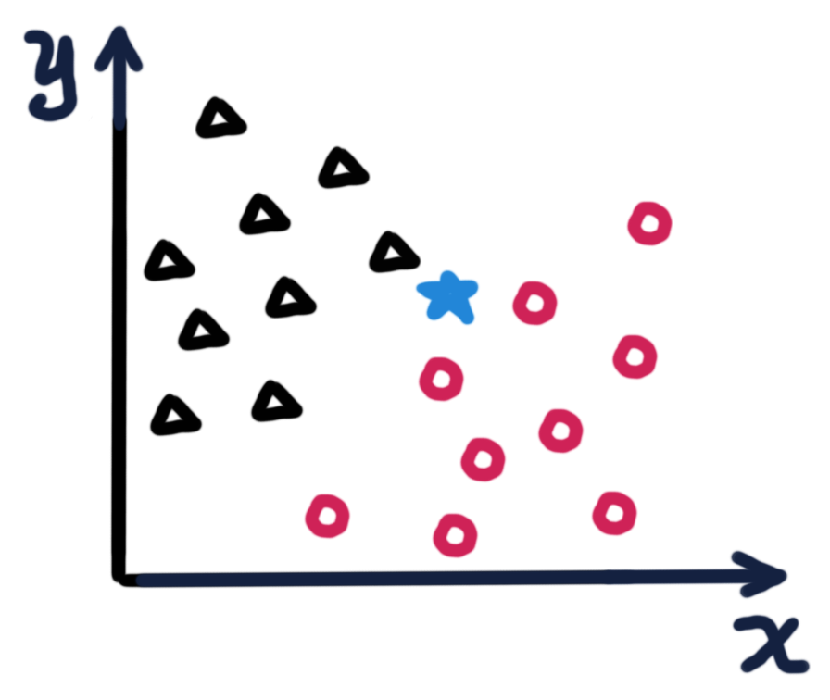
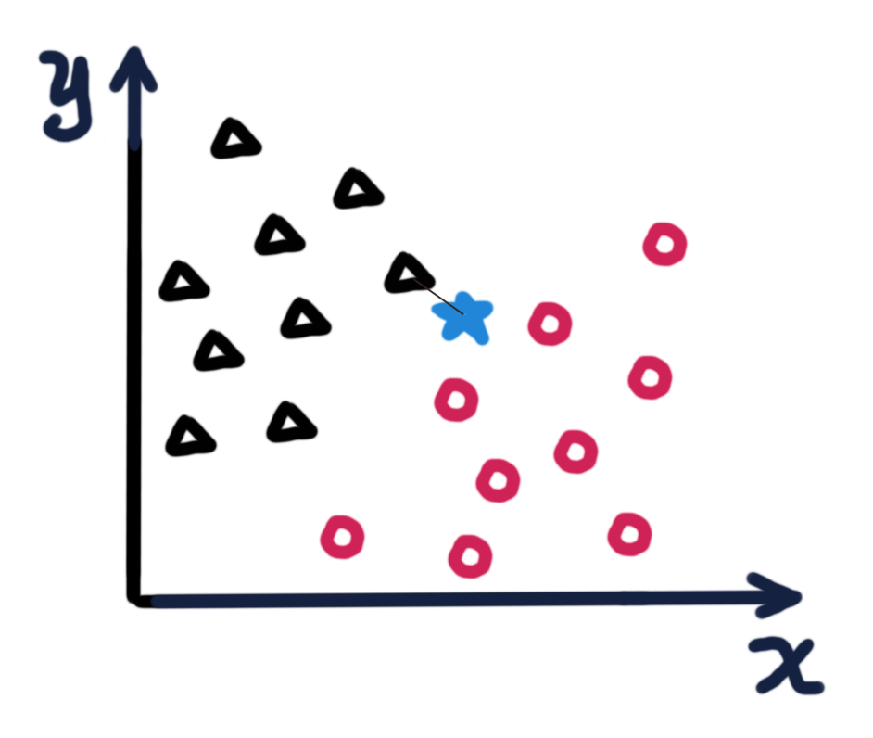
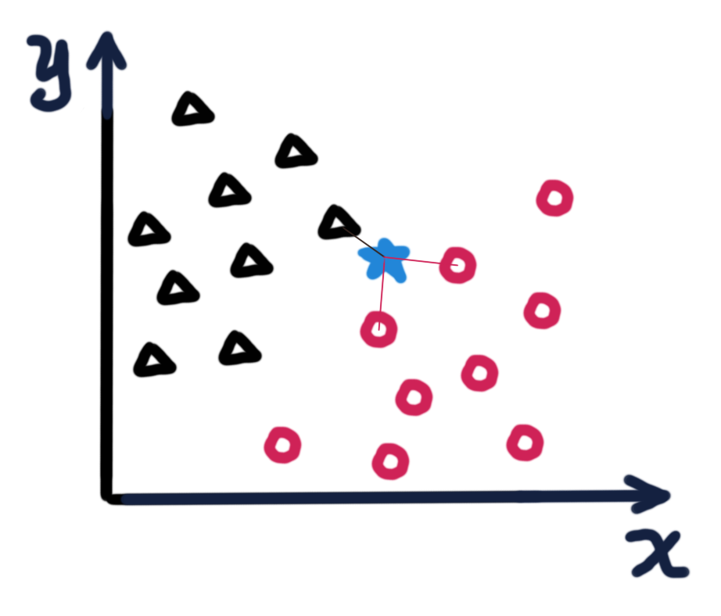
K nearest neighbor classification (Knn)
Nearest neighbor pattern classification (Cover and Hart, 1967)
Supervised learning (training data required)
One of the simplest machine learning algorithm simply based on distance between data (features).
Training data- Black class
Training data- Red class
Testing data- unknown class
k=1
k=3
X, Y are features of every single data (e.g., dominant frequency, max. amplitude)
Notes:
Finding the nearest neighbor for every testing data, k number of nearest neighbors.

Slide 7
How do we evaluate the classifier? True Positive rate (TP)
True positive (TP) rate:
How many of the input events are “predicted” as their actual class?
In this confusion matrix, you have 39 actual local events,
And, 30 of them are predicted to be “local”,
6 of them are predicted to be “regional”,
3 of them are predicted to be “teleseismic”,
here’s our True Positive rate of Local events:
 | Actual class: Local, 39 events
 | Local | 30
 | Regional | 6
 | Teleseismic | 3
True positive rate =
30 / 39 x 100% = 76.92%
Predicted class

Slide 8
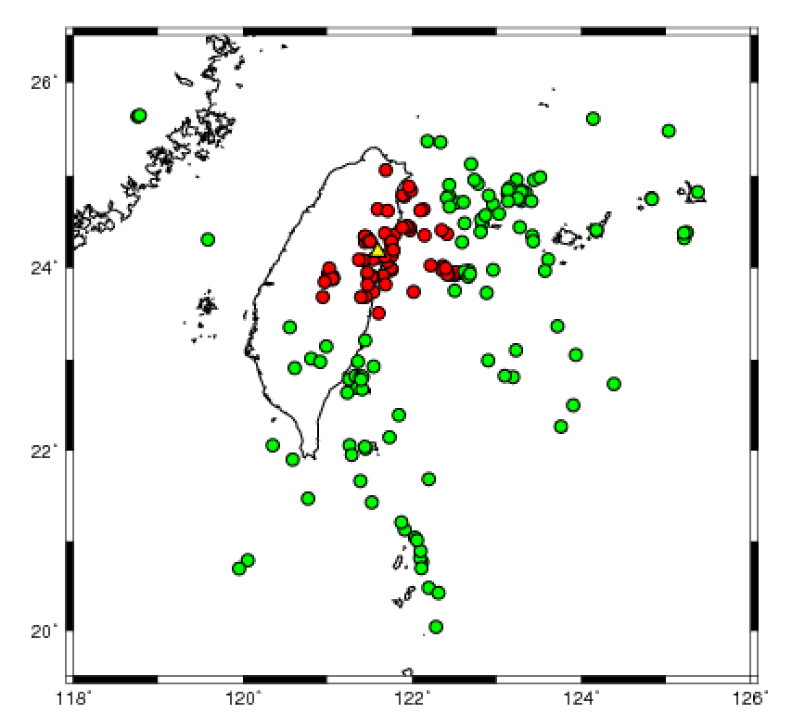
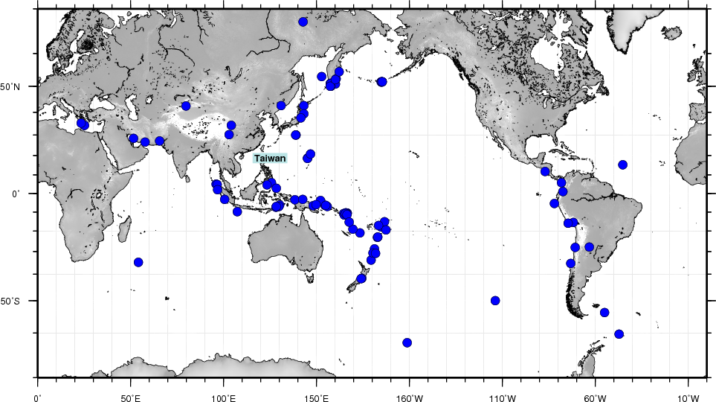
Data: Three classes of seismic events
3 classes Epicentral Distance Magnitude(#n)
C1 Local earthquakes < 100 km 4-7 (79)
C2 Regional earthquakes 100 - 1400 km 4-7 (119)
C3 Teleseismic >1400 km 6-7 (99)
(Lay and Wallace, 1995)
Local events
NACB
Teleseismic events
Regional events
Notes:
Here we defined three different classes of seismic events, using the distance threshold defined by Lay and Wallance (1995). The local earthquakes are earthquakes with an epicentral distance less than or equal to 100 km,
and regional earthquakes with an epicentral distance range from 100 km to 1400 km,
and teleseismics with an epicentral distance larger than 1400 km.
The two figrues here show their distribution and the location of station used.

Slide 9
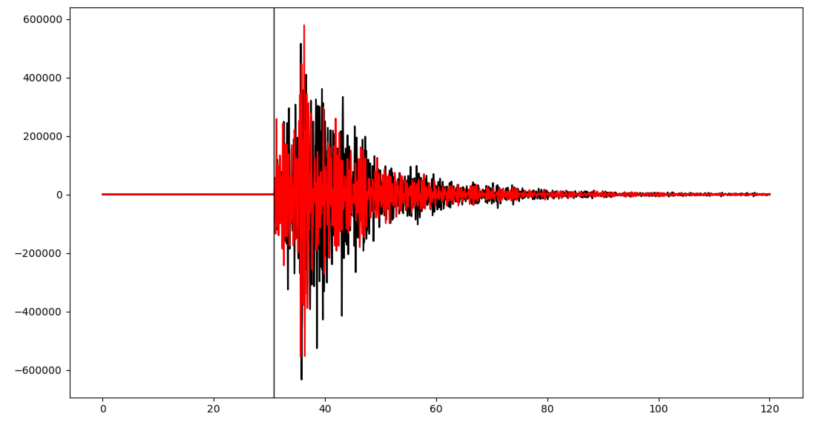
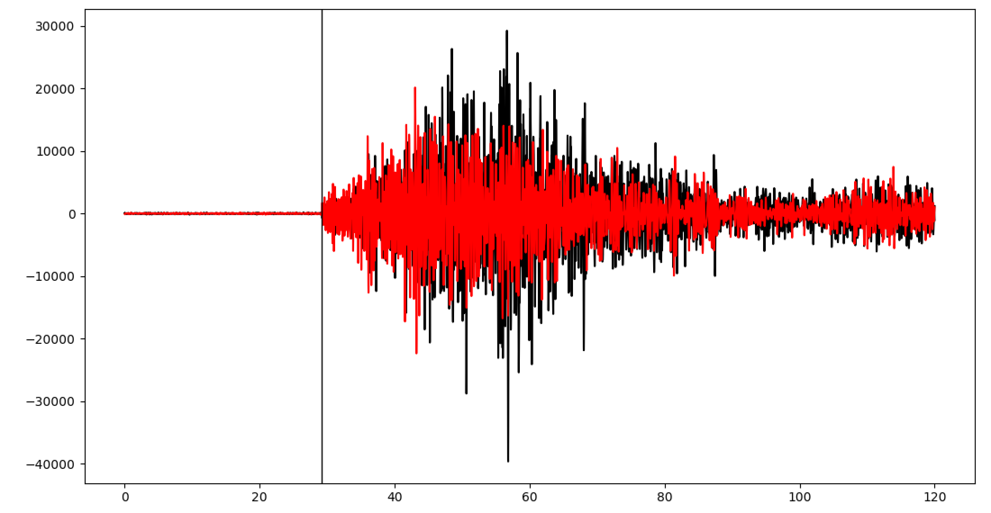
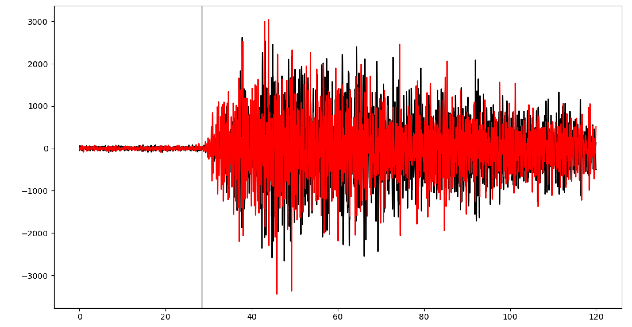
Data: Workflow
Picking P- wave arrival time
(a)
Earthquake catalogs
local
Knn classifier
>> RESULTS
Time after 2013-01-02T12:01:51.030000 (s)
(b)
regional
TO EACH TRACE, SLICE INTO DIFFERENT TIME WINDOW:
Time after 2013-01-03T04:36:37.750000 (s)
(c)
teleseismic
3 seconds
5 seconds
10 seconds
20 seconds
30 seconds
Time after 2013-02-02T14:22:54.480000 (s)
Notes:
The local and the regional events are selected from the earthquake catalog sorted by Yih-Min Wu, 2015
Teleseismics are selected from earthquakes happened in 2013 magnitude from 6 to 7 recorded
What I do is….(1) request three components of data (2) display the waveforms (3) pick the P arrival (4) cut into different time window

Slide 10
Analysis: from feature extraction to classifier evaluation
Spectra analysis (frequency distribution)
A systematic survey on spectral ratio and the separation among 3 classes.
Notes:
In the following slides I will quickly go through feature extraction and classifier evaluation…

Slide 11
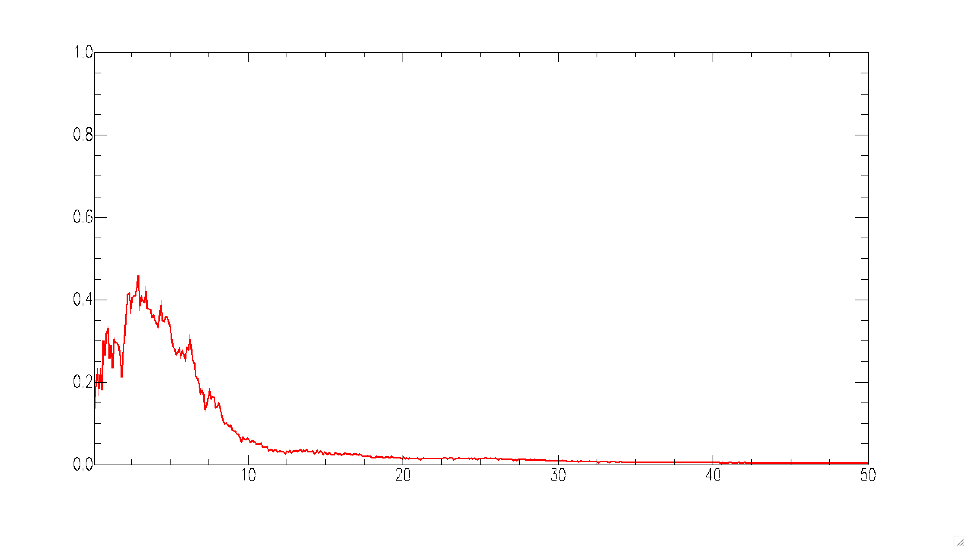
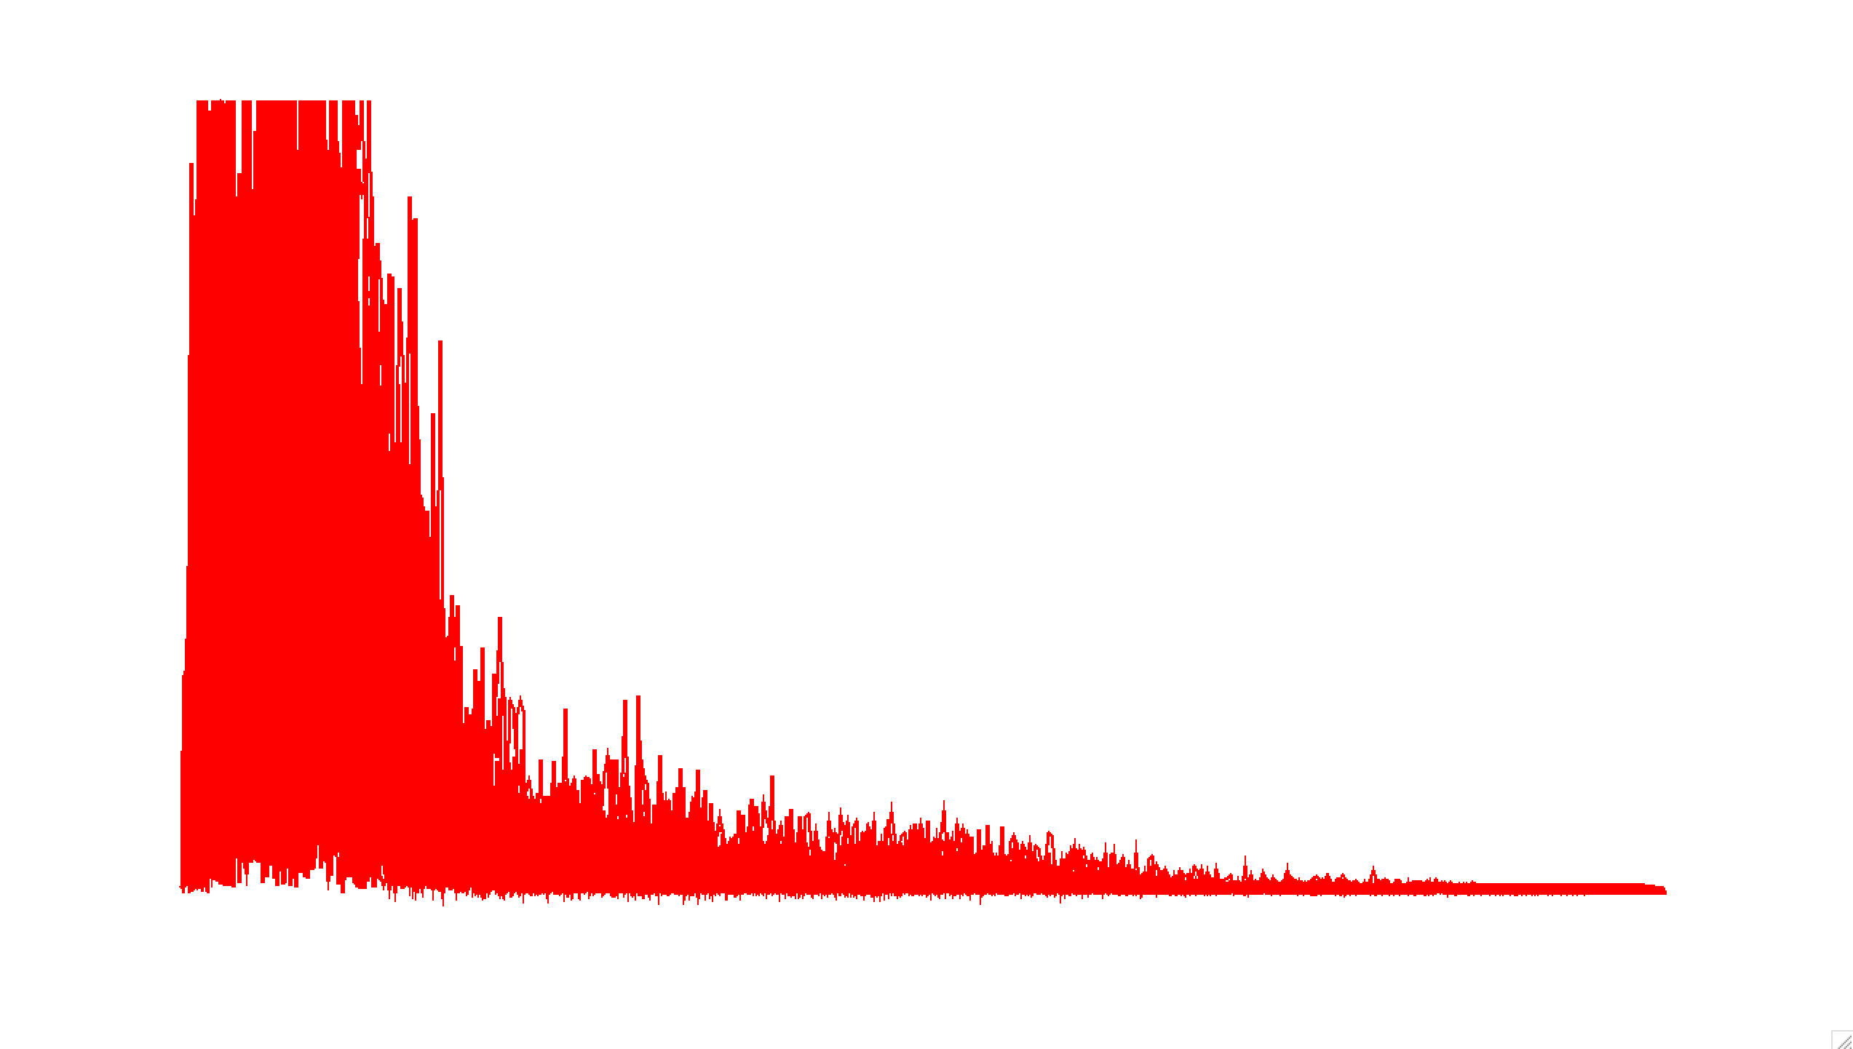
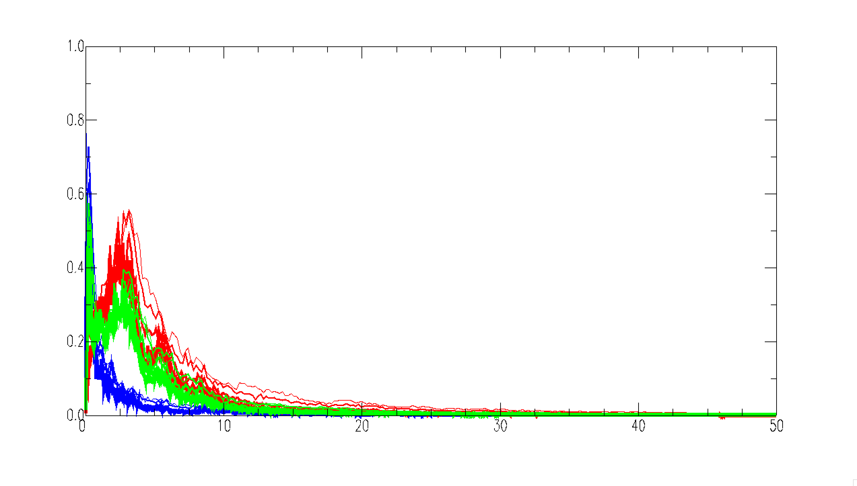
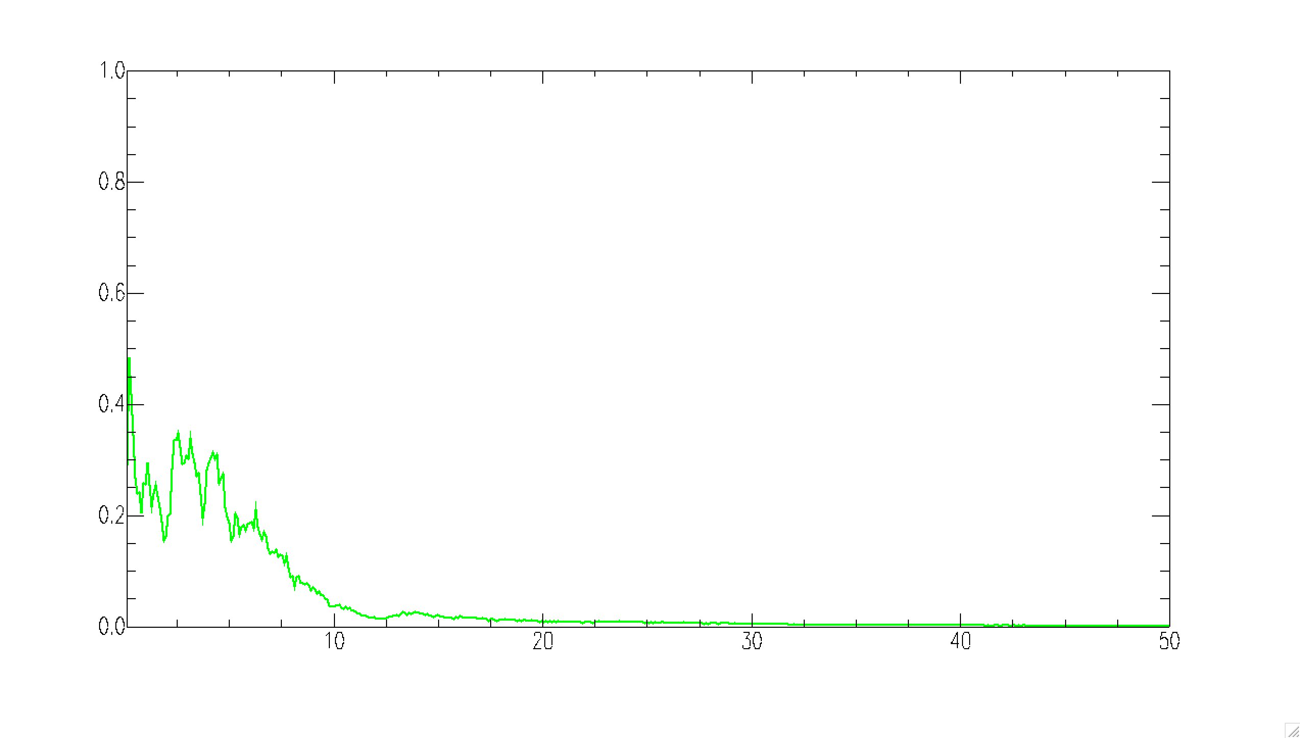
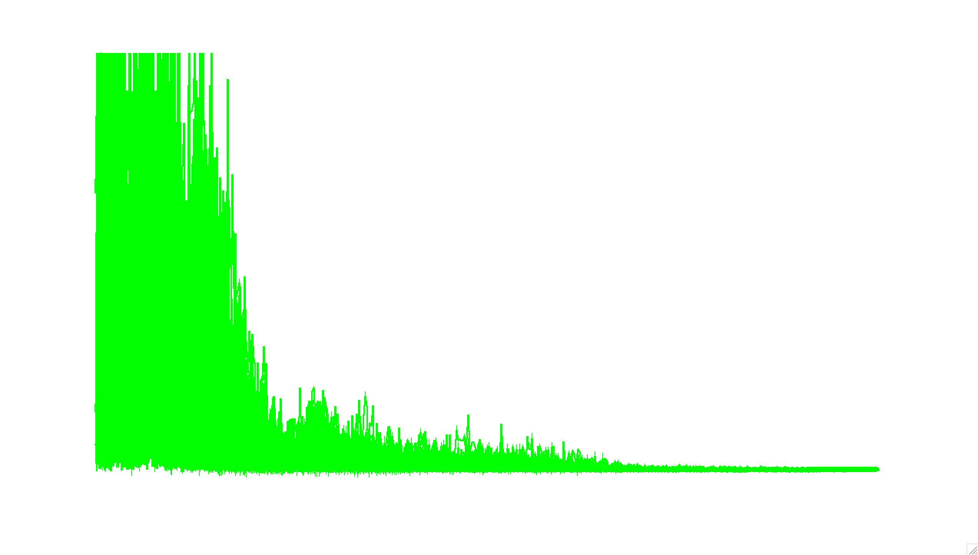
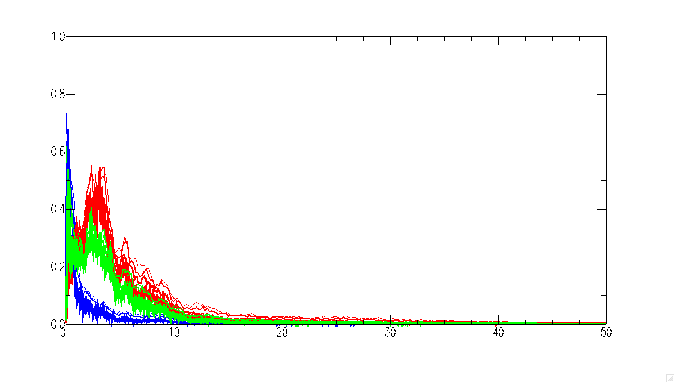
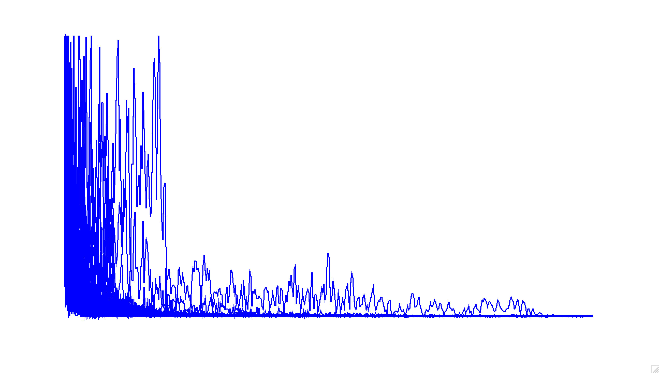
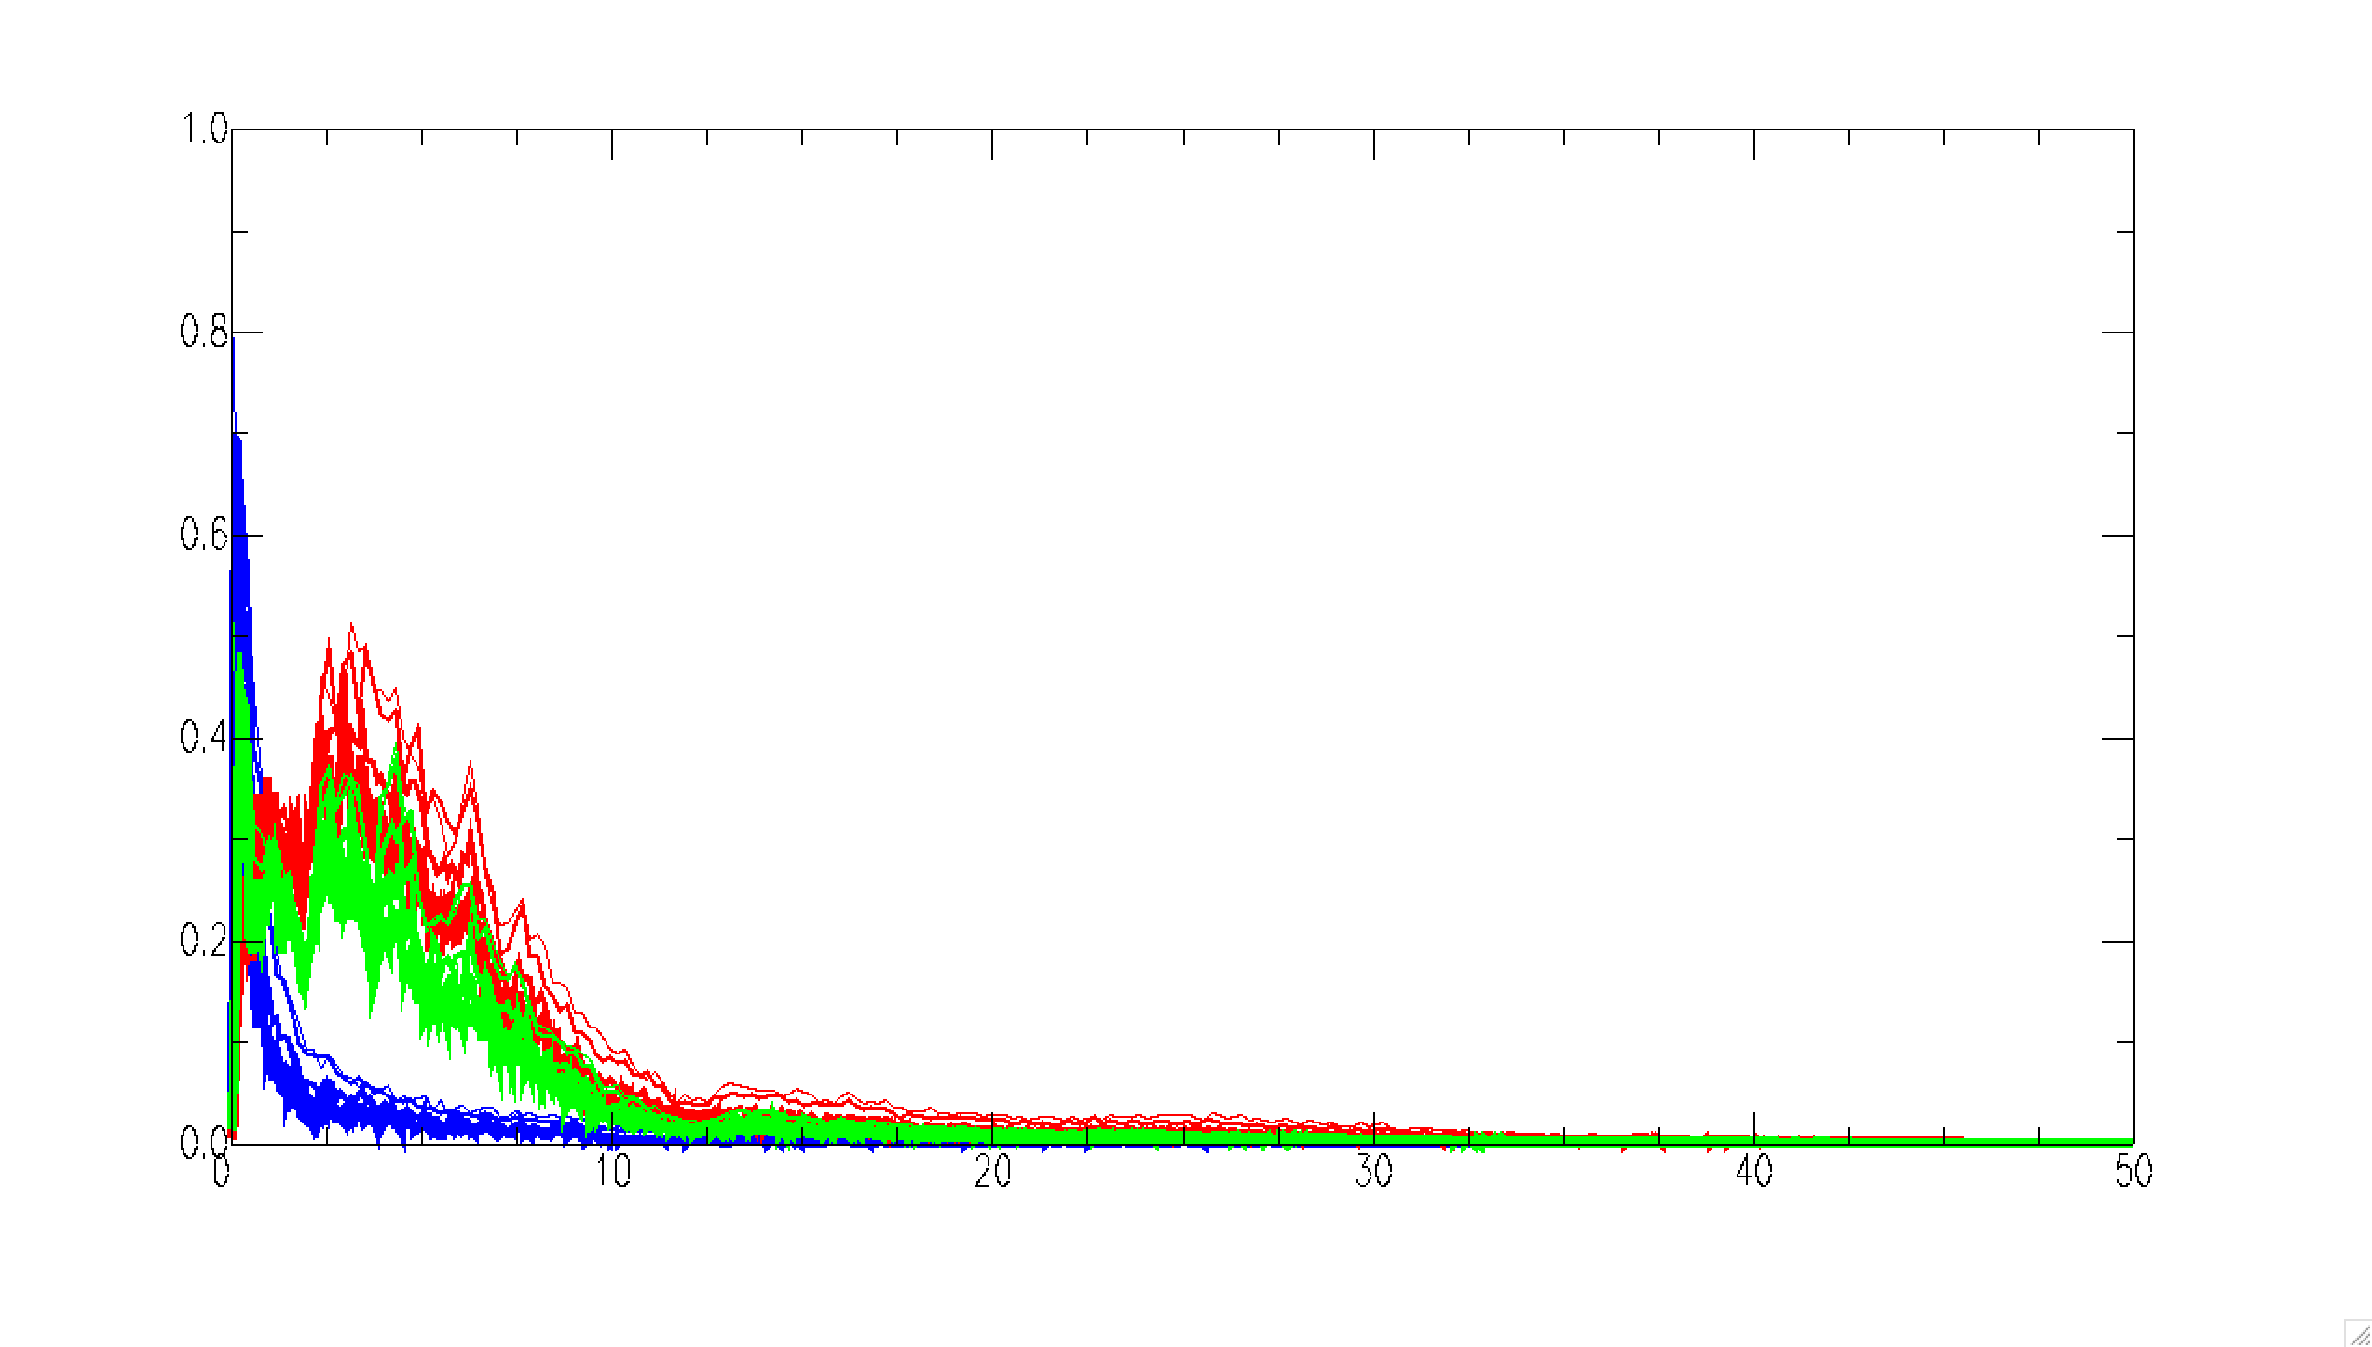
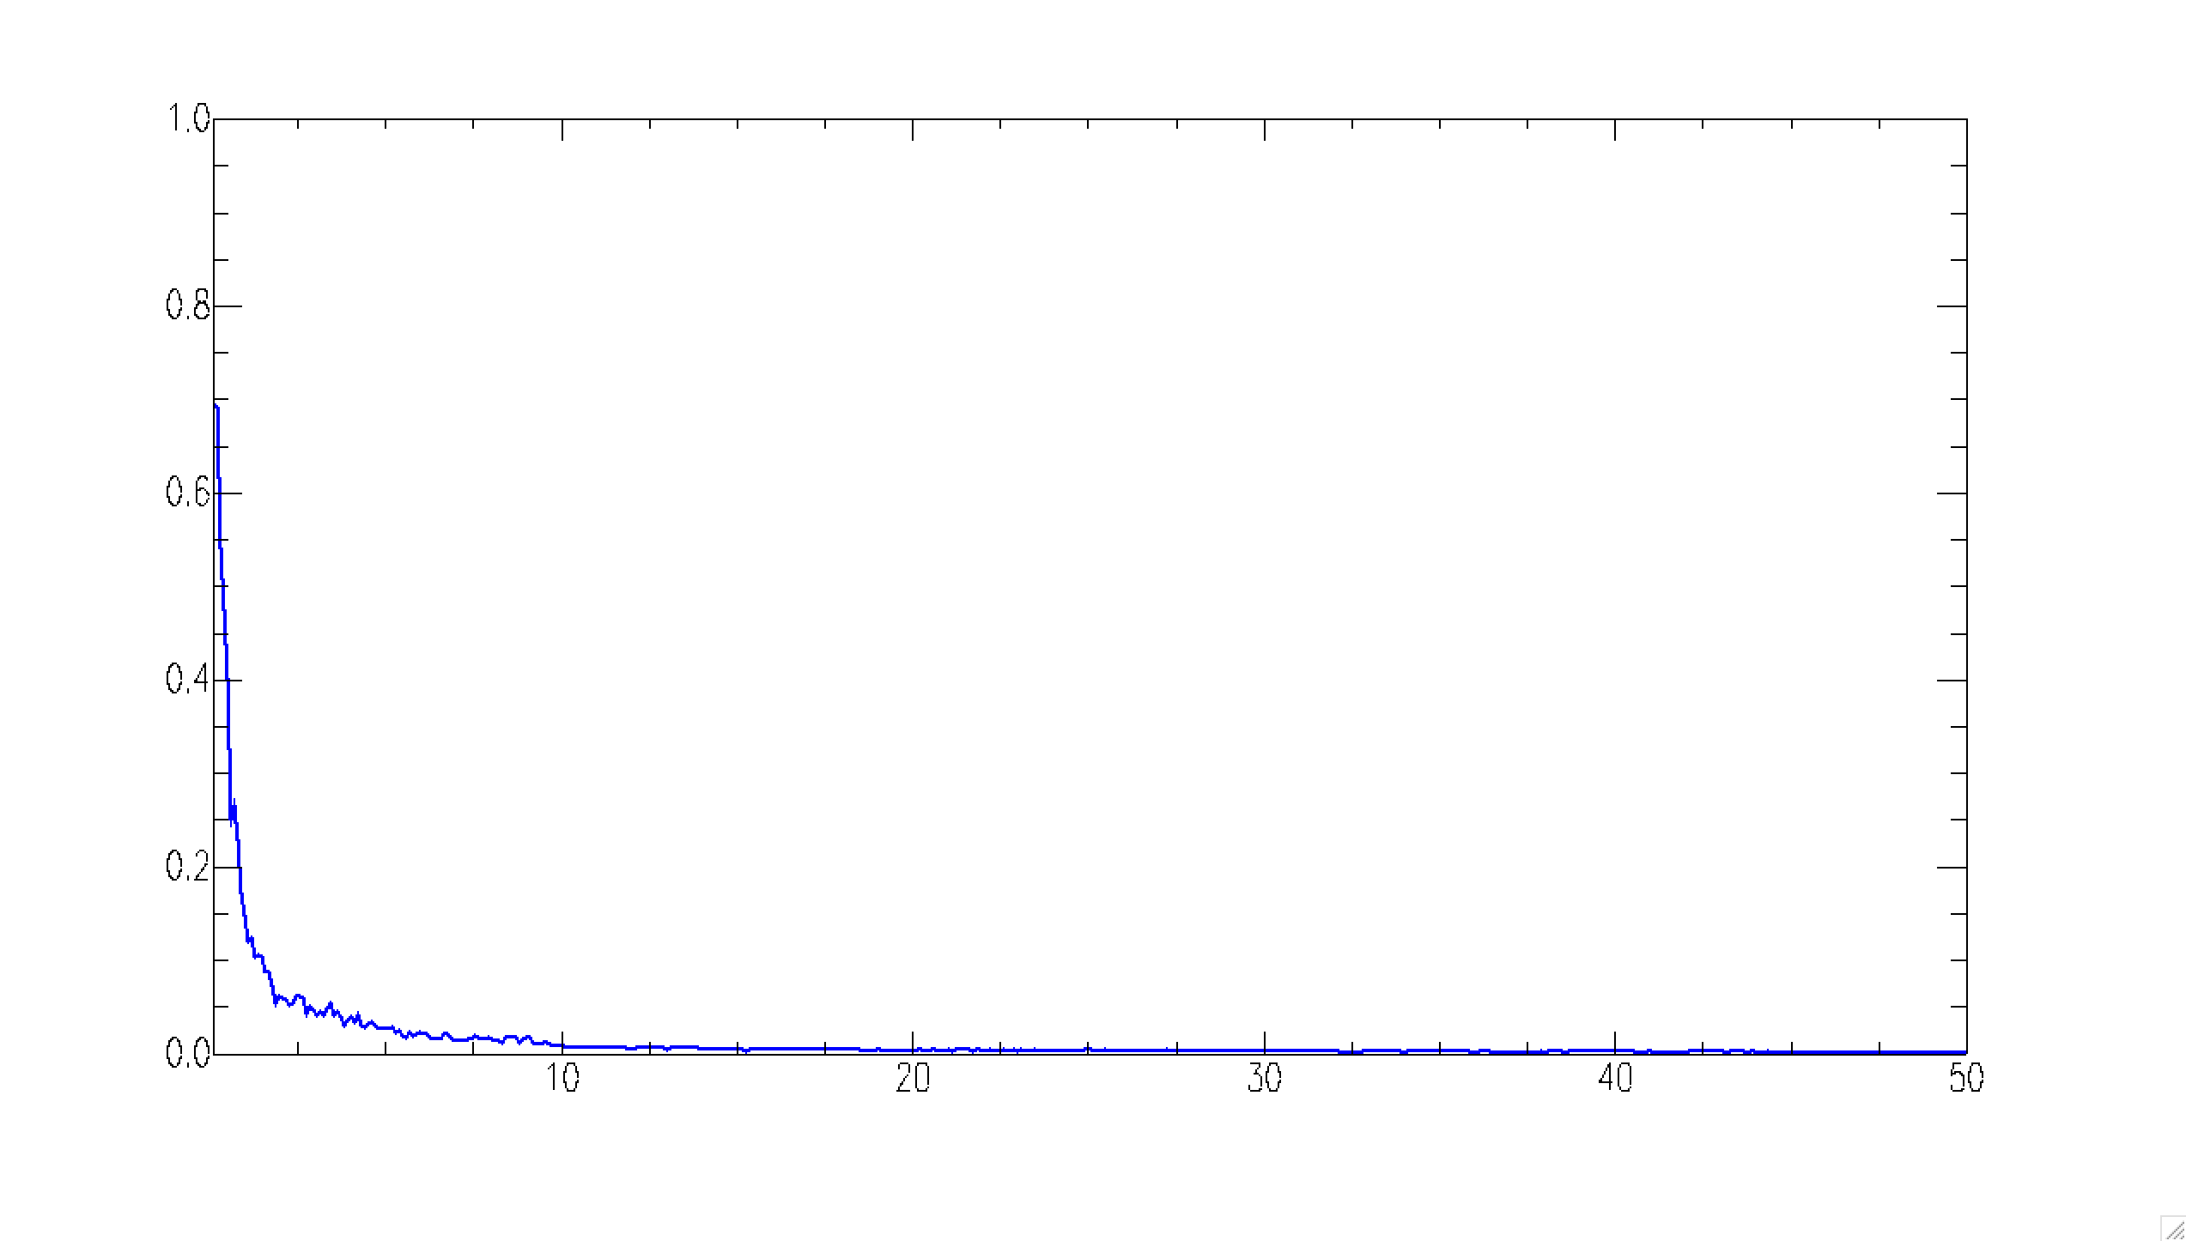
Analysis: feature extraction
What features can we EXTRACT from our traces of each class?
Spectra: Fast Fourier transform
Which frequency band shows the biggest difference among classes?
E-component
Local events
Amplitude
average
0.1 ~ 50 Hz
Regional events
N-comp.
Frequency (Hz)
Z-comp.
Teleseismic events
Three different components behave similarly
Notes:
To find the best choice of the feature, we first use FFT then plot spectra for each class of seismic events, as shown by the colorful thin line here.
Thicker line is the average among all traces. When three classes of events are compared in the same plot, several more lines for each class represent different selection of time window for later discussion. Here shows only the E-W component and close-up to 10 hz and 2 hz.
What you see is …(1), (2), (3)
When you look at other two components – N-S and vertical components, as shown here, they reveal very similar pattern as E-/w component

Slide 12
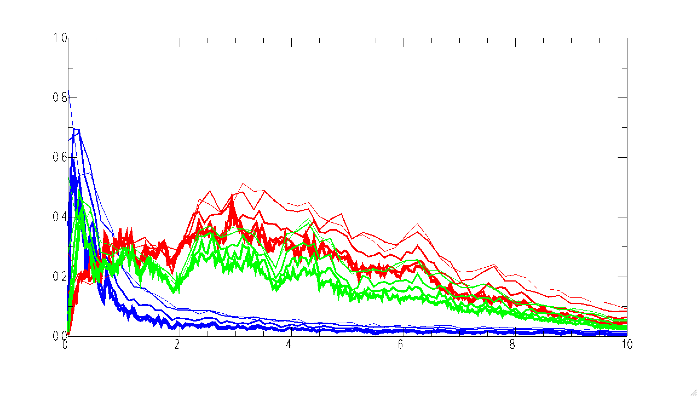
Analysis
C2, C3 are similar
Z
Local –red
Regional- green
Teleseismic- blue
E
Z
Amplitude
N
0.1 ~ 10 Hz
What we see from these…
Frequency (Hz)
Most of energy happens in 2-8 Hz for local & regional, but <1 Hz for teleseismic
Significant difference also takes place in < 1 Hz & 2-8 Hz

Slide 13
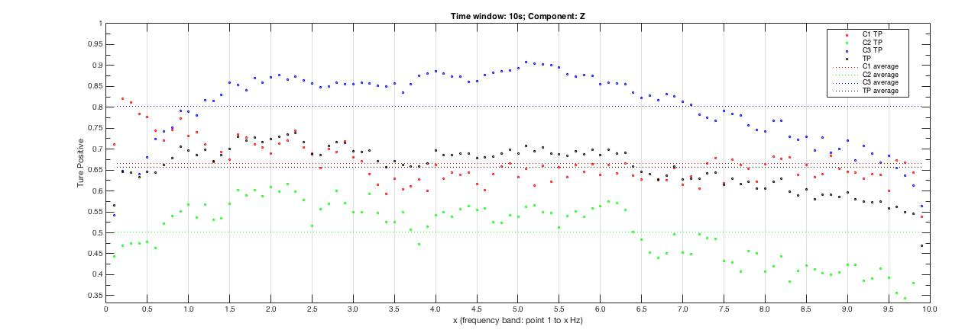
Choice of features: classifier evaluation
Based on spectra and systematic survey on the spectral ratio and the separation among different classes, the choice of features are:
Feature 1: <1 Hz/ 1-10 Hz (lower than 1 Hz)
Feature 2: <2 Hz/ 1-10 Hz (lower than 2 Hz)
Feature 3: < 1Hz/ 2-8 Hz to discriminate Class 2 events
Amplitude
separation
Frequency (Hz)
Sensitivity test
True positive rate
spectral ratio
Notes:
Through a systematic survey on the spectral ratio and the separation among different classes, we come up with the choice of three features:
In the lower freq. range (feature 1) you can see a clear separation between red and two other groups; in the higher f. range the blue becomes distingishable. But we also found a subtle modification on the denominator allow us to …

Slide 14
Result: choice of features, time windows, and components
E-W component
Time length | Using only feature 1 |  |  | Using feature 1 and 2 |  |  | Using feature 1, 2 and 3
3 sec E | C1 | 64.65% | 64.76% | C1 | 73.17% | 71.18% | C1 | 73.73% | 70.99%
 | C2 | 50.20% |  | C2 | 59.01% |  | C2 | 57.61%
 | C3 | 79.44% |  | C3 | 76.92% |  | C3 | 81.64%
5 sec E | C1 | 72.81% | 60.38% | C1 | 79.11% | 70.37% | C1 | 79.13% | 70.33%
 | C2 | 43.21% |  | C2 | 54.71% |  | C2 | 55.65%
 | C3 | 65.12% |  | C3 | 77.29% |  | C3 | 76.22%
10 sec E | C1 | 82.00% | 72.35% | C1 | 82.51% | 77.91% | C1 | 82.03% | 77.45%
 | C2 | 60.30% |  | C2 | 68.03% |  | C2 | 70.10%
 | C3 | 74.82% |  | C3 | 83.21% |  | C3 | 80.79%
20 sec E | C1 | 81.74% | 63.65% | C1 | 82.21% | 70.04% | C1 | 83.33% | 72.39%
 | C2 | 45.54% |  | C2 | 56.51% |  | C2 | 62.44%
 | C3 | 63.67% |  | C3 | 71.41% |  | C3 | 71.41%
30 sec E | C1 | 78.41% | 66.28% | C1 | 75.56% | 70.09% | C1 | 77.33% | 70.48%
 | C2 | 51.64% |  | C2 | 54.85% |  | C2 | 55.49%
 | C3 | 68.79% |  | C3 | 79.87% |  | C3 | 78.62%
First, we can see the TP rate of 3 and 5 seconds are both worse then the others.
And the TP rate of C2 are always lower than the others. But the TP rate when the third feature is added.
The best performance happens when using:
10-second time widow.
Both feature 1 and 2
Notes:
Using these features, we first discuss the performance using different time windows
Pay attention on the growth of the TP of C2 while adding the third feature, it’s a proof that our third feature can help on classifying.

Slide 15
Result: choice of features, time windows, and components
N-S component
Time length | Using only feature 1 |  |  | Using feature 1 and 2 |  |  | Using feature 1, 2 and 3
3 sec N | C1 | 79.23% | 67.52% | C1 | 83.16% | 73.82% | C1 | 83.51% | 72.33%
 | C2 | 51.21% |  | C2 | 58.66% |  | C2 | 57.47%
 | C3 | 72.12% |  | C3 | 79.63% |  | C3 | 76.02%
5 sec N | C1 | 79.89% | 72.80% | C1 | 74.33% | 73.51% | C1 | 74.41% | 70.54%
 | C2 | 62.37% |  | C2 | 62.98% |  | C2 | 58.66%
 | C3 | 76.13% |  | C3 | 83.22% |  | C3 | 78.55%
10 sec N | C1 | 80.00% | 65.47% | C1 | 80.26% | 76.58% | C1 | 83.08% | 77.18%
 | C2 | 48.21% |  | C2 | 65.13% |  | C2 | 68.21%
 | C3 | 68.21% |  | C3 | 84.36% |  | C3 | 80.26%
20 sec N | C1 | 84.54% | 66.44% | C1 | 82.69% | 76.99% | C1 | 82.92% | 78.08%
 | C2 | 51.10% |  | C2 | 68.49% |  | C2 | 71.33%
 | C3 | 63.69% |  | C3 | 79.79% |  | C3 | 79.97%
30 sec N | C1 | 81.18% | 64.11% | C1 | 84.05% | 74.56% | C1 | 84.51% | 76.18%
 | C2 | 48.67% |  | C2 | 58.64% |  | C2 | 65.28%
 | C3 | 62.49% |  | C3 | 80.97% |  | C3 | 78.74%
To the N-S component, the greatest TP happens when using:
20-second time window
All features 1, 2, 3
Again, feature 3 can help on increasing C2 TP.

Slide 16
Result: choice of features, time windows, and components
Vertical component
Time length | Using only feature 1 |  |  | Using feature 1 and 2 |  |  | Using feature 1, 2 and 3
3 sec Z | C1 | 77.86% | 62.25% | C1 | 76.63% | 72.13% | C1 | 77.01% | 71.36%
 | C2 | 45.13% |  | C2 | 58.76% |  | C2 | 59.19%
 | C3 | 64.65% |  | C3 | 81.00% |  | C3 | 77.68%
5 sec Z | C1 | 78.37% | 63.75% | C1 | 79.62% | 75.03% | C1 | 79.84% | 75.11%
 | C2 | 47.35% |  | C2 | 61.65% |  | C2 | 61.22%
 | C3 | 65.51% |  | C3 | 83.84% |  | C3 | 84.26%
10 sec Z | C1 | 81.30% | 64.01% | C1 | 83.28% | 78.32% | C1 | 82.81% | 79.45%
 | C2 | 46.63% |  | C2 | 66.39% |  | C2 | 70.33%
 | C3 | 64.10% |  | C3 | 85.29% |  | C3 | 85.20%
20 sec Z | C1 | 85.24% | 65.18% | C1 | 83.19% | 79.29% | C1 | 83.65% | 80.36%
 | C2 | 47.41% |  | C2 | 67.65% |  | C2 | 69.73%
 | C3 | 62.88% |  | C3 | 86.97% |  | C3 | 87.69%
30 sec Z | C1 | 83.21% | 67.47% | C1 | 85.00% | 77.74% | C1 | 85.30% | 77.75%
 | C2 | 52.27% |  | C2 | 61.79% |  | C2 | 64.41%
 | C3 | 66.93% |  | C3 | 86.24% |  | C3 | 83.54%
The Z component shows the same result with that for N-S component.
Features 1~3 should be all considered
Z component waveforms have better performances
20-s window has better performances

Slide 17
Result: choices of k (how many neighbors)
3 nearest neighbors shows the highest TP rate in our study.
20 seconds Z component
k=1 |  |  | k=3 |  |  | k=5
C1 | 83.65% | 80.36% | C1 | 88.55% | 81.05% | C1 | 87.68% | 80.15%
C2 | 69.73% |  | C2 | 67.15% |  | C2 | 64.49%
C3 | 87.69% |  | C3 | 87.46% |  | C3 | 88.27%
k=1
k=3
k=5

Slide 18
Conclusion
Using a single station (NACB), we try to discriminate three classes of seismic events with varying epicentral distance: local (<100 km), regional (100-1400 km), and teleseismic (> 1400 km) events.
The k-nearest neighbors technique separate these three classes of events better when (1) vertical component (2) 20-s time window (3) 3 neighbors are considered using.
We provide three relevantly efficient features on discriminating these 3 classes.
Toward the future real time system that demands fast classification, the challenge is to increase the performance in C2 class (regional events). This can be done by a wider choices of features (e.g., higher frequency band, features in time domain, polarity and so on).
Notes:
Test on different stations is also needed.

Slide 19
Thank you for your listening!

Slide 20
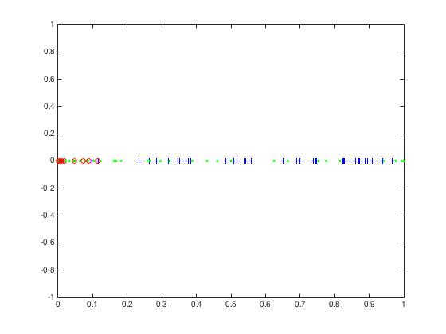
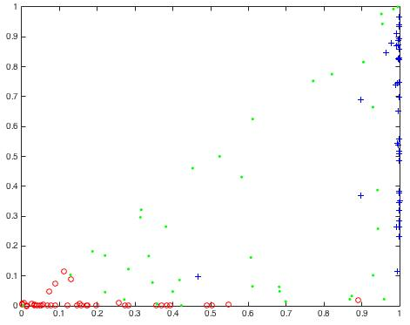
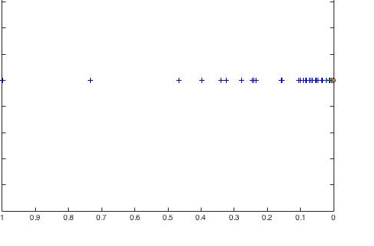
Feature 1 and 2

Slide 21
Data: Three classes of seismic events
3 classes Magnitude Select Number of events
C1 Local earthquakes Ml 4 - 7 79
C2 Regional earthquakes Ml 4 - 7 119
C3 Teleseismic Mw 6 - 7 99
0-100 100-1400 >1400
Distance from event to the station (km)
Notes:
3 classes have different magnitude and number of events, as shown by the table and figure here.
(the different magnitude range is to ensure the equal number of data for each class)

Slide 22
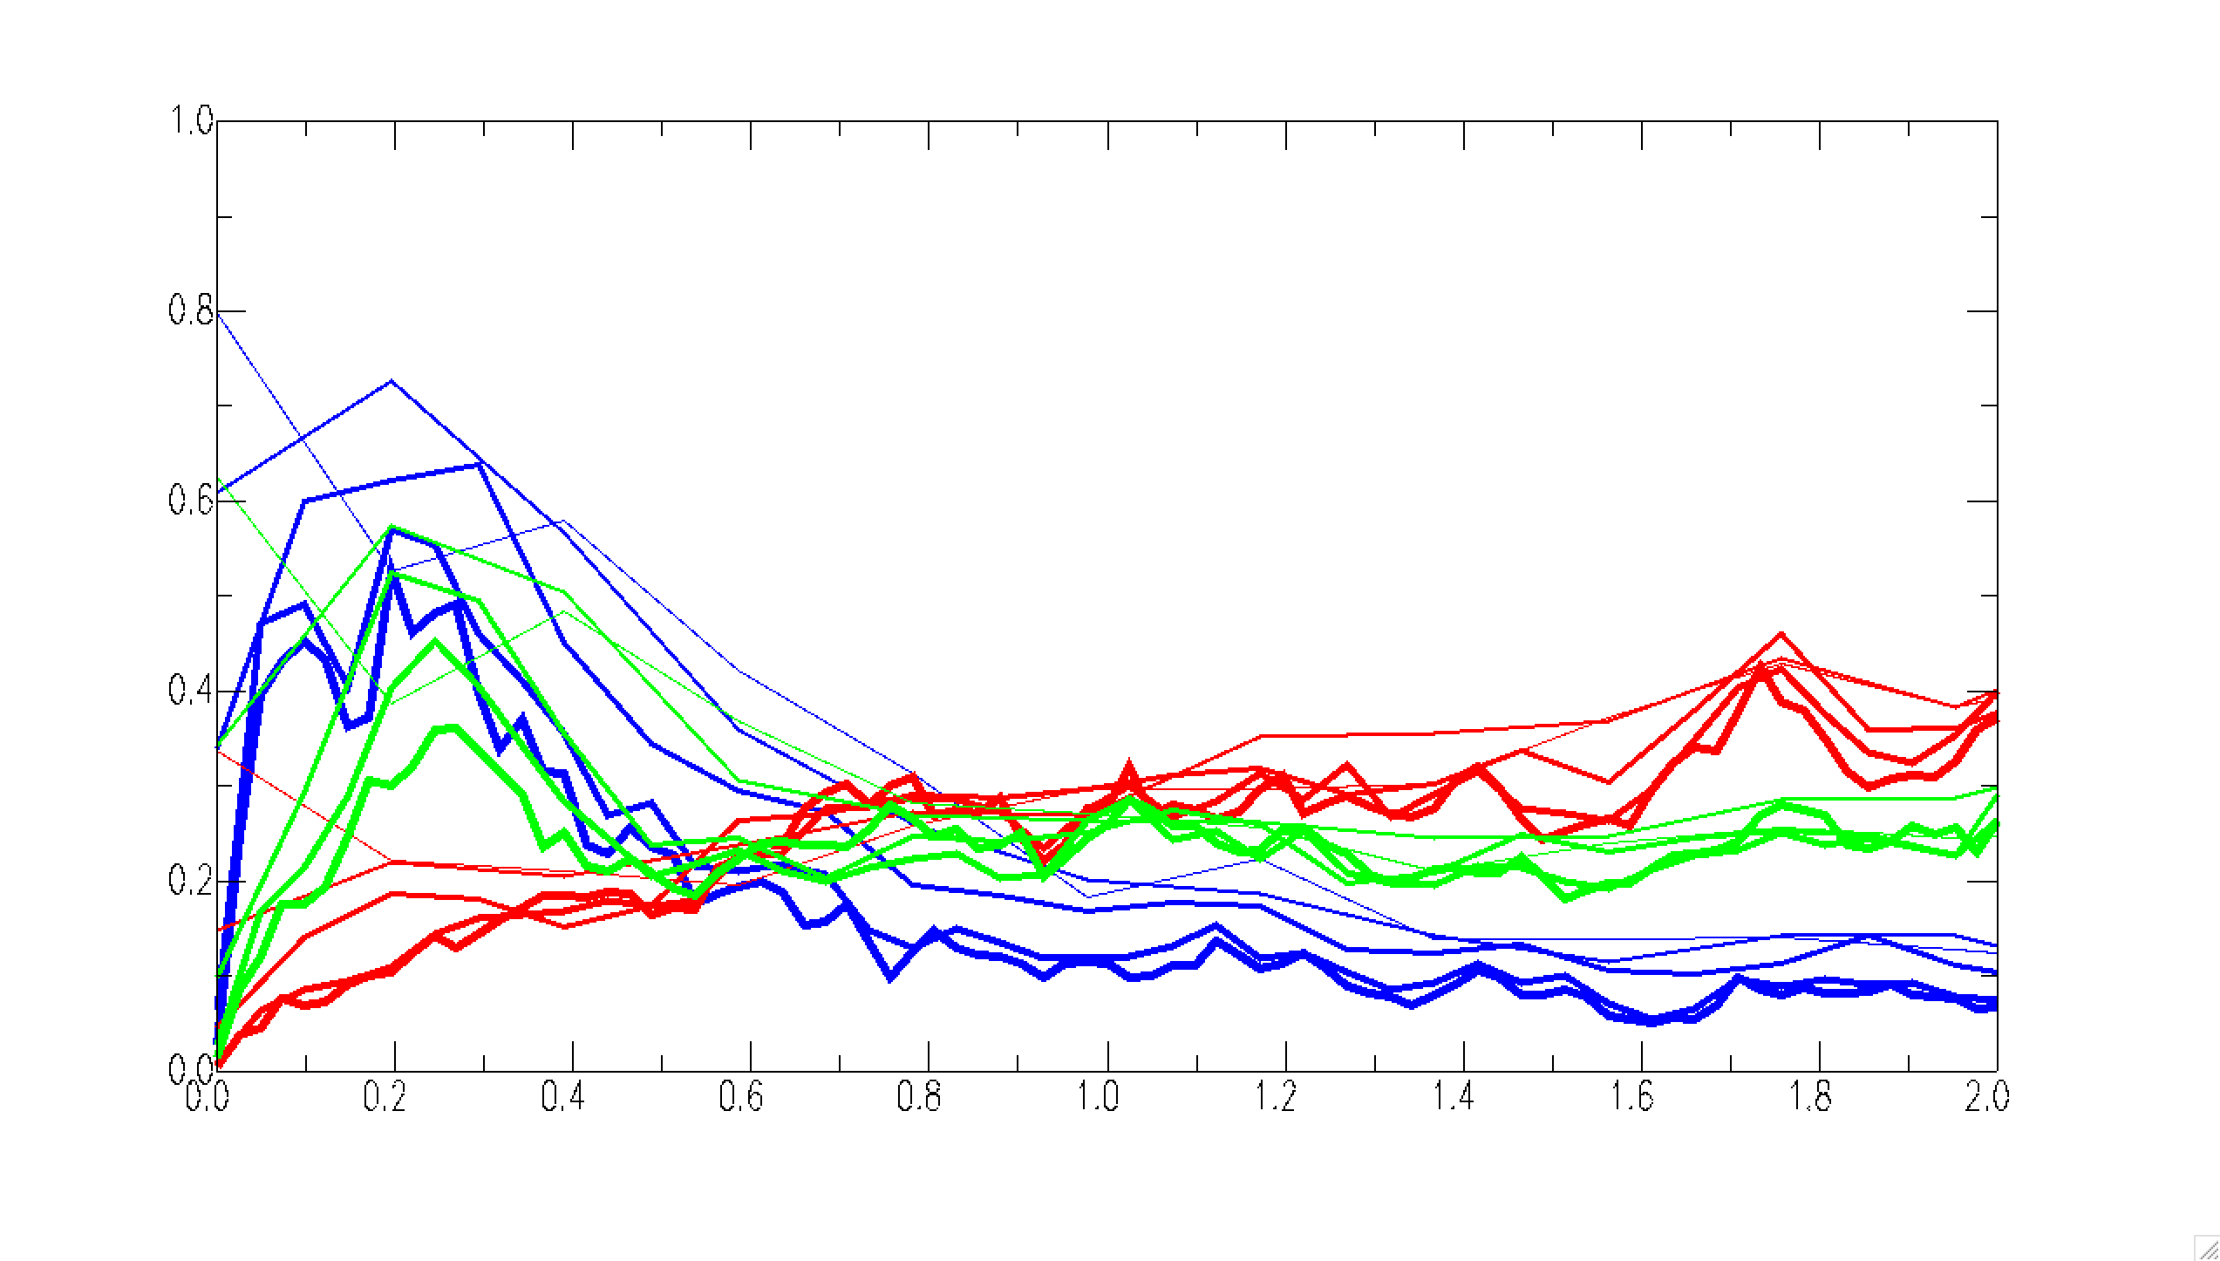
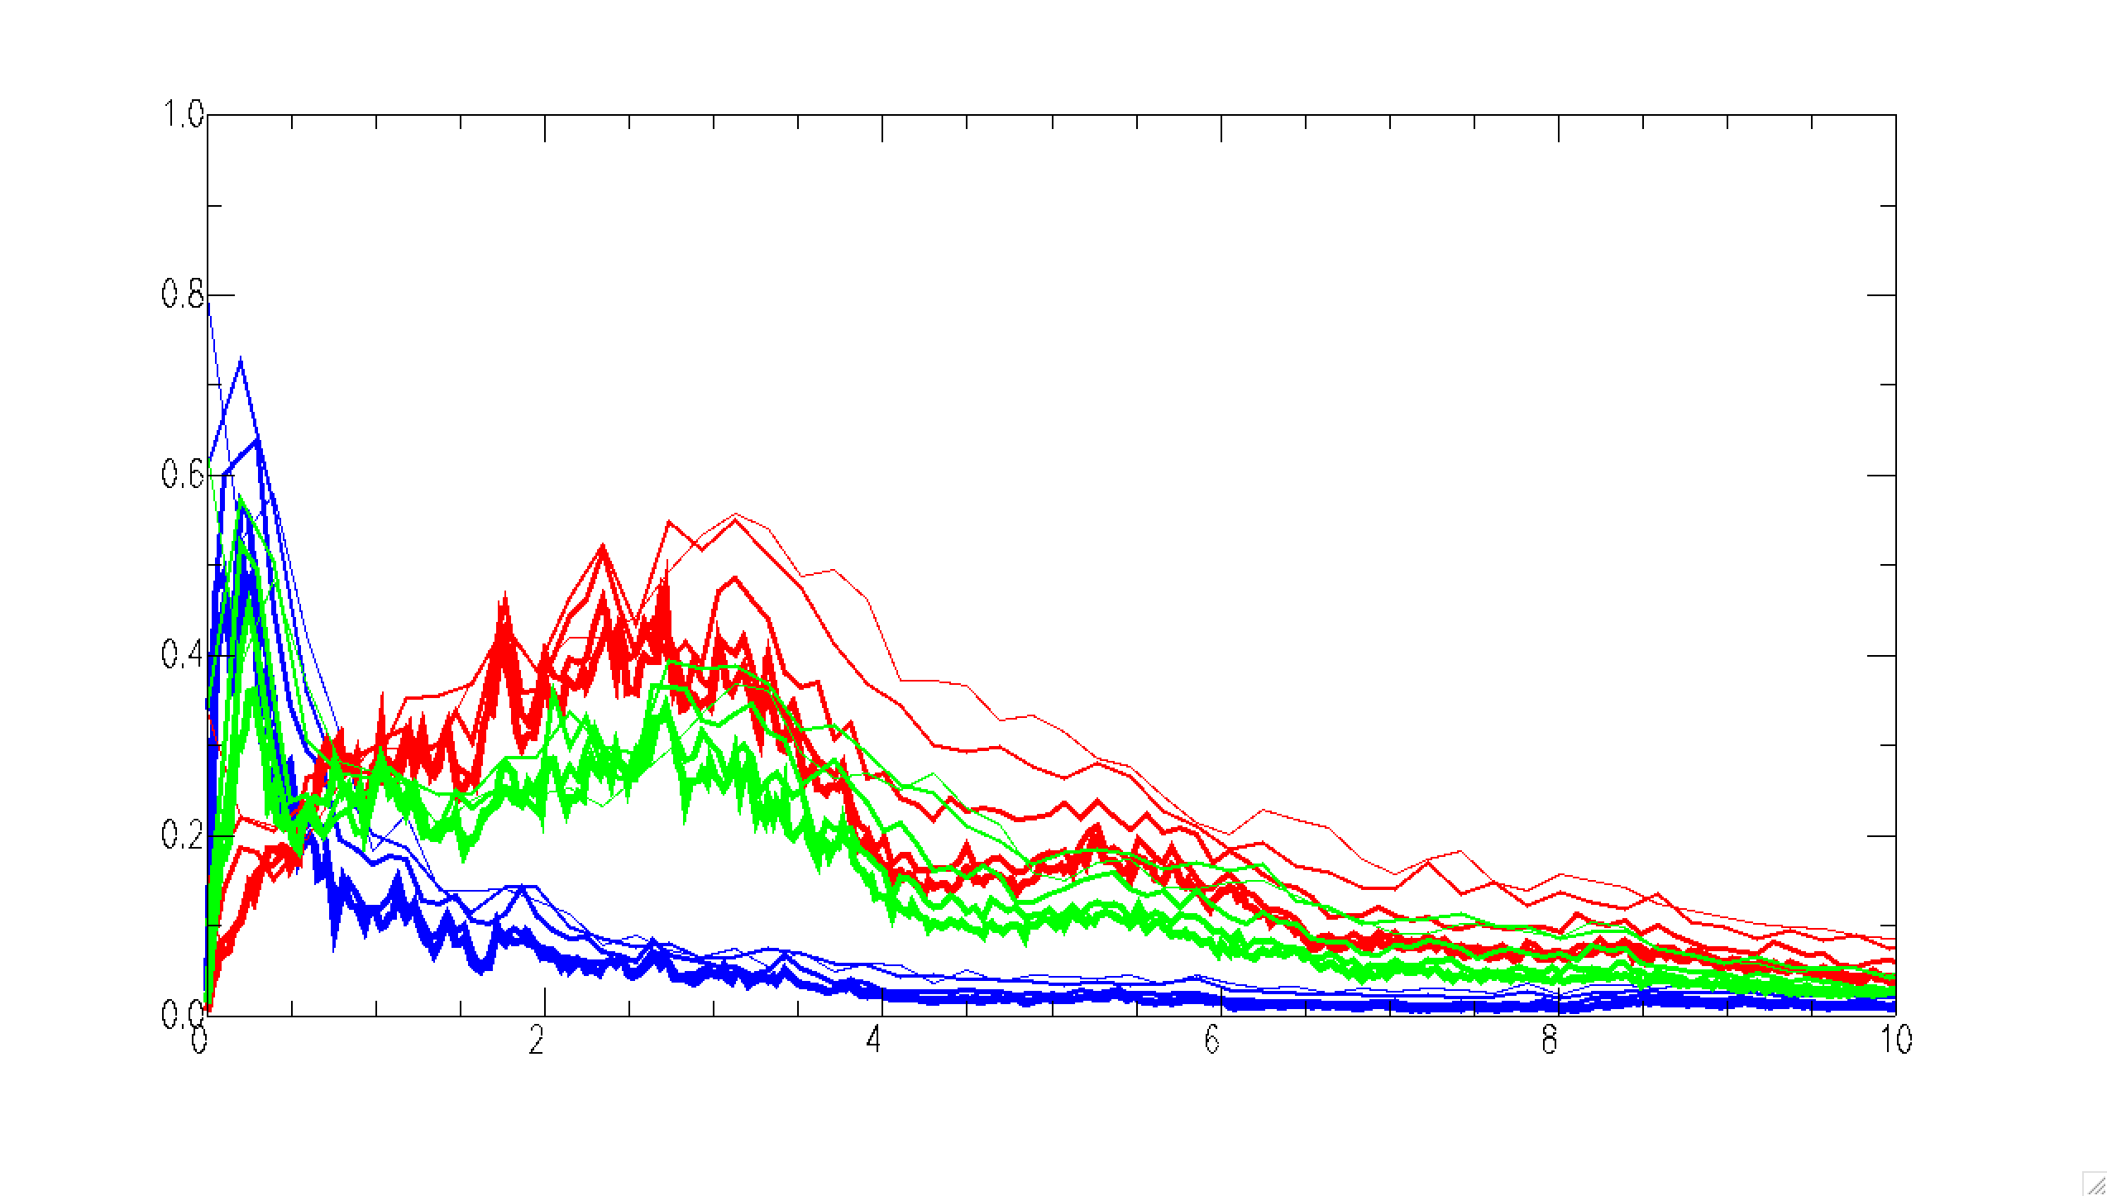
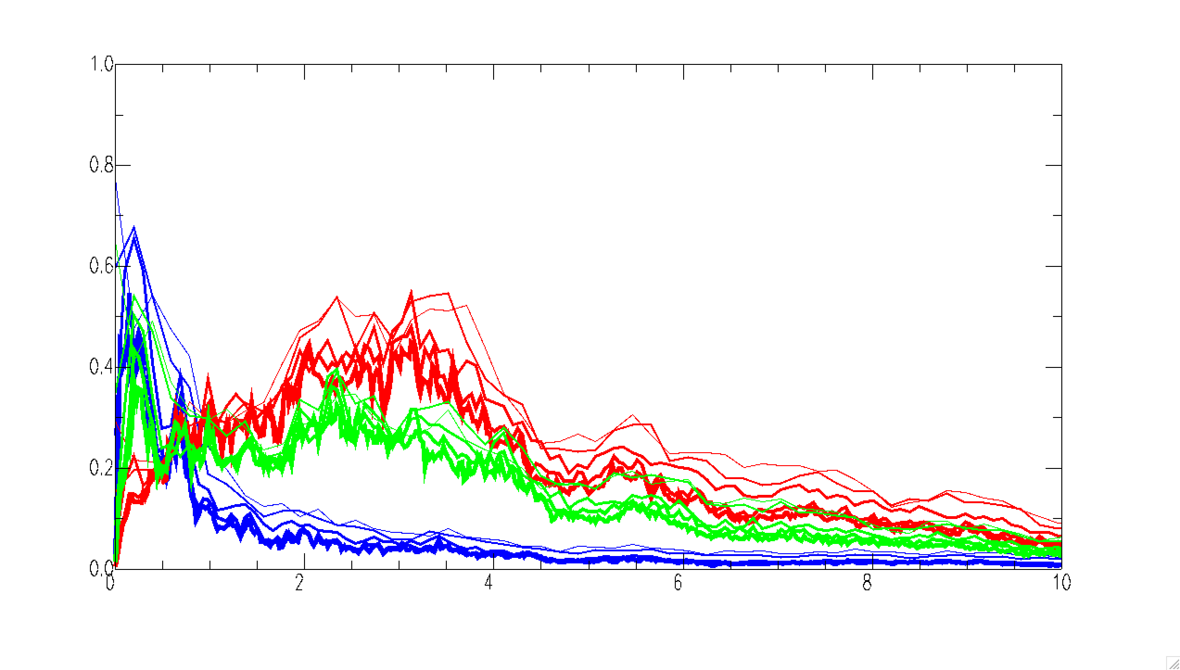
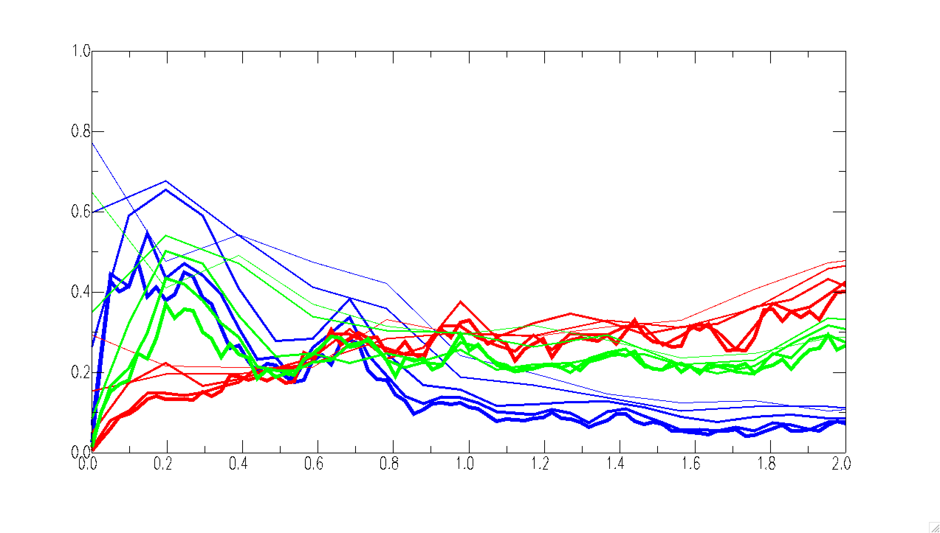
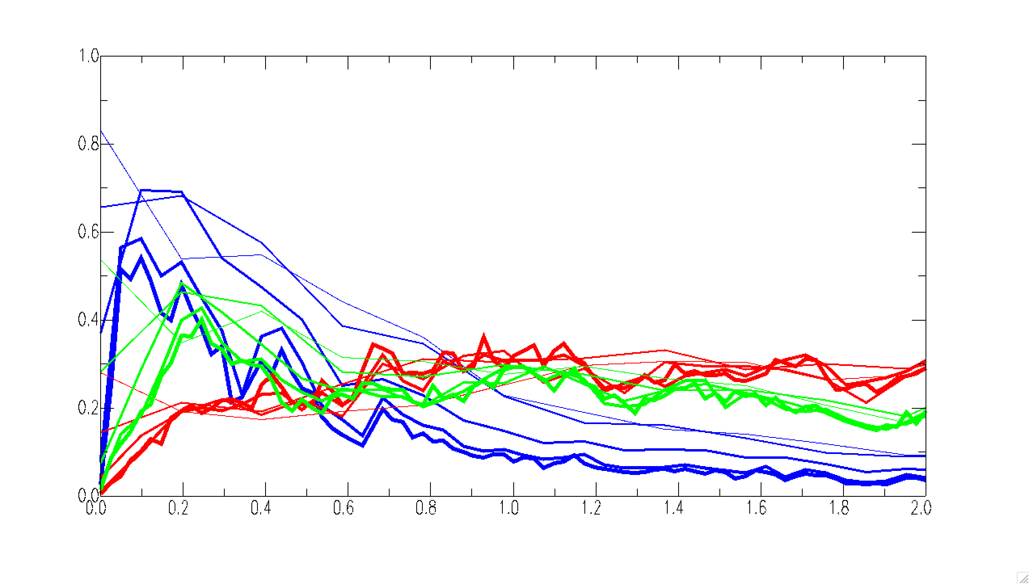
Choice of features
What features can we EXTRACT from our traces of each class?
Fast Fourier transform
Which frequency band shows the biggest difference among classes?
local
E, <50 Hz
E, <10 Hz
E, <2 Hz
amplitude
Frequency (Hz)
0.1~ 10 Hz
regional
most of energy is within 10 Hz
Higher than 0.5 Hz, local event has biggest energy, then regional, telesiesmic the smallest.
Lower than 0.5 Hz, teleseismic has biggest energy, then regional, the local events the smallest.
N, <50 Hz
N, <10 Hz
N, <2 Hz
teleseismic
Z, <50 Hz
Z, <10 Hz
Z, <2 Hz
Notes:
To find the best choice of the components and time window, we first use FFT then plot spectra for each class of seismic events, as shown by the colorful thin line here.
Thicker line is the average among all traces. When three classes of events are compared in the same plot, several more lines for each class represent different selection of time window for later discussion. Here shows only the E-W component and close-up to 10 hz and 2 hz.
What you see is …(1), (2), (3)
When you look at other two components – N-S and vertical components, as shown here, they reveal very similar pattern as E-/w component

