Slide 1
Linking increases precipitation extremes to changes in atmospheric temperature and moisture
Presentation : 2017.09.12
Supervisor : Professor Cheng-Ta, Chen
National Tsing-Hua University Hsin-Yi, Wu

Slide 2
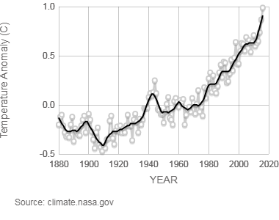
Introduction
Climate Change
Average Temperature
Average Glacier
Thickness
Ocean Heat
Average Sea Level
Greenhouse Gas
Concentration
Possible Impact
Floods
Heat Wave
Sea Level Rise
Irregular Precipitation
Source : NASA Global Climate Change Vital Signs of the Planet
(https://climate.nasa.gov/vital-signs/global-temperature/ )

Slide 3
Theory Base
Clausius–Clapeyron relation
$$\frac{de_{s}}{dT}=\frac{L_{v}(T)e_{s}}{R_{v}T^{2}}$$
where $e_{s}$ : saturation vapor pressure
$L_{v}$ : specific latent heat of evaporation of water
$R_{v}$ : gas constant of water vapor
, which gives saturation water vapor pressure increases
by about 7% for every 1 ⁰C rise in temperature.

Slide 4
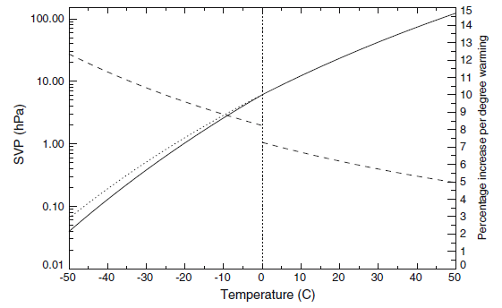
Theory Base
Clausius–Clapeyron relation
Source: Testing the Clausius-Clapeyron constraint on changes in extreme precipitation under CO2 warming, Pall et al, 2006

Slide 5
Assumptions and Arguments
Relatively constant relative humidity
water vapor capacity by C-C relation leads to
precipitable water by C-C relation
Extreme events are dominated by precipitable water in the atmosphere
ignore the conditions needed for cloud formation etc
Atmospheric circulation does not change much
as climate changes
might not be realistic as cloud dynamics can be
invigorated with warming

Slide 6
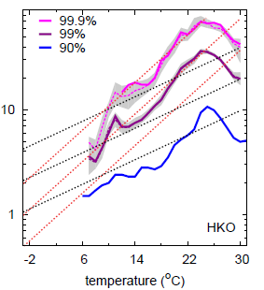
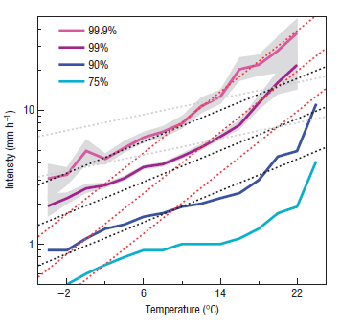
Results from Past Research
Precipitation-Temperature Plot – hourly observation
(De Bilt) (Hong Kong)
Source: Increase in hourly precipitation extremes beyond expectations from temperature changes, Lenderink et al, 2008
Source: Scaling and trends of hourly precipitation extremes in two different climate zones – Hong Kong and the Nederlands, Lenderink et al, 2011

Slide 7
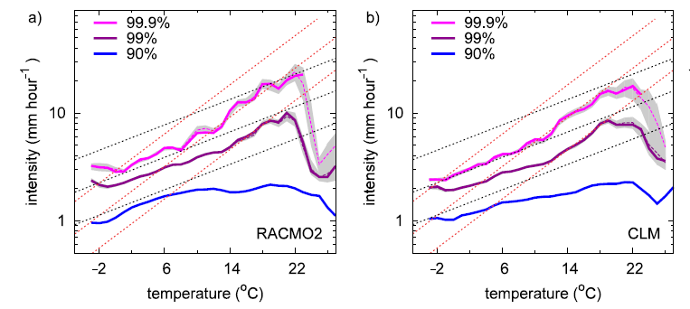
Results from Past Research
Precipitation-Temperature Plot – hourly model
(Nederland)
Source: Linking increases in hourly precipitation extremes to atmospheric temperature and moisture changes, Lenderink et al, 2010

Slide 8
Results from Past Research
Precipitation-Temperature Plot
super C-C below 24 ⁰C for Hong Kong
C-C below 12 ⁰C, double C-C above for De Bilt
double C-C from 10 ⁰C to 20 ⁰C for models (RACMO2, CLM)
Conceptually, empirical studies show C-C scaling below
12 ⁰C, super C-C between 12 ⁰C and 24 ⁰C, and negative
scaling for above 24 ⁰C
Hourly (or subdaily) precipitation extreme is far more sensitive to temperature comparing to daily ones.
Cause of super C-C scaling might come from latent heat release, atmospheric stability, enhanced cloud dynamics, etc.

Slide 9
Data Source (Model)
 | MRI | WRF_cfsr
Resolution | 20km * 20km | 5km * 5km
Frequency (data/day) | hourly, 4 | hourly, 24
Wet day criteria | > 0.1 mm/day | > 0.1 mm/hr
Data Size (time*lat*lon) | 36524*20*12 | 254208*81*60
Parameter | Temperature (2m) ) Temperature (850hpa) Temperature (500hpa) Temperature (200hpa) Precipitation Relative Humidity (2m) ) Relative Humidity (850hpa) Relative Humidity (500hpa) Relative Humidity (200hpa) Vertical Velocity (500hpa) | Temperature (2m) Precipitation Relative Humidity (2m)
Additional Parameter | Water Vapor(2m, 850hpa, 500hpa, 200hpa / 2m)
Notes:
MRI (Meteorological Research Institute of Japan): 1979.01.01-2003.12.31
WRF(Weather Research and Forecast) : 1979.01.01-2007.12.31
cfsr : climate forecast system reanalysis

Slide 10
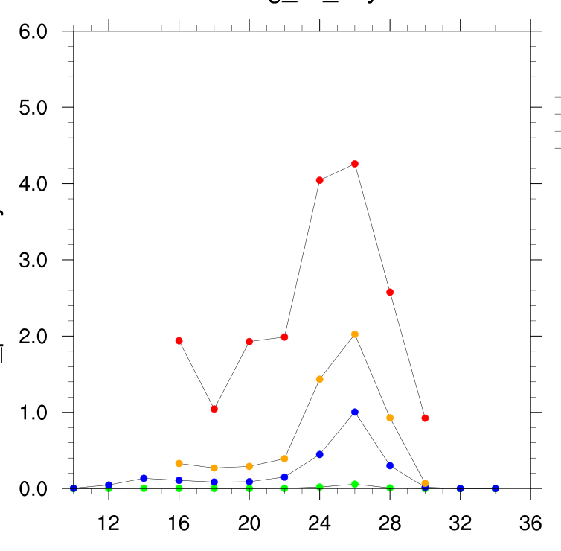
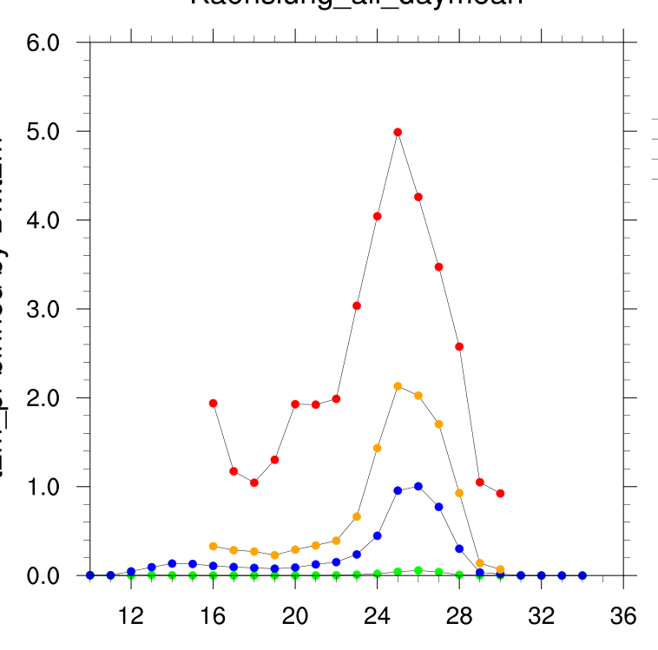
Methods
Precipitation
Bin separation
bin width = 2, bin overlap = 1, percentile : 99.9, 99, 95, 50
→ Reuse data to get a smoother curve, also avoid bias from
the choice of starting temperature.
P R

Slide 11
Methods
P R
Precipitation
Bin separation
bin width = 2, bin overlap = 1, percentile : 99.9, 99, 95, 50
→ Reuse data to get a smoother curve, also avoid bias from
the choice of starting temperature.
Bin size
thick, gray line that shows how many data exists in each bin
→ Help to see which part of the results are well sampled.
Confidence Interval (99 percentile, 99.9 percentile)
Repeat by drawing with replacement to get a 90% CI, which
act as another way to evaluate the result.
Dash Line
growth line for 7% / 14% per degree, respectively.

Slide 12
Methods
Relative Humidity
Bin separation
Bin size
Relative Humidity respective to precipitation
for specific precipitation percentile (99, 95, 90, 50) in each
bin, average the corresponding relative humidity from +/- 1
percentile of precipitation (98-100, 94-96, 89-91, 49-51)
→ Sort by precipitation instead of relative humidity, to
reflect the true relative humidity at the moment.
R H
5
2
3
8
1
4
7
…
6
e
b
c
h
a
d
g
…
f

Slide 13
Methods
Relative Humidity
Bin separation
Bin size
Relative Humidity respective to precipitation
for specific precipitation percentile (99, 95, 90, 50) in each
bin, average the corresponding relative humidity from +/- 1
percentile of precipitation (98-100, 94-96, 89-91, 49-51)
→ Sort by precipitation instead of relative humidity, to
reflect the true relative humidity at the moment.
R H
Pr Max
1
2
3
4
5
6
7
8
…
Pr min
a
b
c
d
e
f
g
h
…

Slide 14
Methods
Water Vapor
Bin separation
Bin size
Water Vapor respective to precipitation
basically the same as relative humidity, but this time taking
temperature into consideration
→ Obtaining true amount of water vapor that exists in the
air at the moment.
Dash Line
W V
$$r.h.=\frac{water vapor pressure}{saturation vapor pressure (T)}$$
by
CC-equation

Slide 15
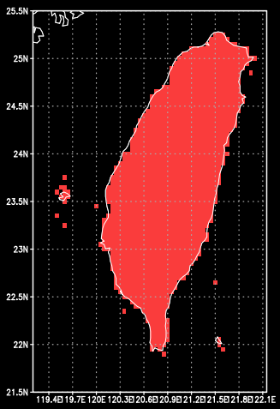
Data Selection (WRF)
Single Pooling
Yilan Number of grids : 9 taking grid Yilan and 8 grids around Yilan. Data size : 827,130 | North Number of grids : 9 taking grid Banqiao, Tamsui, Taipei, Keelung, Xinwu, Suao, Yilan, Hsinchu, Chupei Data size : 530,959
Kaohsiung Number of grids : 9 taking grid Kaohsiung and 8 grids around Kaohsiung. Data size : 201,672 | South Number of grids : 6 taking grid Tainan, Yongkang, Kaohsiung, Chiayi, Hengchun, Chiku Data size : 142,350
Notes:
convective v.s. convective and stratiform

Slide 16
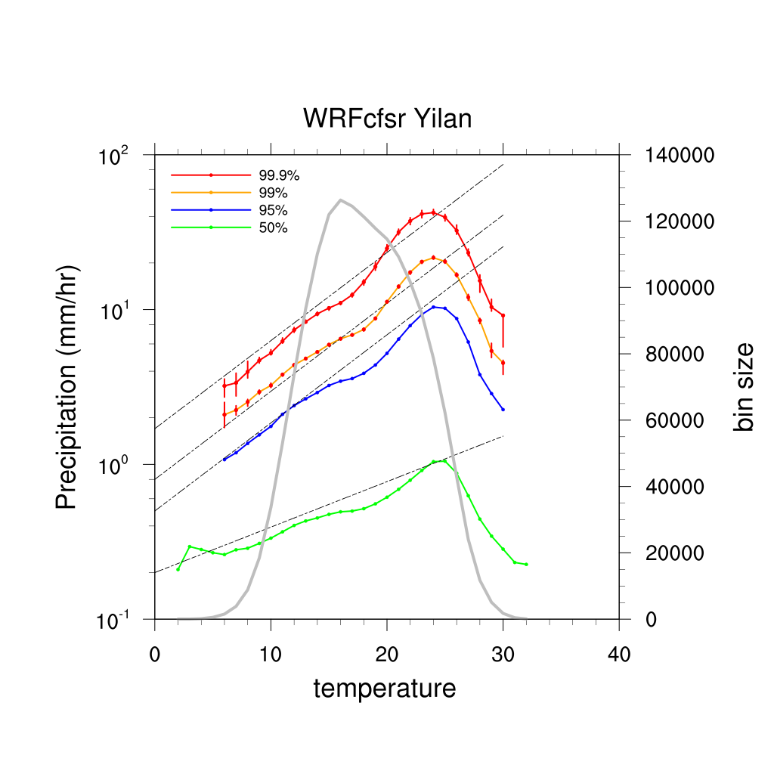
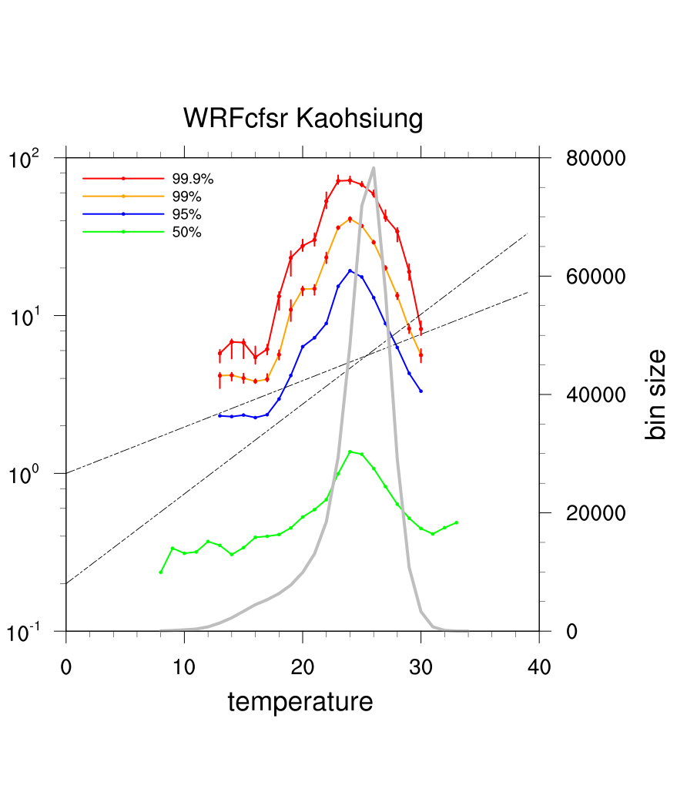
P R
Result-WRF
Double C-C relation
Super double C-C relation
Slightly different turning point for different percentile

Slide 17
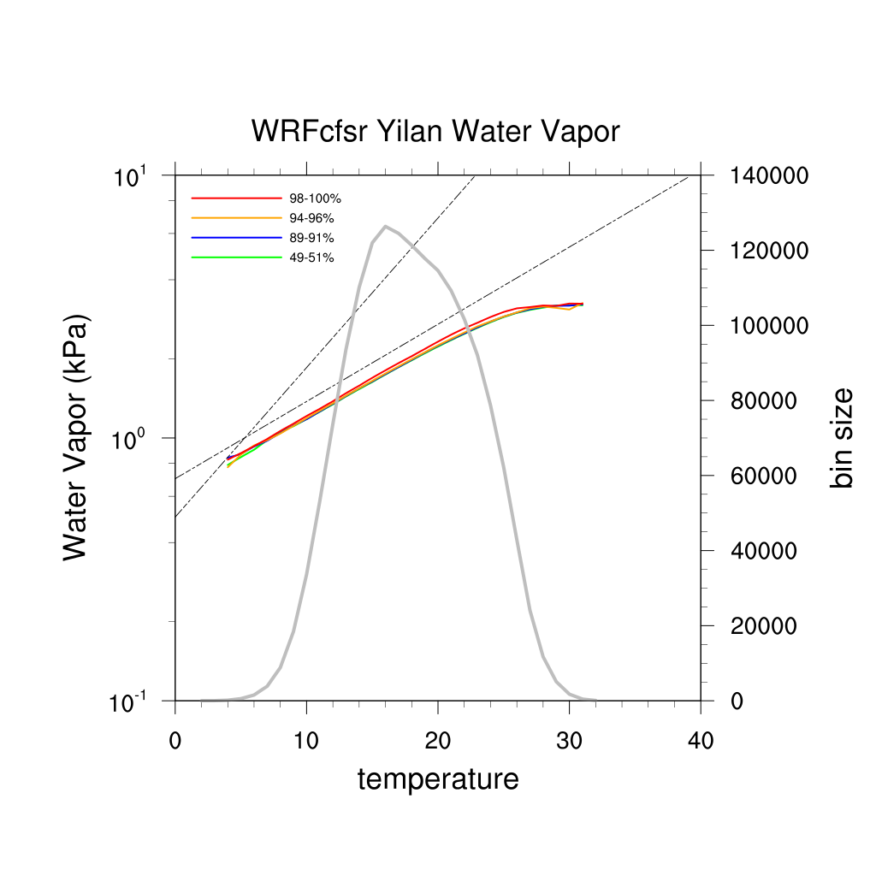
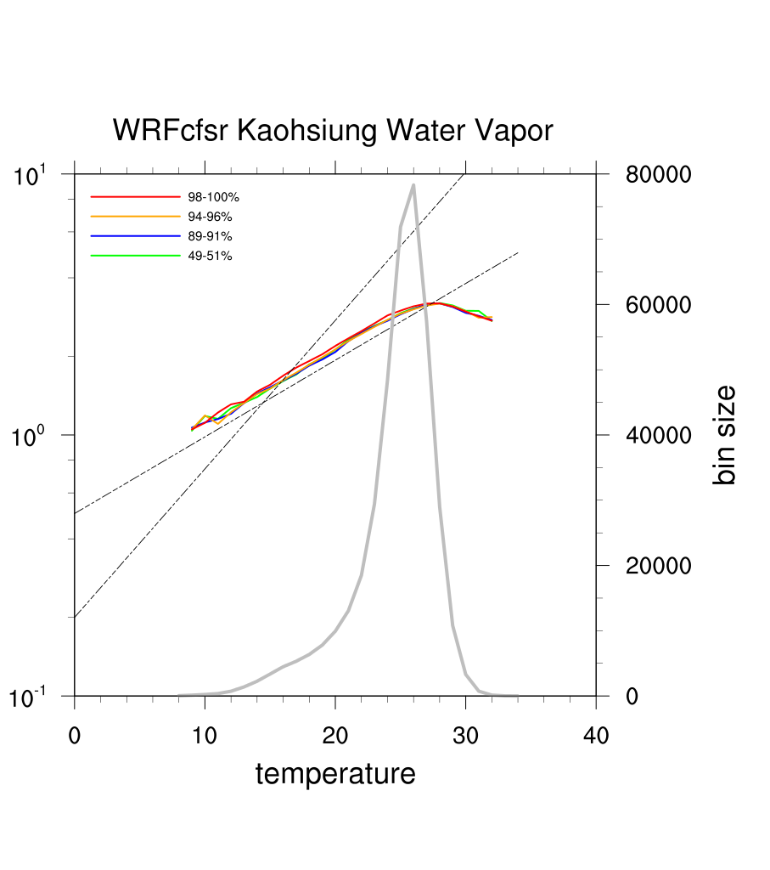
W V
Result-WRF
Water Vapor generally follows C-C relation
There are almost no difference in water vapor between
high and low percentile

Slide 18
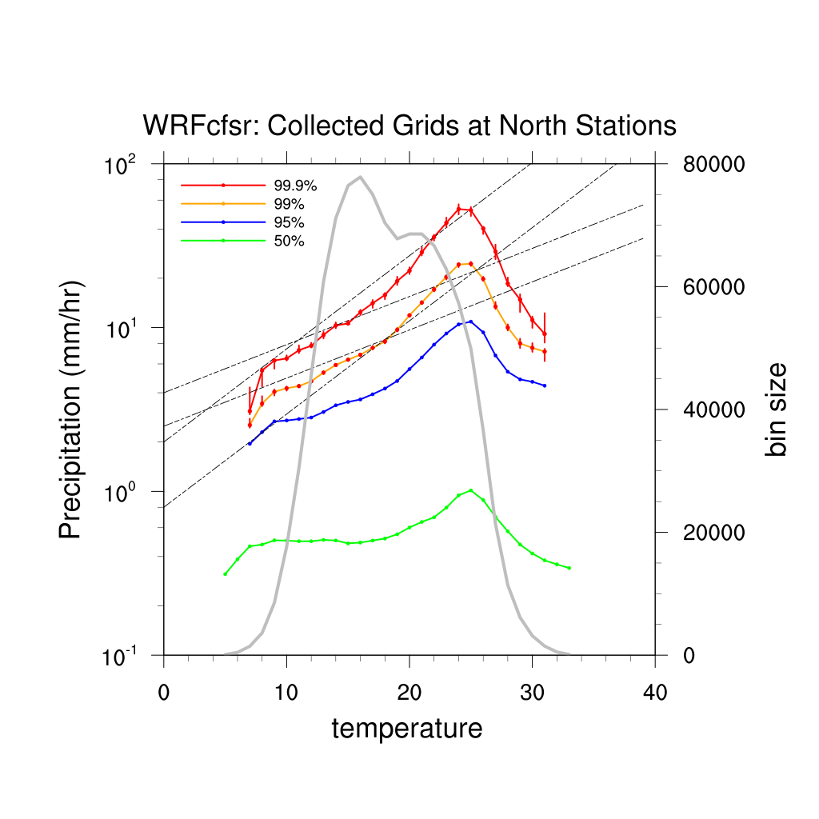
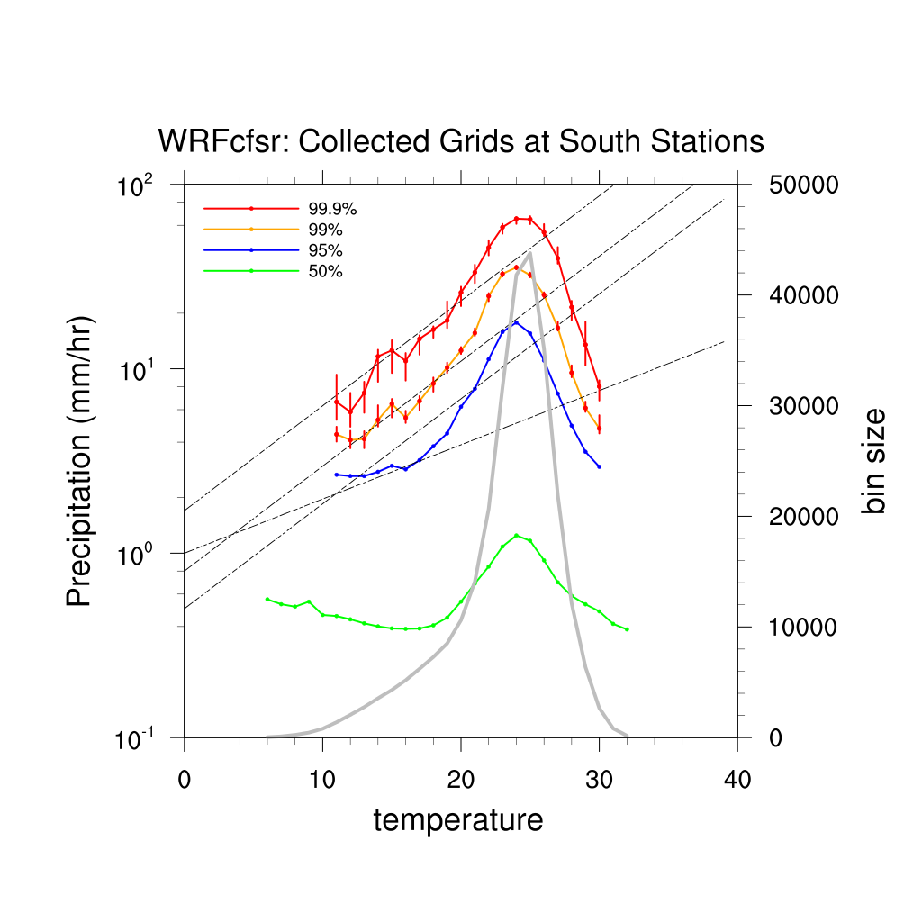
P R
Result-WRF
Turning points appear at 16-19 ⁰C
Precipitation starts to drop at about 24 ⁰C in all cases
Larger difference in performance between mean and extreme

Slide 19
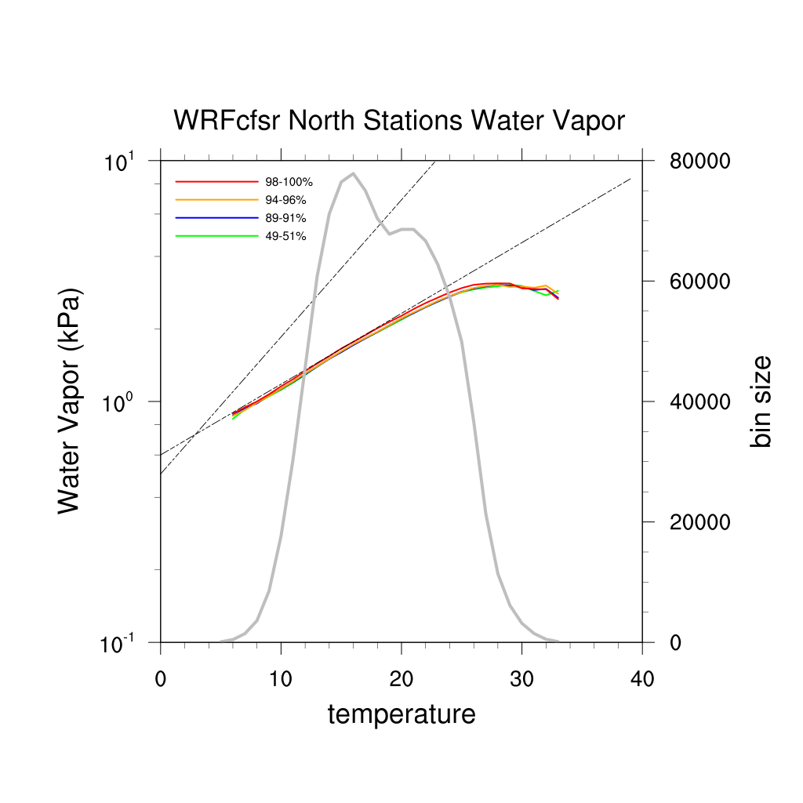
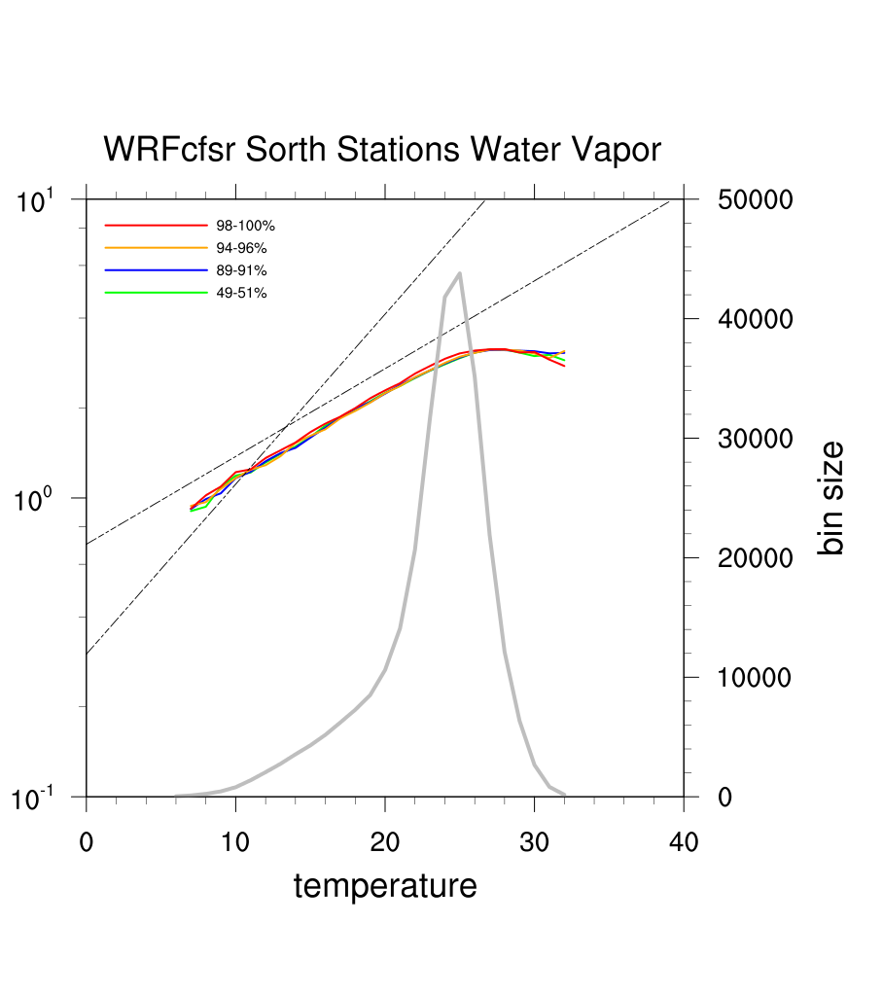
W V
Result-WRF
Water Vapor follows C-C relation up to 26-28 ⁰C
Performance of water vapor are almost the same regardless
of different area and different percentile of precipitation

Slide 20
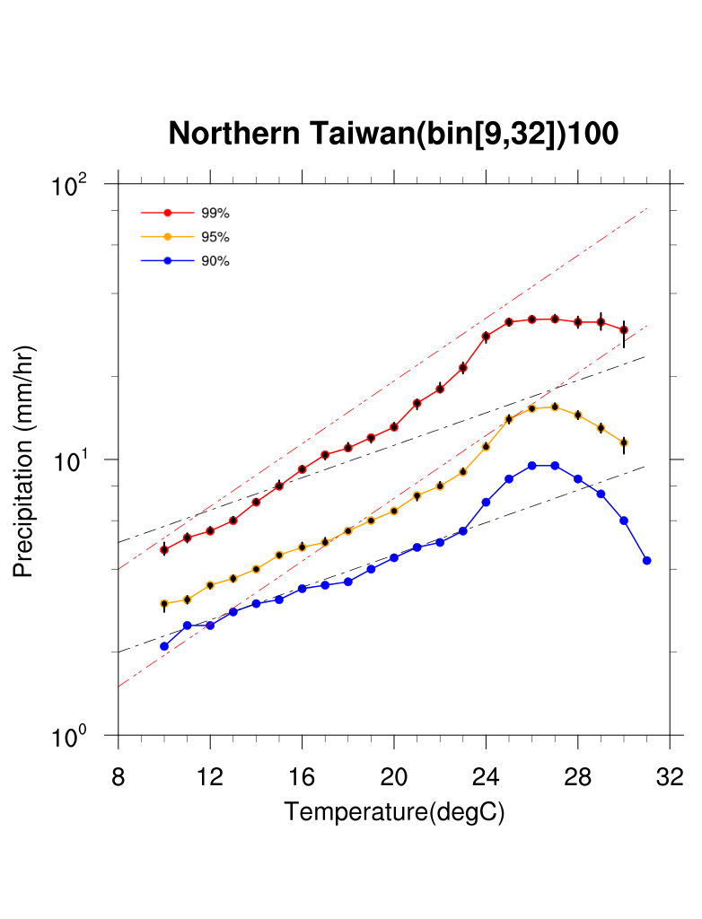
P R
Comparison
Adjust to make the scale of model and observation correspond
Note the different percentile

Slide 21
P R
Comparison
Precipitation and turning temperature underestimated
Somewhat reproduce the relation between temperature and precipitation

Slide 22
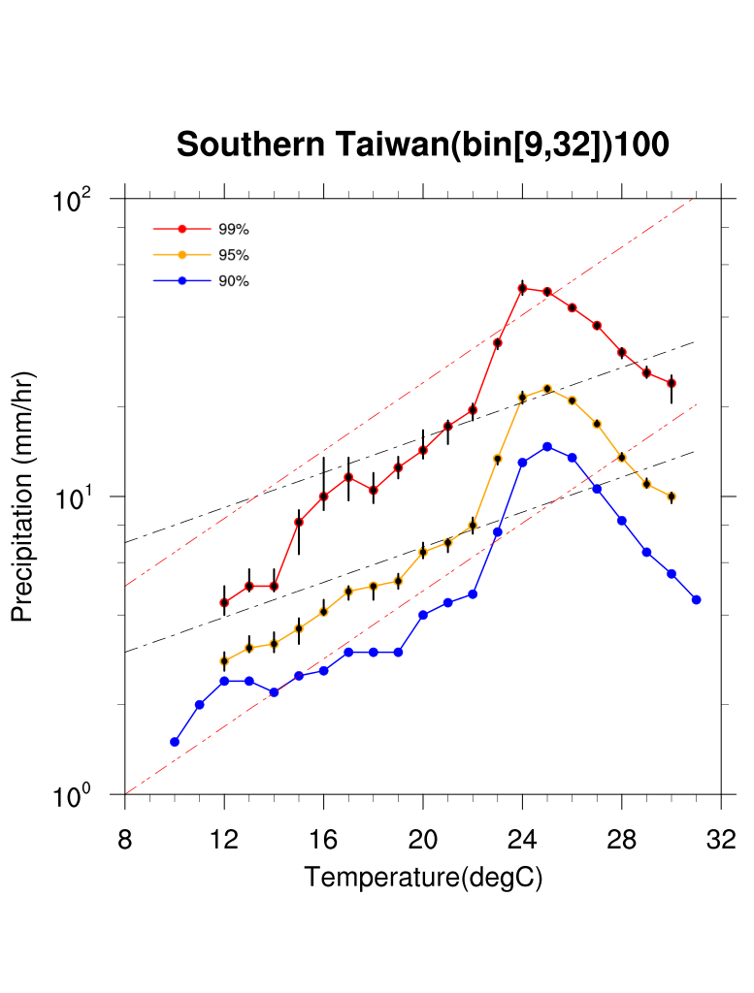
P R
Comparison
For stations in the south :

Slide 23
P R
Comparison
Precipitation underestimated
Down-turning point is a lot clearer, so is the delay for lower percentile results

Slide 24
Result-WRF
WRF_cfsr can reproduce the relation between observed precipitation and temperature to a certain extent
North : C-C → double C-C, South : super C-C
The negative scaling found in tropic area is robust
Why is the trend in water vapor so much different from that of precipitation?
super C-C
negative scaling
→ discussion from the point of dynamics /
cloud microphysics needed

Slide 25
Assumptions and Arguments
Relatively constant relative humidity
water vapor capacity by C-C relation leads to
precipitable water by C-C relation
Extreme events are dominated by precipitable water in the atmosphere
ignore the conditions needed for cloud formation etc
Atmospheric circulation does not change much
as climate changes
might not be realistic as cloud dynamics can be
invigorated with warming

Slide 26
Result-WRF
WRF_cfsr can reproduce the relation between observed precipitation and temperature to a certain extent
North : C-C → double C-C, South : super C-C
The negative scaling found in tropic area is robust
Why is the trend in water vapor so much different from that of precipitation?
super C-C
negative scaling
→ discussion from the point of dynamics /
cloud microphysics needed

Slide 27
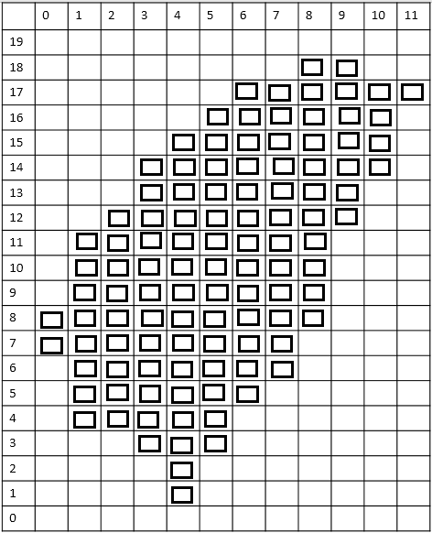
Data Selection (MRI)
Grid : 108
Total data : 3,944,592
Wet data : 1,560,881
To start from, we separate data by vertical velocity, and consider wet events with temperature > 10 ⁰C only.
 | % wet, > 10 ⁰C | % wet | % all
velocity < -6 | 1.76% | 2.44% | 1.15%
velocity < -1 | 19.03% | 19.97% | 10.09%
All velocity | 100% | 100% | 100%
velocity > 1 | 31.12% | 33.17% | 18.05%
velocity > 6 | 5.90% | 7.38% | 3.53%

Slide 28
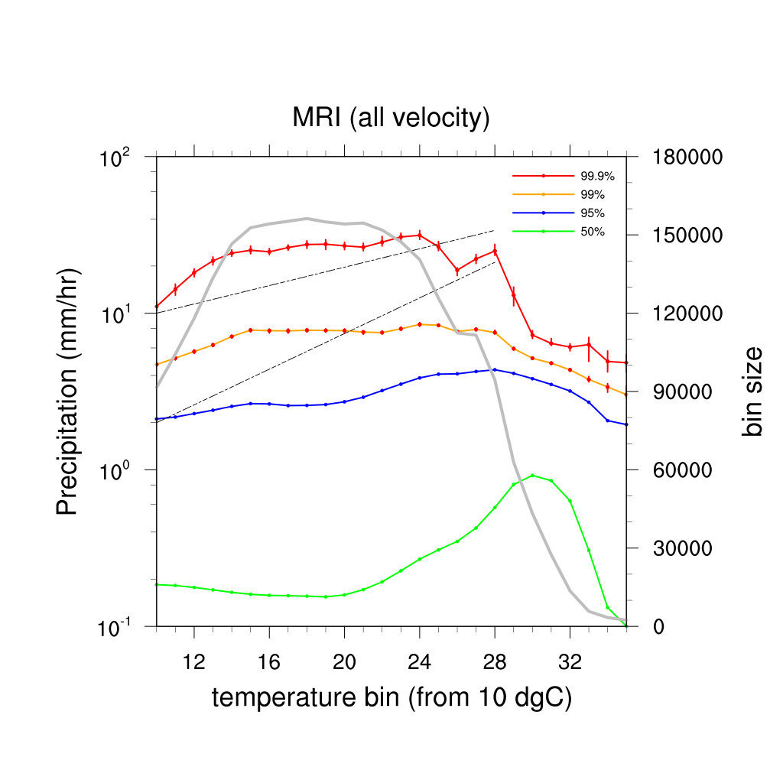
P R
Result-MRI
Velocity > 6
Velocity > 1
all
Velocity < -1
Velocity < -6
(from 10 deg C)

Slide 29
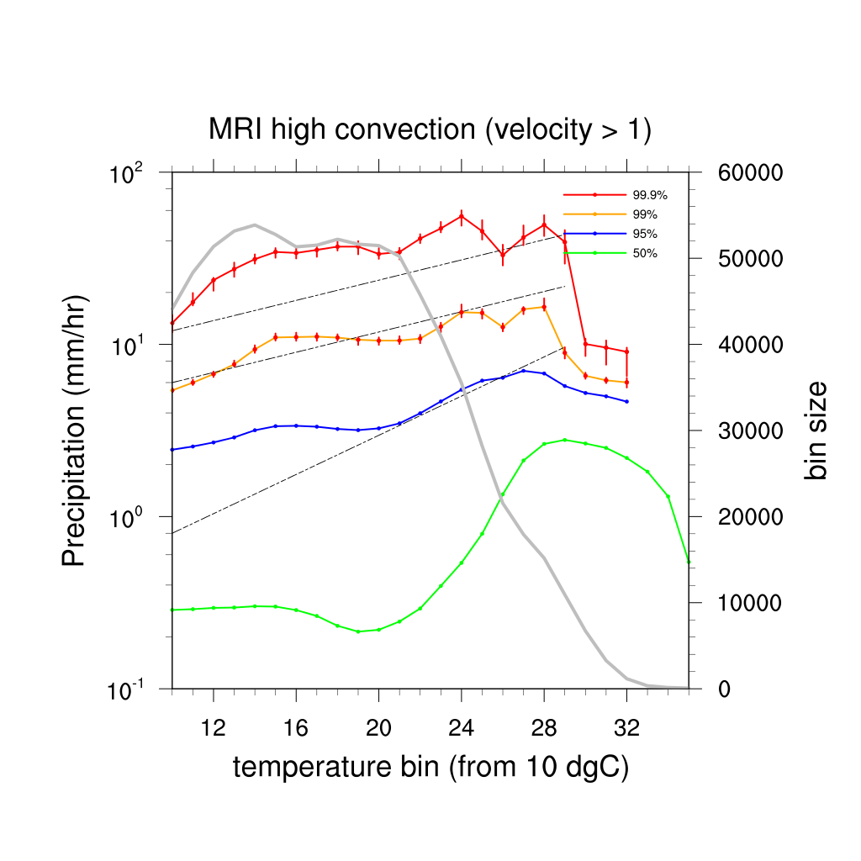
P R
Result-MRI
Velocity > 6
Velocity > 1
all
Velocity < -1
Velocity < -6
(from 10 deg C)

Slide 30
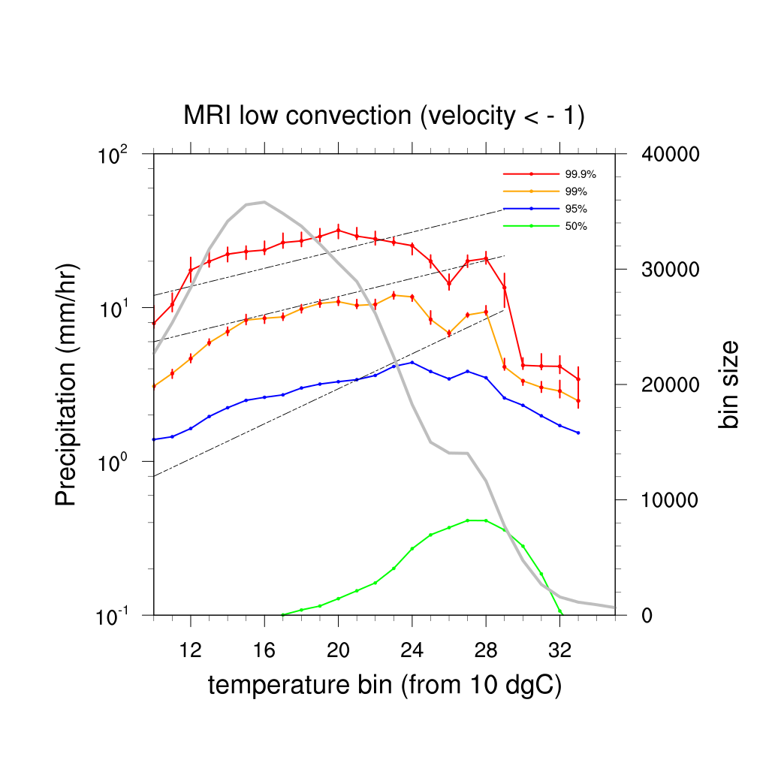
P R
Result-MRI
Velocity > 6
Velocity > 1
all
Velocity < -1
Velocity < -6
(from 10 deg C)

Slide 31
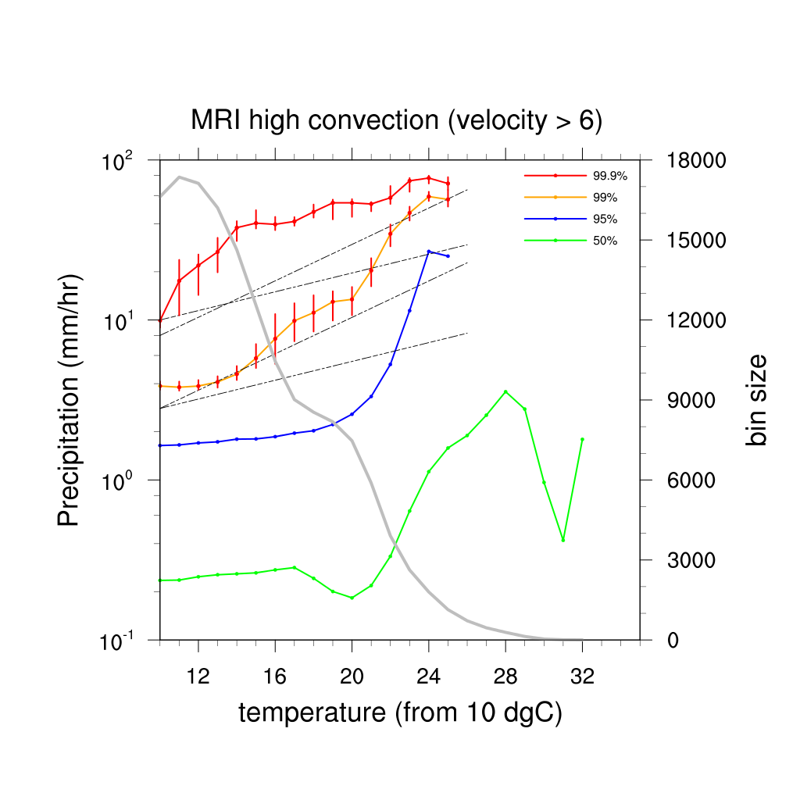
P R
Result-MRI
Velocity > 6
Velocity > 1
all
Velocity < -1
Velocity < -6
(from 10 deg C)

Slide 32
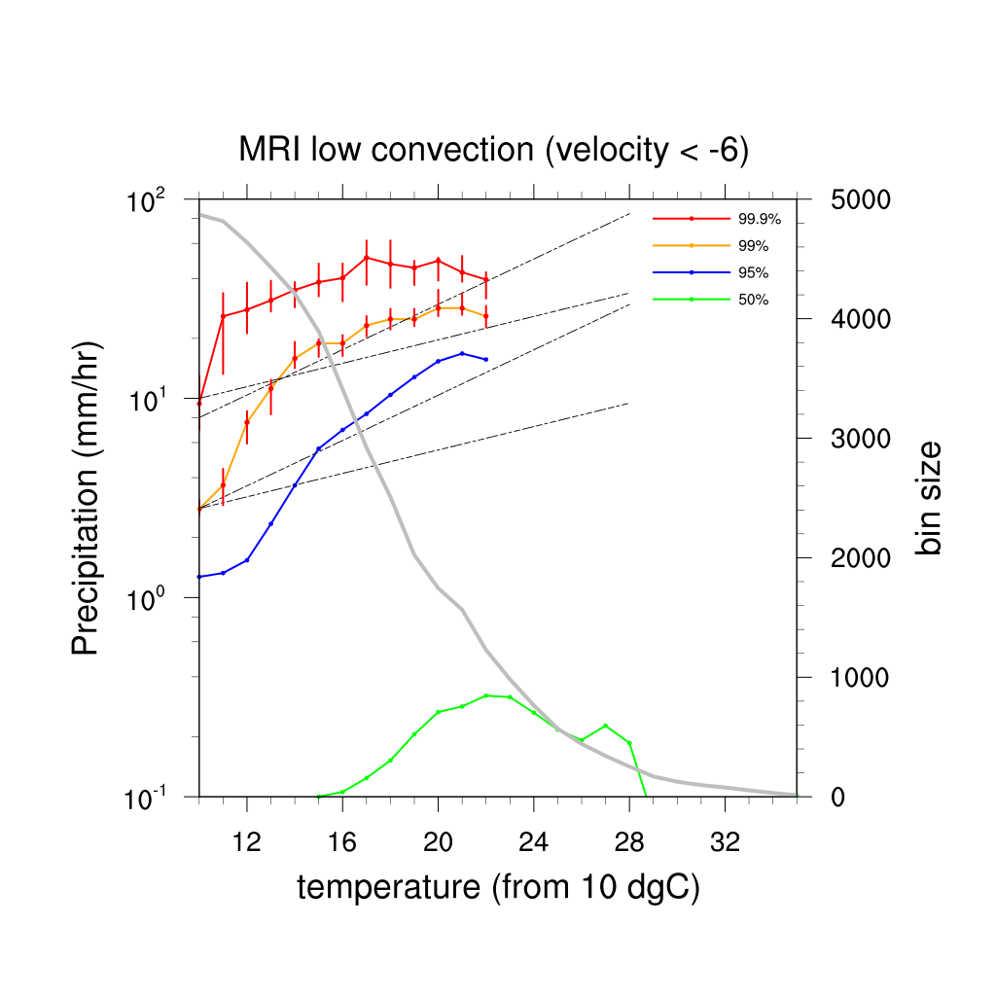
P R
Result-MRI
Velocity > 6
Velocity > 1
all
Velocity < -1
Velocity < -6
(from 10 deg C)

Slide 33
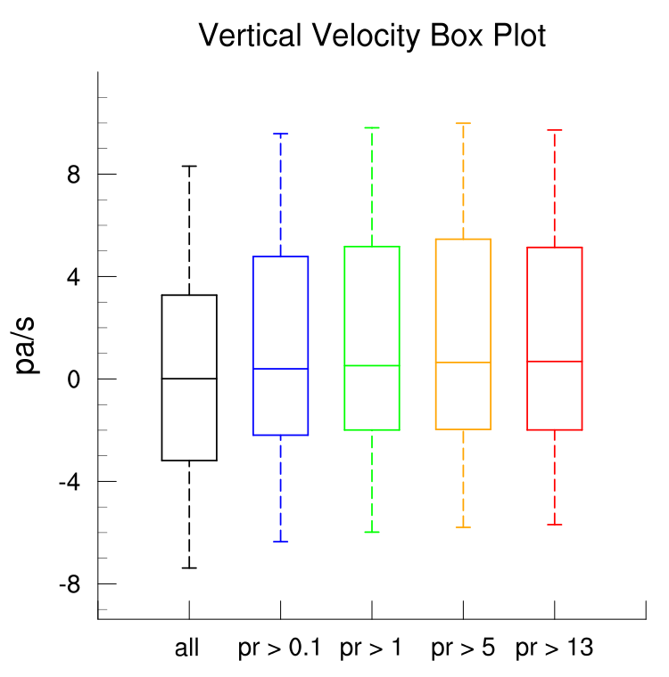
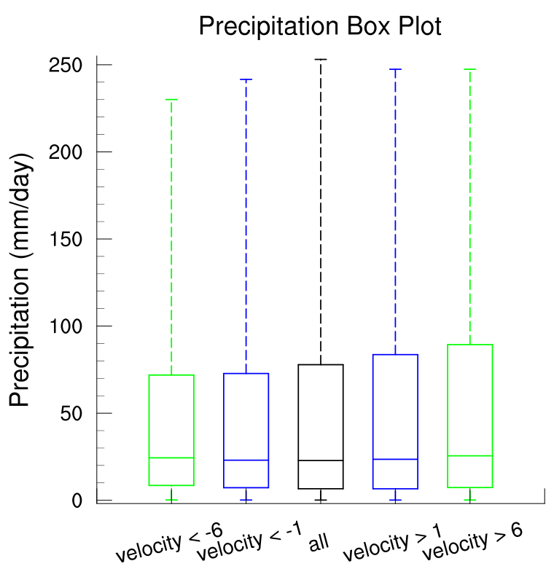
Result-MRI
Vertical velocity can not be used to separate different types of precipitation.
Precipitation grows linearly in general, exponentially when the absolute value of vertical velocity is greater than 6 (-Pa/s)
99.9 p
99 p
-Pa/s
95 p
mean
5 p
99 p
1 p
95 p
90 p
75 p

Slide 34
Result-MRI
MRI might not be suitable for analysis of this form
Resolution ( 20km * 20km )
Vertical velocity at 500 hPa ( 6000m )
Precipitation underestimate
→ Turn to results of different layers :
Check the performance of water vapor and
relative humidity at different layer.
*Results from 200 hPa are excluded.
Notes:
-60~-50

Slide 35
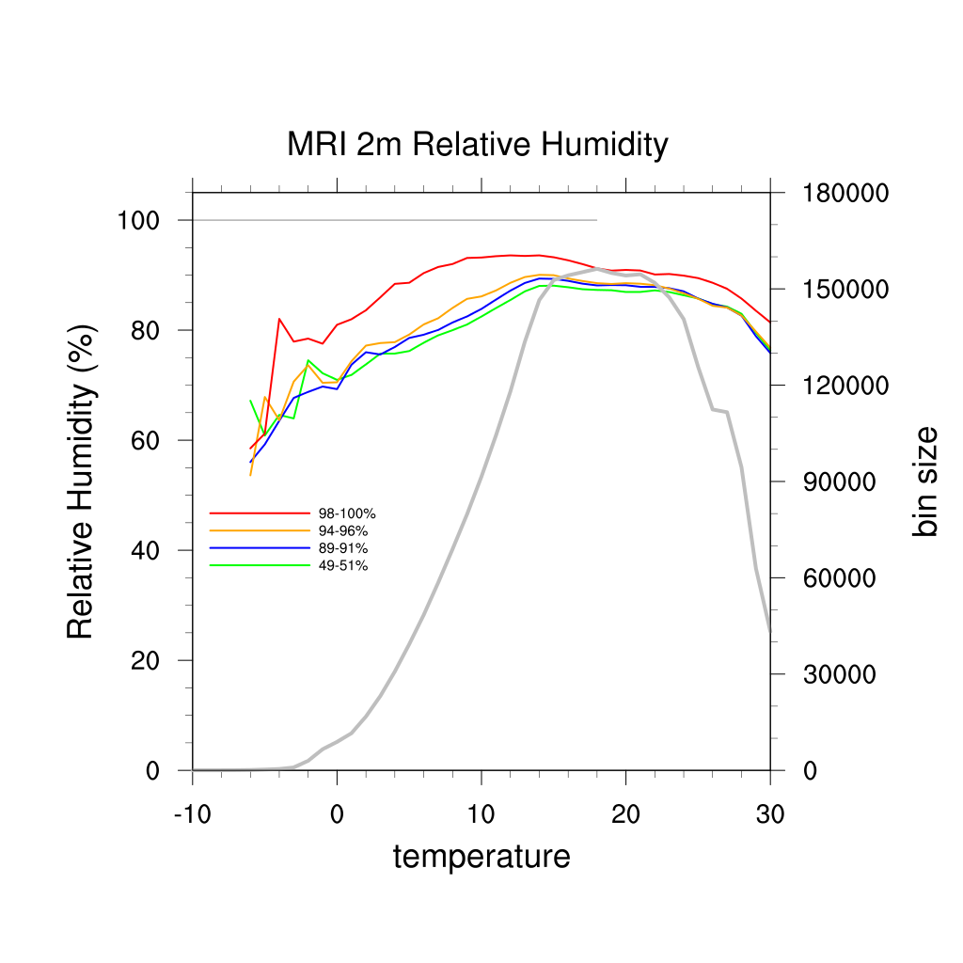
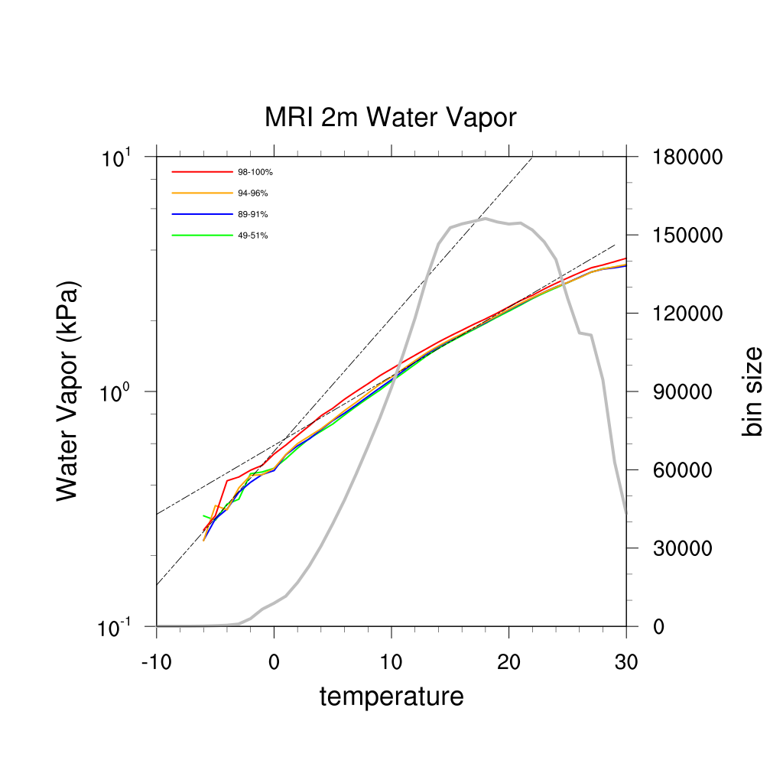
R H
W V
Result-MRI
500 hPa
850 hPa
2m

Slide 36
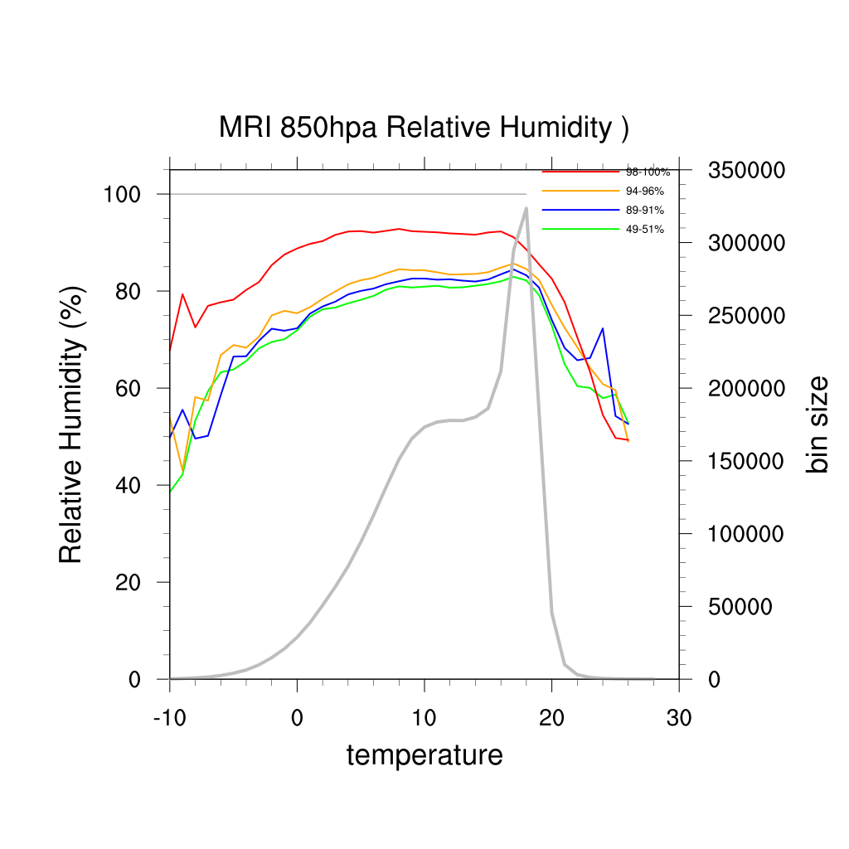
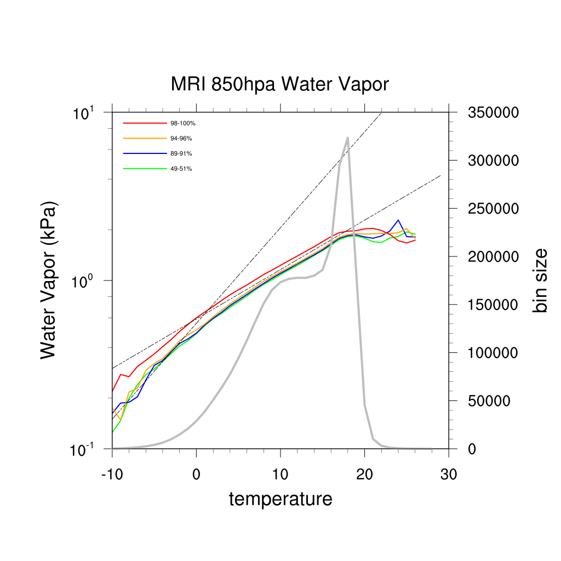
R H
W V
Result-MRI
500 hPa
850 hPa
2m

Slide 37
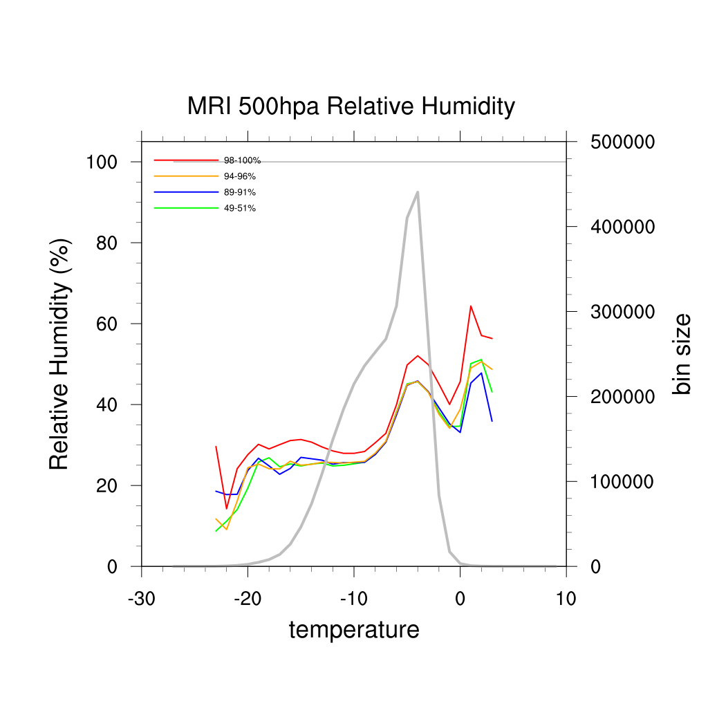
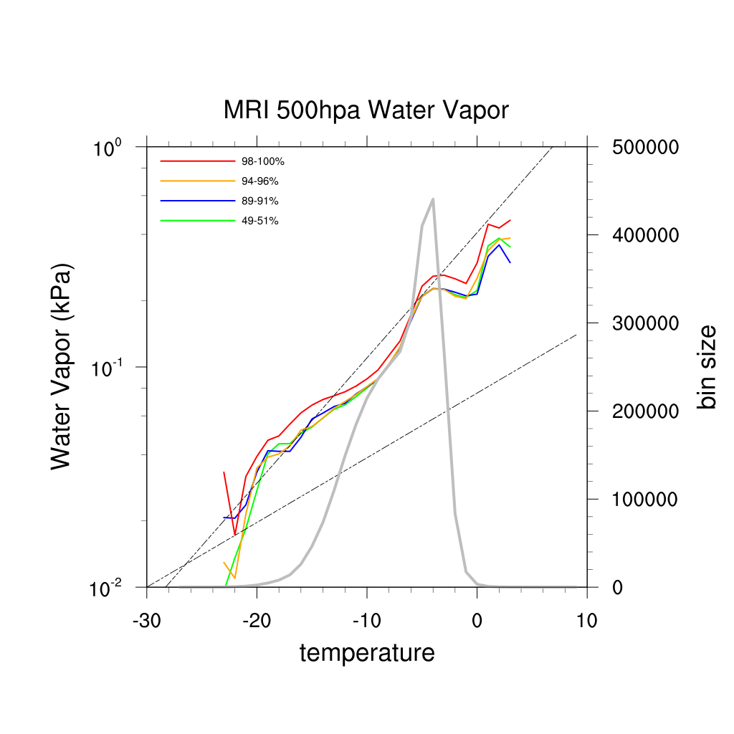
R H
W V
Result-MRI
500 hPa
850 hPa
2m

Slide 38
Result-MRI
For 2m layer and 850 hPa layer :
relative humidity remains constant
water vapor follows C-C scaling
For 500 hPa layer :
relative humidity doesn’t remain constant
water vapor depends more on relative humidity
water vapor follows double C-C scaling

Slide 39
Result-MRI
For 2m layer and 850 hPa layer :
relative humidity remains constant
water vapor follows C-C scaling
For 500 hPa layer :
relative humidity doesn’t remain constant
water vapor depends more on relative humidity
water vapor follows double C-C scaling
Can this be one of the reason for
the super C-C scaling in precipitation ?

Slide 40
W V
Result-MRI
Once again,
adjust to make the scale of model and observation correspond.

Slide 41
W V
Result-MRI
Temperature : -10 ⁰C ~ 10 ⁰C
Water Vapor : 0.1 kPa ~ 1 kPa

Slide 42
Conclusion and Future Work
In WRF, the turning point happens at 16-19 ⁰C (compared to 12-14 ⁰C at mid-latitude area), and the down turning point at 24 ⁰C (same as past results).
Only near surface relative humidity remains constant.
Both results point to research focusing more on dynamic meteorology and complete process of precipitation.
Separating different types of precipitation
Dynamical and cloud physical discussion
Model evaluation → prediction by model results

Slide 43
Reference
Reviews of Geophysics : Future changes to the intensity and frequency of short-duration extreme rainfall, S. Westra et al, 2014
Scaling and trends of hourly precipitation extremes in two different climate zones – Hong Kong and the Nederlands, G. Lenderink et al, 2011
Linking increases in hourly precipitation extremes to atmospheric temperature and moisture changes, Geert Lenderink and Erik van Meijgaard, 2010
Increase in hourly precipitation extremes beyond expectations from temperature changes, Geert Lenderink and Erik van Meijgaard, 2008
Testing the Clausius-Clapeyron constraint on changes in extreme precipitation under CO2 warming, P. Pall et al, 2006
NASA Global Climate Change Vital Signs of the Planet (https://climate.nasa.gov/vital-signs/global-temperature/)
The Scientific Basis for Anthropogenic Climate Change (https://chriscolose.wordpress.com/2007/12/18/the-scientific-basis-for-anthropogenic-climate-change/)

