Slide 1
Linking increases precipitation extremes
to changes in atmospheric temperature and moisture
分析大氣溫度與濕度變化對於極端降雨增加的影響
Chien-En, Hsu (徐健恩)
Dept. of Earth Sciences,
National Taiwan Normal University
Supervisor: Prof. Cheng-Ta, Chen(陳正達教授)

Slide 2
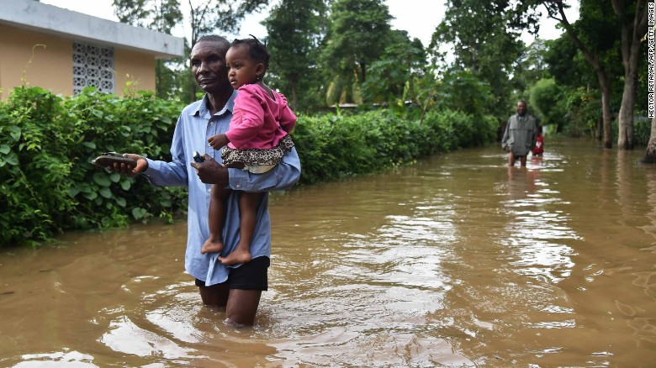
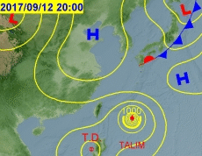
Introduction
Hurricane Irma tears through Caribbean on 9/8
(Source: CNN)
It is generally conceived that the intensity of precipitation extremes will increase as the climate warms (IPCC, 2007)
Warmer atmosphere can hold more moisture(saturated vapor pressure)
Governed by the “Clausius Clapeyron equation”(hereafter C-C eqation)
→ Approximately “7%” per degree temperature rise
$$\frac{1}{e_{s}}\frac{de_{s}}{dT}=\frac{l_{v}}{R_{v}T^{2}}$$
$$ln\frac{e_{s}}{6.11}=\frac{l_{v}}{R_{v}}\left(\frac{1}{273}−\frac{1}{T}\right)$$
(Source: CWB)

Slide 3
Introduction
The notion that the C-C relation in extreme precipitation is based on following arguments: (Lenderink et al. ,2008)
1. If the relative humidity as climate changes approximately the same,
the amount of water vapor in the atmosphere will increase at the
similar rate(7%) ̶ which is generally excepted based on model results
2. If the nature of the atmospheric circulation, with mainly the upward
motions producing precipitation, does not change considerably

Slide 4
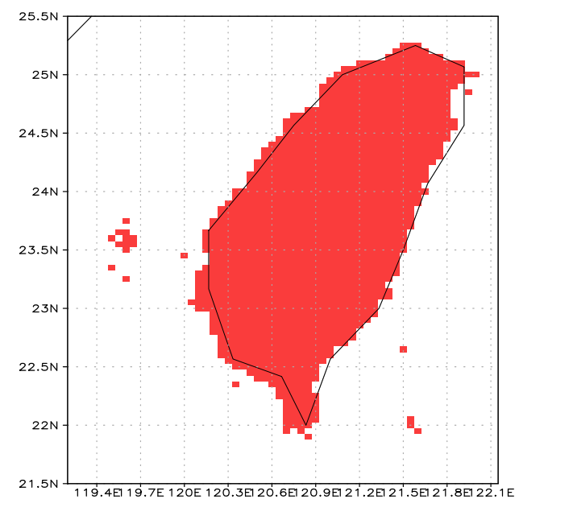
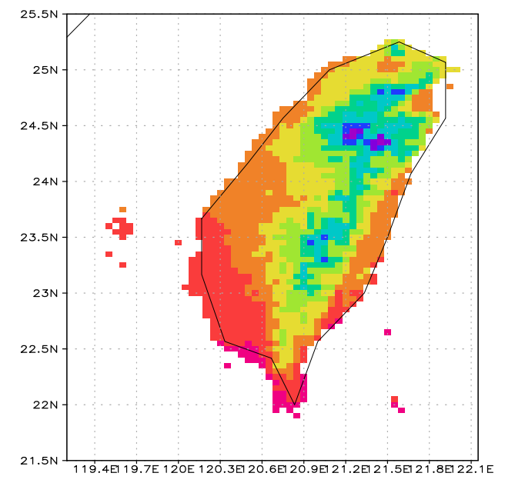
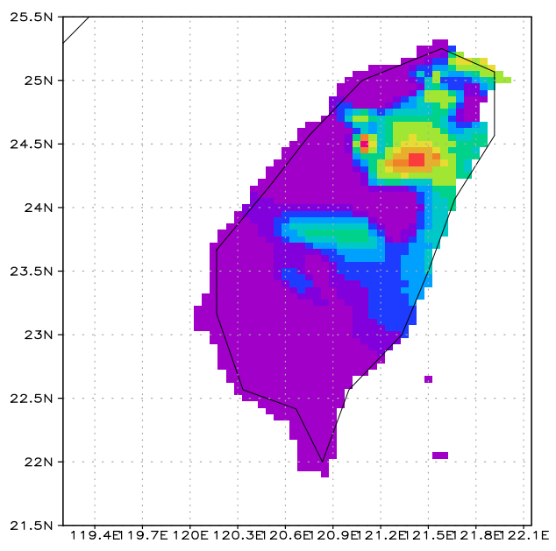
Data Description
Note: TCCIP and NCDR data used
objective analysis from CWB stations
 | CWB Stations | TCCIP 5km Grid | NCDR 5km Grid
Atmospheric Parameters | T、T_{d}、RH、Precipitation | T、Precipitation | T、Precipitation
Time Scale | Hourly | Daily | Hourly
Duration | 1911/1/1(Earliest)~ 2017/5/31 | 1960~2013 | 1991~2013

Slide 5
Methodology
Precipitation
(≥ 0.1mm/”hr “)
Remove missing value
In classes of 2 °C width
Bins are overlapping
with steps of one degree
CWB Stations
Binning technique
Median temperature
Precipitation
Daily mean Temp
NCDR 5km
Precipitation
(≥ 0.1mm/day )
Remove missing value
Different
Percentile
(90-99th)
(rainfall)
from each
bin data
The median temperature in each bin is used as the representative temperature
v
v
TCCIP 5km
I take the daily mean temperature
instead of hourly temperature.
In order to remove the possibility
to find the impact from diurnal cycle

Slide 6
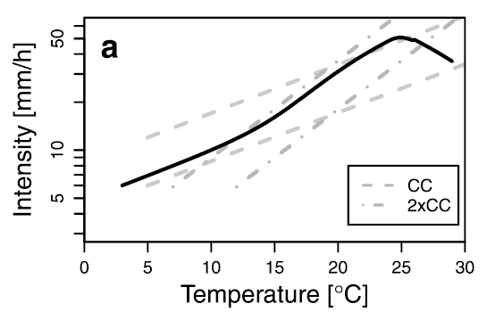
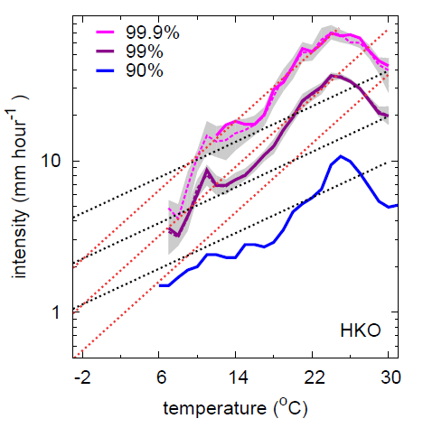
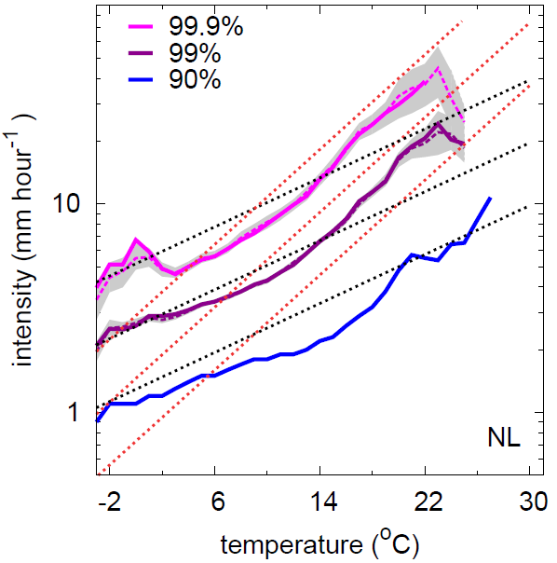
Percentiles of precipitation
intensity as a function of
temperature in the
Netherlands and Hong Kong
[Lenderink, G. et al. 2011]
Conceptual diagram of the observed relationship between temperature and extreme rainfall intensity
T < 12°C → C-C relation
12°C ≤ T < 24°C → Double(Super) C-C relation
(Increase in hourly precipitation extremes of
approximately two times the C-C relation)
T ≥ 24°C → Negative Scaling
[Westra et al. 2014]

Slide 7
Motivation
Few meteorologists discussed (sub)tropics regions condition about the extreme events(Only Hong Kong and Australia, but the description is not detailed enough)
In this research, I will …
→ Analyze Taiwan observation data to understand the association between
hourly (daily) extreme rainfall intensity and atmospheric temperature
(The typical behavior of the observation only C-C and super C-C scaling ?)
→ Verify that the TCCIP and NCDR data are accurate for the simulation of
the station data
→ Find the relation between relative humidity and temperature
(Relative humidity remains constant is true ?)

Slide 8
PART A
Observed relationships between
Daily Mean Temperature and Extreme Hourly Precipitation
from CWB stations and NCDR 5km grid

Slide 9
Dependency of different percentiles of observed hourly precipitation intensity on daily mean temperature in Northern Taiwan(pool 9 stations)
Solid line are the different percentiles
90% confidence intervals estimate by the bootstrap(x100)(99th、95th)
Dashed line are the exponential relations given by a 7%(black) and a 14%(red) increase per degree
Note the natural logarithmic y –axis

Slide 10
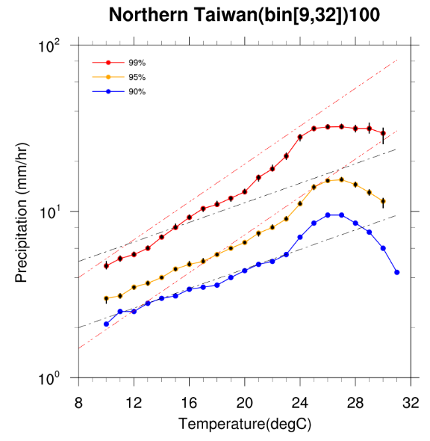
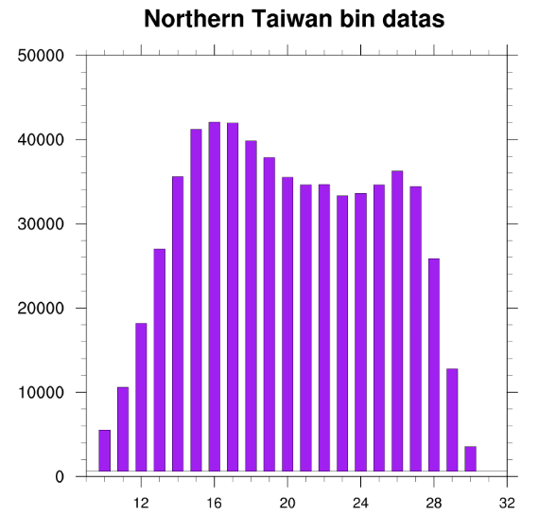
Percentile | Temperature Range (°C) (CC relation) | Intensity Change | Temperature Range (°C) (Super CC relation) | Intensity Change
99% | 10~12 | 7.05% | 12~25 | 14.53%
95% | 10~20 | 8.08% | 20~26 | 15.63%
90% | 11~23 | 7.03% | 23~26 | 19.4%
For daily mean temperature roughly below 12°C ,the 99th percentile show
a dependency of 1hr precipitation extremes close to C-C relation
For higher temperatures , this dependency increases to two times the C-C
relation
More extreme events show an earlier transition to super C-C scaling than the
less extreme events
There is clear hint of a decrease in precipitation intensity for temperature
approximately above 26°C in Northern Taiwan
Overall, the data distribution is relatively uniform, and in the temperature
range near the border, the amount of data in each bin is relatively small

Slide 11
Compared northern Taiwan with
Netherlands(Lenderink, G. et al. 2011)
we can find :
The turning point between C-C and super
C-C scaling in northern Taiwan and
Netherlands approximately the same(12°C)
for 99th percentile
Decrease in rainfall intensity for
temperatures above 23°C for Netherlands
however, northern Taiwan is above 26°C
[Lenderink, G. et al. 2011]

Slide 12
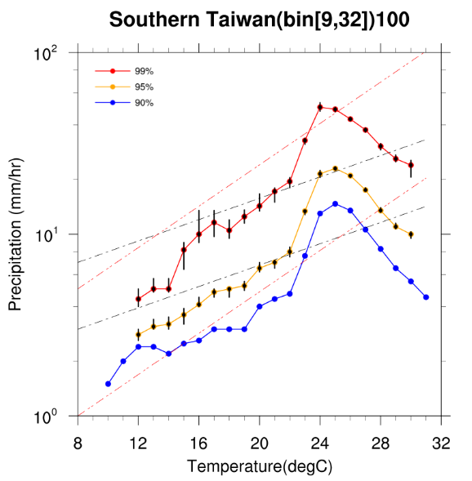
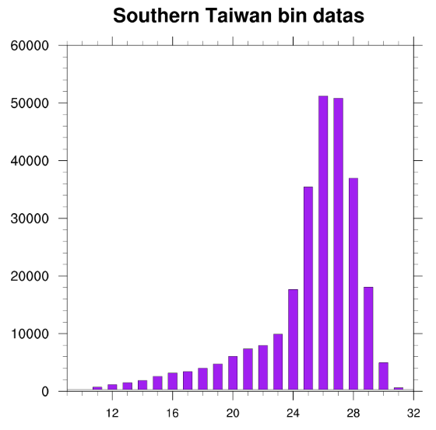
Percentile | Temperature Range (Super CC relation) (°C) | Intensity Change
99% | 12~24 | 24.48%
95% | 12~24 | 20.04%
90% | 10~25 | 18.27%
Dependency of different percentiles of observed hourly precipitation intensity on daily mean temperature in Southern Taiwan (pool 6 stations)
Different from northern Taiwan ,only the super C-C relation(and higher) exists
Most data distribution of higher temperature because the precipitation events in summer are more than winter in southern Taiwan

Slide 13
Only super C-C relation exists in Hong Kong and southern Taiwan
The temperature that changes to negative slope is approximately the same
Different from Hong Kong , for higher temperatures we can find higher than super Clausius–Clapeyron behavior in southern Taiwan
[Lenderink, G. et al. 2011]

Slide 14
Distinctive seasonal rainfall and differences in large scale conditions(especially winter monsoon) of southern Taiwan cause highly different precipitation intensity in winter and summer. We can discover sudden increases in rainfall when we are discussing extreme precipitation
The negative scaling might cause by the transition between typhoon rainfall and convective afternoon rainfall(CAR)

Slide 15
Wet events are even distribution throughout the year in northern Taiwan
In summer , heavy rains are mostly triggered by CAR and tropical cyclones
The weather is dominated by northeast monsoon in winter

Slide 16
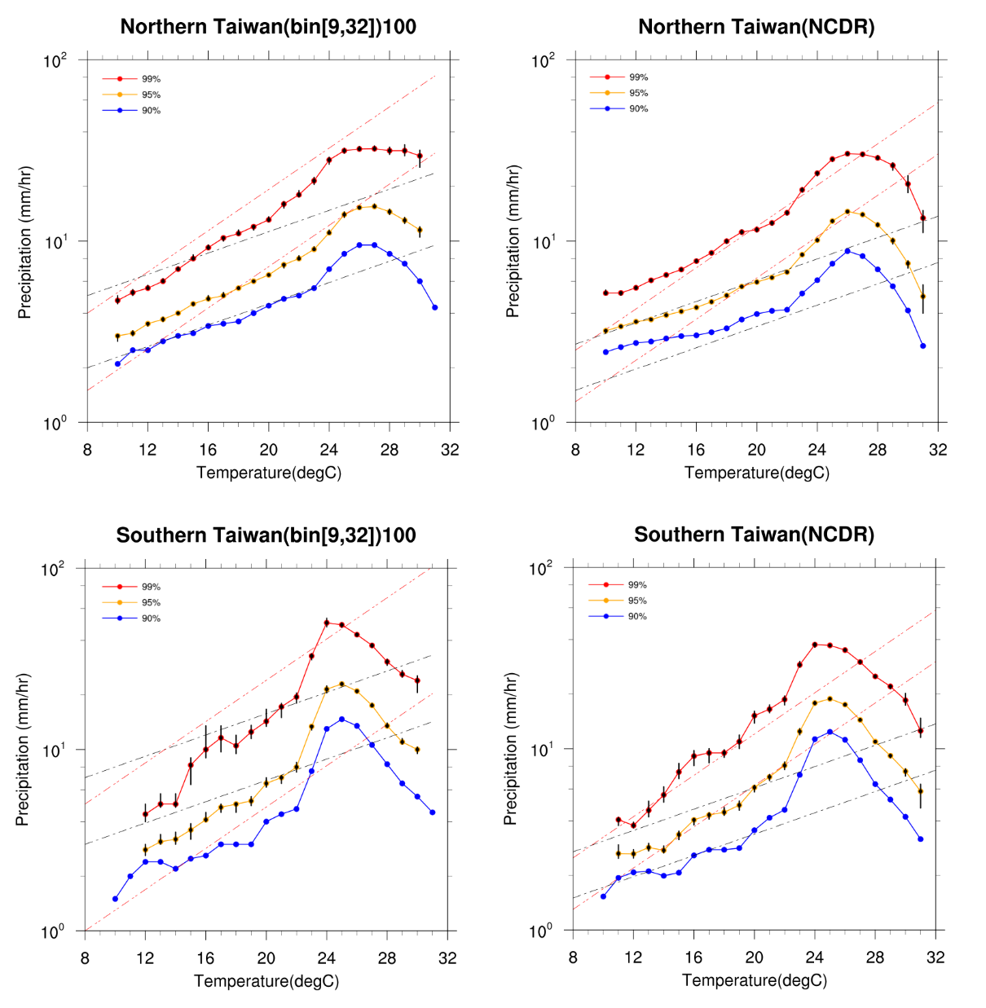
The behavior of NCDR data is roughly similar to weather station data
In northern Taiwan, 90th percentile is smaller than C-C for a lower temperature range
NCDR have some underestimation of the precipitation for heavy rainfall in southern Taiwan

Slide 17
PART B
Observed relationships between
Daily Mean Temperature and Extreme “Daily” Precipitation
from CWB stations and TCCIP 5km grid

Slide 18
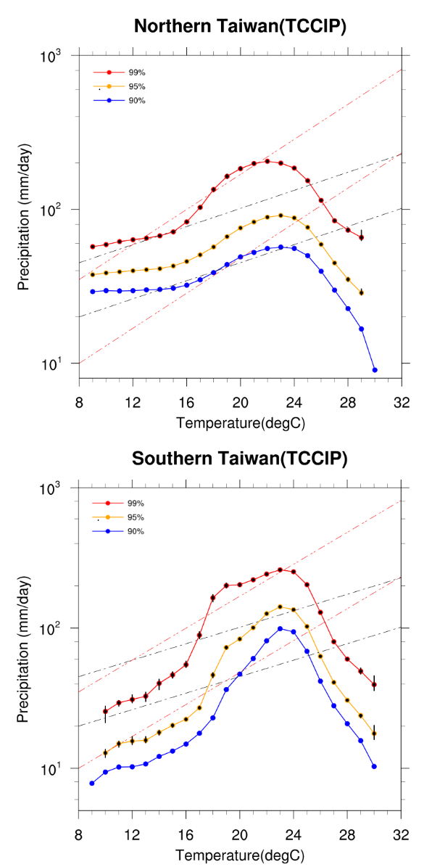
Lon:120.9~121.8 Lat:24.75~25.2 Total Grid:190
The time series of the individual grid points are pooled to obtain one data set and the different percentiles of the distribution are computed
Lon:120.65~120.9
/120.25~120.6 Lat: 22~22.45/22.5~23 Total Grid:148

Slide 19
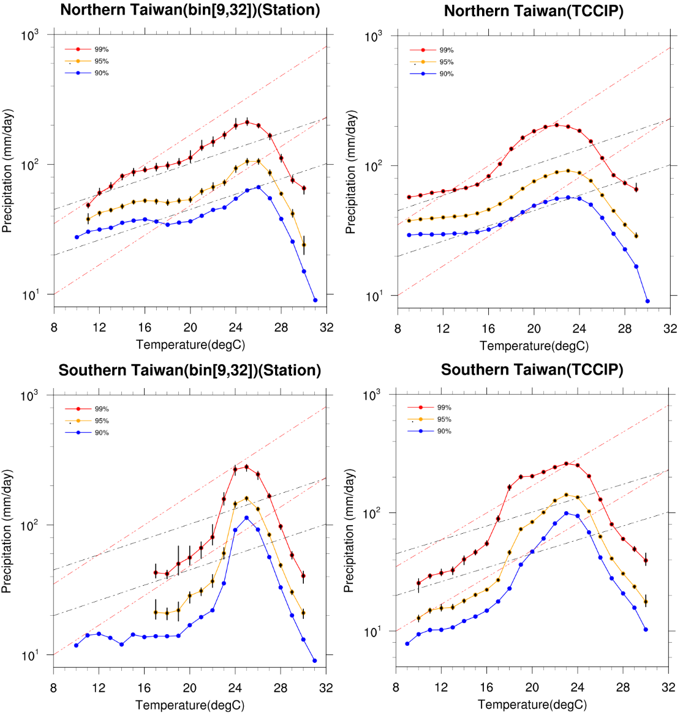
The event time scale has an
important influence on the scaling
relationship , showing lower scaling
rates for daily durations
(Especially lower temperature)
Compared with hourly intensities,
the daily intensities have a less well-
defined scaling behavior
Super C-C relation is not vanished for daily durations
Lower temperature in northern, scaling appears to be lower than C-C

Slide 20
PART C
Observed relationships between
Daily Mean Temperature and Hourly Relative Humidity
from CWB stations

Slide 21
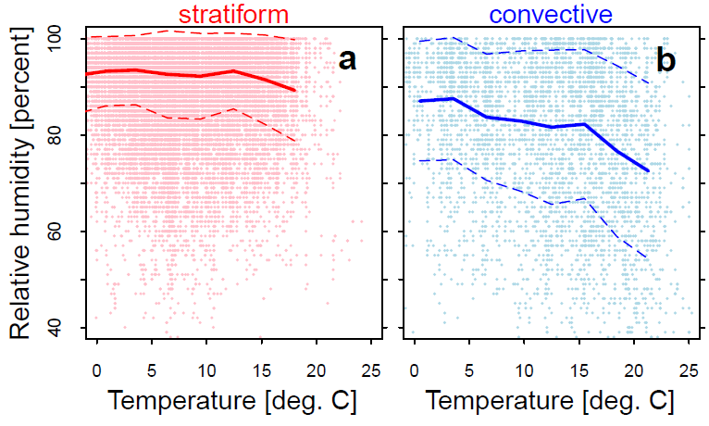
Relative humidity(RH) as a function of the temperature
in South Western Germany [Berg and Haerter, 2013]
Try to repeat Dr.Berg analysis to RH from our CWB stations
Red soild line indicates the mean of RH for each bin
in Northern Taiwan
Blue dash line is in Southern Taiwan
Below 26°C RH remains approximately the same
Decrease in RH at high temperature

Slide 22
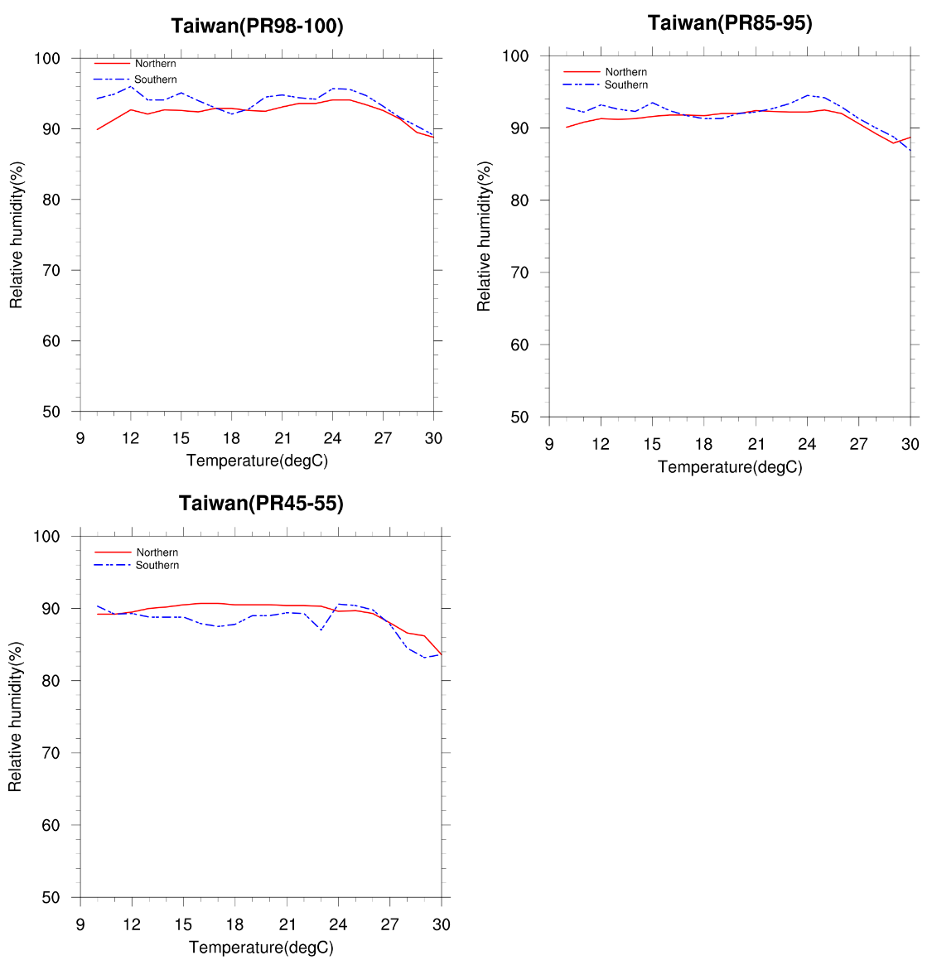
I think the mean of RH for each bin
can not represent RH in higher
percentile
In order to demonstrate the dependency of RH on temperature in high-percentile situation, I extended the scope of data selection when I was calculation the mean RH, such as for 99th percentile, I calculated +/- 1%, however, for 90th percentile,
I calculated +/- 5% instead
Relative humidity does not change considerably in the
transition between C-C relation and super C-C relation
RH in southern(25°C) is early slightly decrease than northern(26°C)

Slide 23
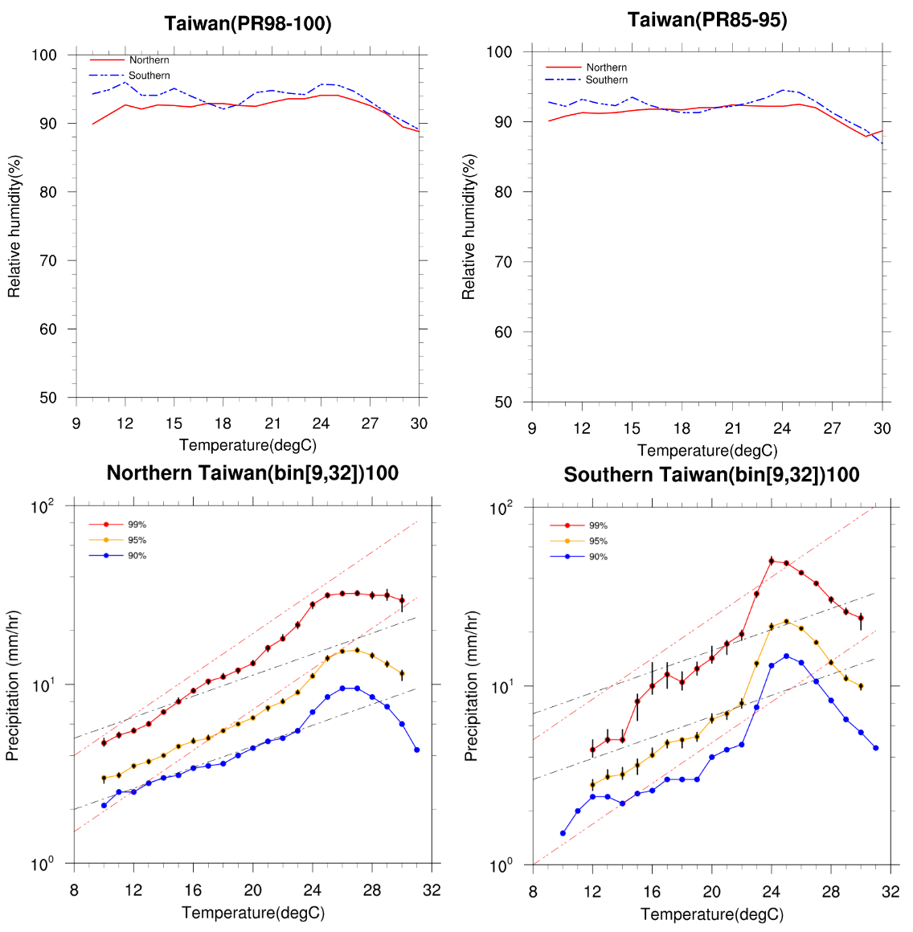
Relative humidity
approximately decreases
5% above 26°C. Although
the rainfall intensity has
declined , it is much higher
than 5% ,indicating that
the negative scaling at high
temperatures is not only
related to the decreasing of
moisture availability and
may be related to large
scale atmosphere
conditions changing.

Slide 24
Results
There are many types of weather system associated with extreme rainfall in
Taiwan , including typhoon , frontal system(especially MCS) , and convective
afternoon rainfall(CAR). These events are mainly strong convective events
(special cases) so there is no typical behavior as mid-latitude regions
(dominated by baroclinic systems).
Our discussion about the scaling relation is not emphasizing the dynamic
effect compared with the thermodynamic effect . Changes in the atmospheric
large scale motions , rain types , and the dynamics of the clouds also play a
vital role in extreme events discussion.

Slide 25
Results
NCDR have some underestimation of the temperature dependency .
Even so , NCDR and TCCIP are still a good simulation of the station data.
The two transition are very interesting issue for extreme precipitation
discussion . Especially negative scaling for higher temperature.
(No scientists can give good reason to explain this behavior)

Slide 26
Future work
From a dynamic point of view, including atmospheric stability or
vertical velocity omega to discuss the two transition in extreme
precipitation. (Take Lenderink, G. et al. (2017) as a reference )
Find out the time and place of extreme rainfall events and select
special cases such as CAR and typhoon events and discuss
the dependency of extreme precipitation intensity on temperature.
I will follow Wan-Ru Huang et al.(2016) about the CAR definition.

Slide 27
Reference
Berg, P.,C.Moseley, and J. O. Haerter (2013), Strong increase in convective precipitation in response to higher temperatures
Hardwick-Jones, R., S. Westra, and A. Sharma (2010), Observed relationships between extreme sub-daily precipitation, surface temperature and relative humidity
Lenderink, G. et al. (2017) , Super-Clausius–Clapeyron Scaling of Extreme Hourly Convective Precipitation and Its Relation to Large-Scale Atmospheric Conditions
Lenderink, G., H. Y. Mok, T. C. Lee, and G. J. van Oldenborgh (2011), Scaling and trends of hourly precipitation extremes in two different climate zones – Hong Kong and the Netherlands
Lenderink, G., and E. van Meijgaard (2010), Linking increases in hourly precipitation extremes to atmospheric temperature and moisture Changes
Lenderink, G. and E. van Meijgaard, E (2008), Increase in hourly precipitation extremes beyond expectations from temperature changes
S. Westra et al.(2014), Future changes to the intensity and frequency of short - duration extreme rainfall
Wan-Ru Huang et al. (2016) , Summer Convective Afternoon Rainfall Simulation and Projection Using WRF Driven by Global Climate Model. Part I: Over Taiwan

