Slide 1
Study of Mountain Building Processes of the Hsuehshan Range, Taiwan 雪山山脈造山機制之研究
Student：Stz-Yuan Wang
Supervisor：Prof. En-Chao Yeh

Slide 2
Introduction
There has been many debates and discussion on Taiwan mountain building processes.
Based on previous studies, we can summarize how the rocks into Taiwan’s mountain belt as two types: frontal accretion and basal accretion.
What’s the difference between these mechanisms?

Slide 4
Regional background
Bounded by Chuchih Fault and Lishan Fault
The composition of Hsuehshan Range is metamorphosed terrestrial sediments
HR
Northern part | Central part | Southern part
 | Sule Formation
Audi Formation | Audi Formation
Tatungshan Formation | Paleng Formation
Tsuku Sandstone
Kangkou Formation |  | Shuichangliu Formation
Szeleng Sandstone | Szeleng Sandstone | Paileng Formation
 | Hsitsun Formation
Ⅰ | Penghu Islands
Ⅱ | Western Plain
Ⅲ | Western Foothill
Ⅳa | Hsuehshan Range
Ⅳb | Backbone Range
Ⅴa | Taroko Belt
Ⅴb | Yuli Belt
Ⅵ | Longitudinal Valley
Ⅶ | Coastal Range
Modified from 陳文山，台灣地質概論，2016
何春蓀，台灣地質概論，1986

Slide 5
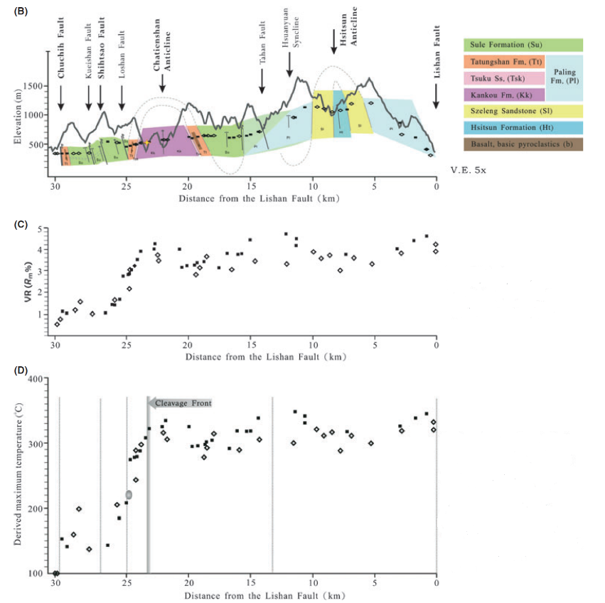
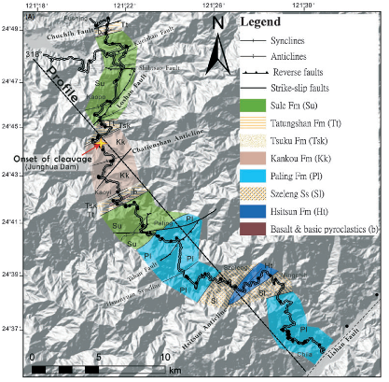
Chen et al.(2011)

Slide 6
Motivation
We think the previous research is worth to further study
The model needs more data to be verification
Whether the southern part of the Hsuehshan Range also follow the process of basal accretion.
We’ll try to solve problems by…
More data in northern part of the HR
Analyze the data in southern part of the HR

Slide 7
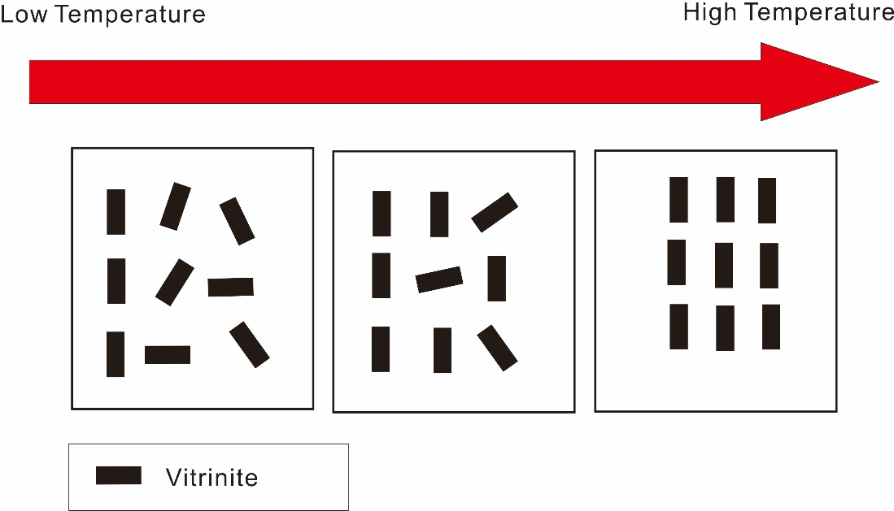
Method
Converted Vitrinite Reflectance($\text{R}\text{M}$) to maximum metamorphic temperature(T_{M}).
Vitrinite
Vitrinite Reflection
One of the primary components of coals and most sedimentary kerogens.
T_{M}=$\frac{\ln\left(\text{R}\text{M}\right)+1.26}{0.00811}$
(Barker and Goldstein, 1990)

Slide 8
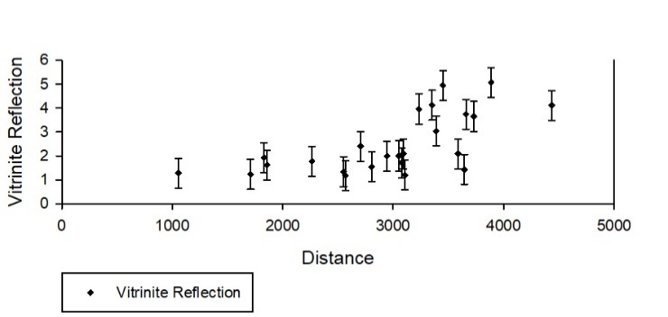
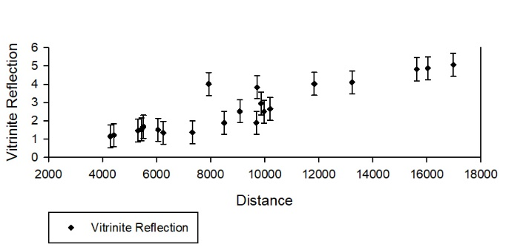
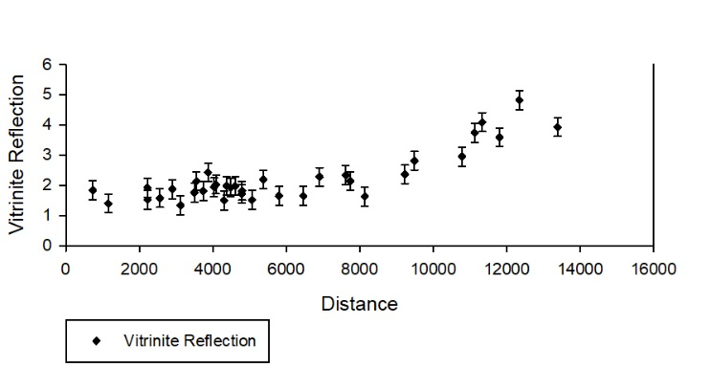
林志貴碩士論文，1994
林志貴碩士論文，1994
林清俊碩士論文，2000

Slide 9
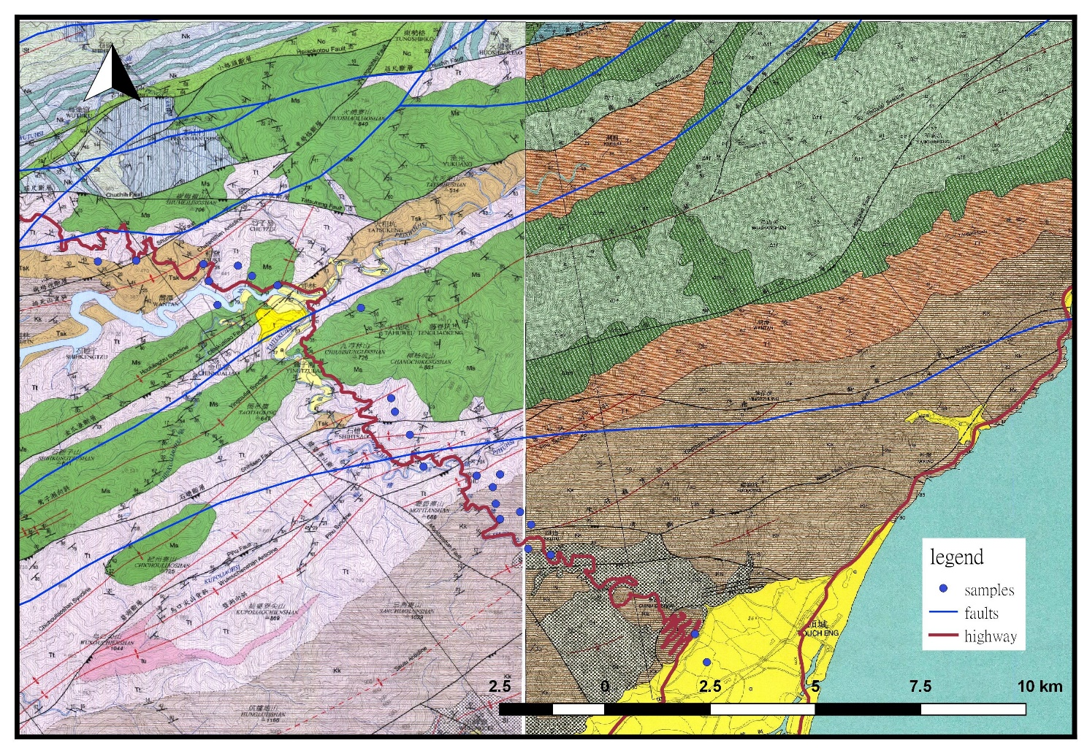
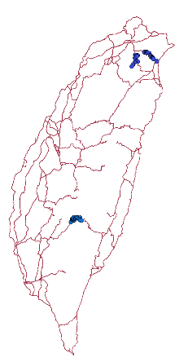
Result
Taipei-Ilan highway
profile
Modified from 中央地質調查所，五萬分之一台灣地質圖幅第九、十號

Slide 10
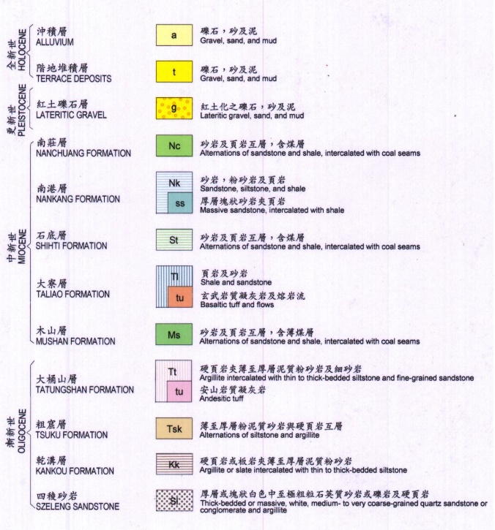
Modified from 中央地質調查所，五萬分之一台灣地質圖幅第九號

Slide 11
Xindian-Wulai highway
profile
Modified from 中央地質調查所，五萬分之一台灣地質圖幅第九號

Slide 12
Modified from 中央地質調查所，五萬分之一台灣地質圖幅第九號

Slide 13
Southern Cross-island Highway
Modified from 李錫堤 等，1977

Slide 14
Modified from 李錫堤 等，1977

Slide 15
Summary
We can summarize three observations from the temperature profiles.
The temperature do not change along with large-scale structure.
T_{M} do not also display the difference that due to the stratigraphic thickness.
There might be a fault that caused the change of temperature .

Slide 16
Conclusion
Based on the results above, we can have reasonably think as following
Northern part of Hsuehshan Range is tend to be basal accretion.
Southern part of Hsuehshan Range might be tend to basal accretion inferred from available data.

Slide 17
Future work
In these research areas, we found that there are potential irregularities that might be affect by faults.
If there might be late tectonic activity in the Hsuehshan Range?
What’s the relationship between faults, and whether these fault activities still ongoing?

Slide 18
Reference
林朝宗（2000）。《五萬分之一台灣地質圖幅第九號：新店》。臺北：經濟部中央地質調查所。
黃鑑水、何信昌（2003）。《五萬分之一台灣地質圖幅第十號：頭城》。臺北：經濟部中央地質調查所。
Suppe, J.(1981):《Mechanics of mountain building and metamorphism in Taiwan》.MEMOIR OF THE GEOLOGICALSOCIETY OF CHINA, 4, 1981, pp.67-89.
Barker, C.E. and Goldstein, R.H., (1990):《Fluid-inclusion technique for determining
maximum temperature in calcite and its comparison to the vitrinite reflectance geothermometer》. Geology, 18, 1990, pp.1003–1006.
Simoes, M. et al.(2007):《Mountain building in Taiwan: a thermokinematic model》. J. Geophys. Res., 112, 2007, B11405.
Beyssac et al.(2007):《Late Cenozoic metamorphic evolution and exhumation of Taiwan》. TECTONICS, 32, 2007, pp.1-32.
Chen et al.(2011):《Nappe structure revealed by thermal constraints in the Taiwan metamorphic belt》. Terra Nova, 23, 2011, pp.85-91.
李錫堤、王源（1985，6）。〈臺灣南部橫貫公路禮觀一帶之地層及構造〉。《地質》，6，頁1­-20。
林志貴（1994）。《烏來–坪林地區漸新世變質泥質岩中鏡煤素反射率之研究》。國立台灣師範大學地球科學所，未出版，臺北。
林清俊（2000）。《南部橫貫公路禮觀地區鏡煤素反光率及其地質意義》。國立台灣師範大學地球科學所，未出版，臺北。

Slide 19
Thank you for your listening

